Slide 2
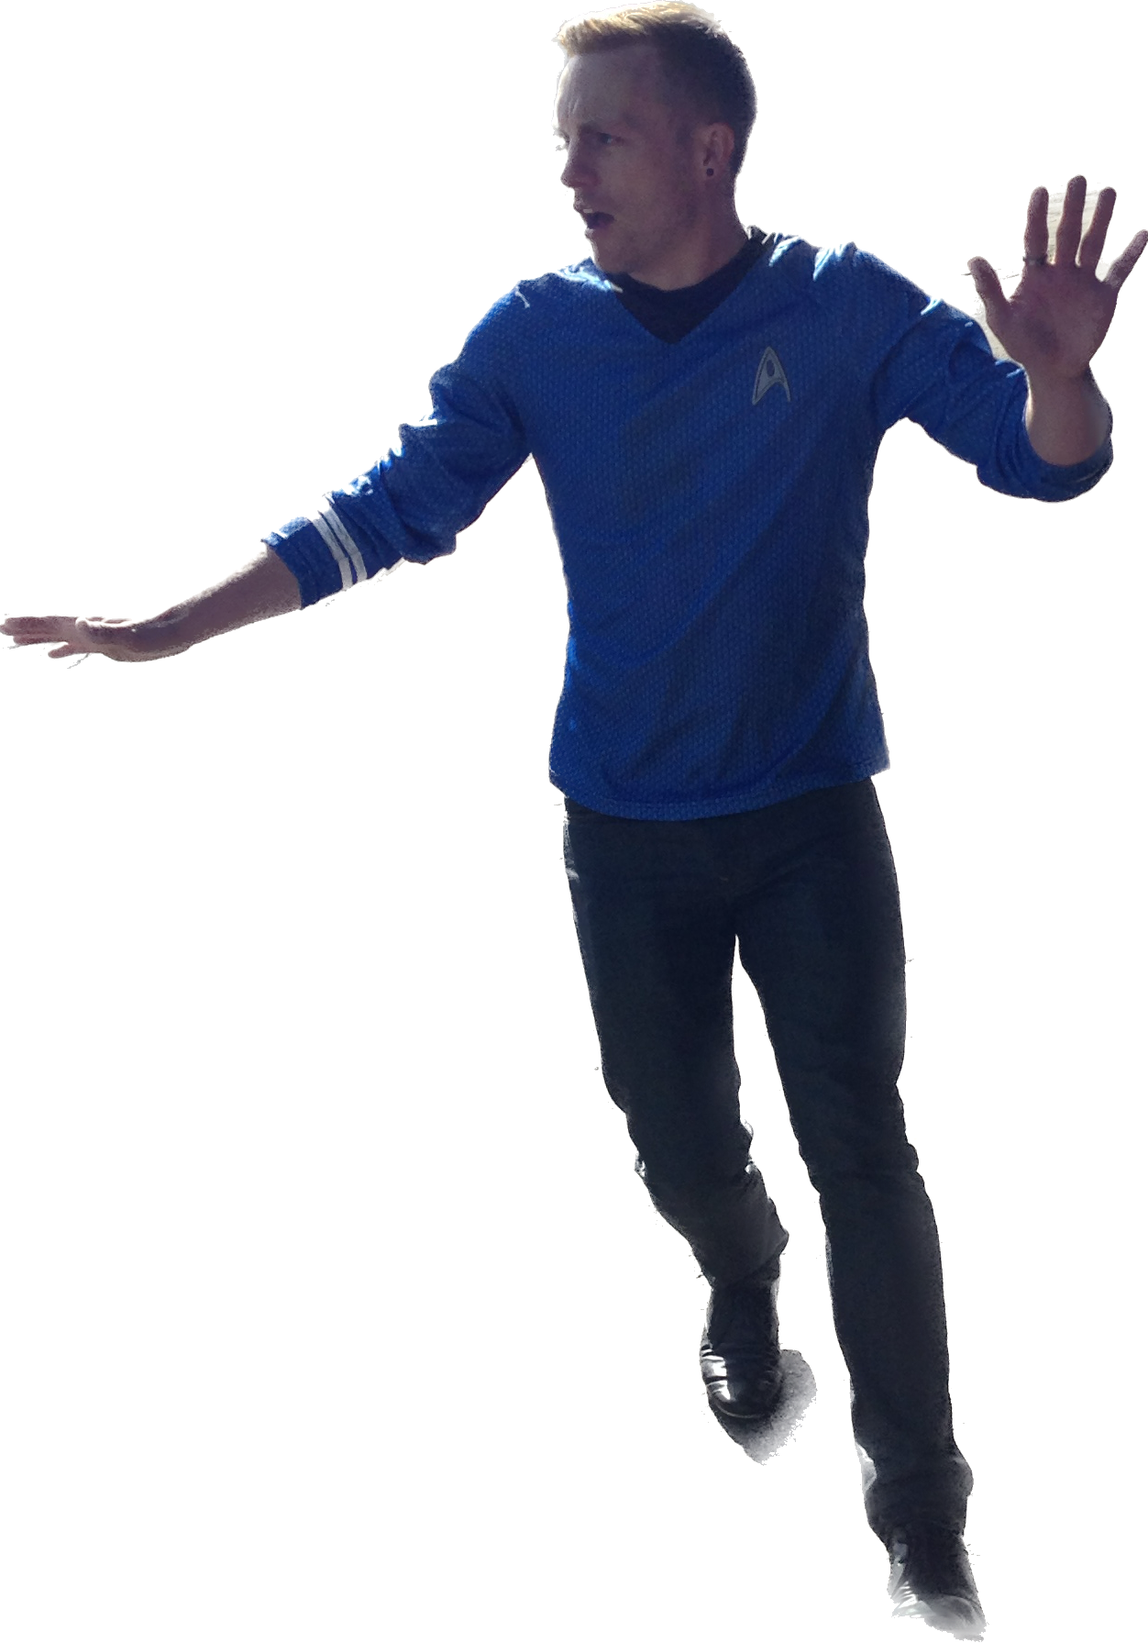
Hello I’m Ian Timbrell
Educator for 17 years including a deputy head for 5 years.
Accredited RSE teacher and a master’s degree in education leadership and management.
Dad
Total Star Trek Nerd

Slide 4
What you need for today

Slide 5
Is this a safe space?

Slide 6
Safe | Seen | Supported
Your knowledge Challenging bullying | Representation in books Role Models | Coming out Working with parents

Slide 7
Safe Your knowledge

Slide 8
Gender
Sex
Sex refers to the different biological and physiological characteristics of females, males and intersex persons, such as chromosomes, hormones and reproductive organs.
Gender refers to the characteristics of women, men, girls and boys that are socially constructed. This includes norms, behaviours and roles associated with being a woman, man, girl or boy, as well as relationships with each other. As a social construct, gender varies from society to society and can change over time.

Slide 9
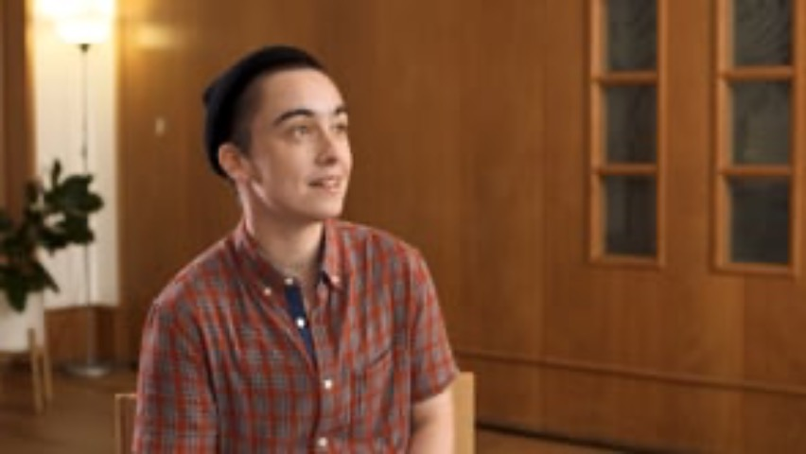
What does non-binary mean?
Some people who are non-binary experience their gender as both male and female, and others experience their gender as neither male nor female.
Non-binary identities have been
recognized for millennia by
cultures and societies around the
world.
World Health Organisation – 2022

Slide 10
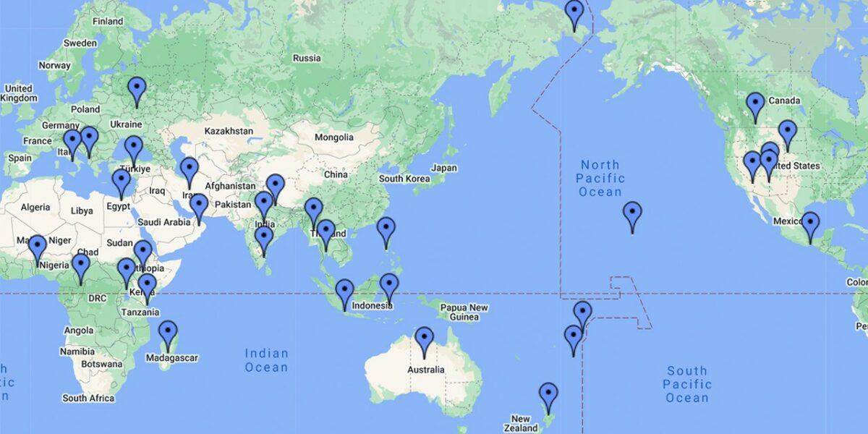
https://www.pbs.org/independentlens/content/two-spirits_map-html/

Slide 11
Are you trying to eradicate man and woman?
How can a person not be a man or a women?

Slide 13
There are as many ways to be a man as there are men.
There are as many ways to be a woman as there are women.
There are as many ways to be non-binary as there are non-binary people.
-Alok Vaid-Menon

Slide 14
Transgender & gender non-conforming
Transgender
NHS - Gender dysphoria is a term that describes a sense of unease that a person may have because of a mismatch between their biological sex and their gender identity.
Non-conforming
Wears clothes they feel comfortable in
Challenges gender pre-conceptions such as toys, make-up, etc

Slide 15
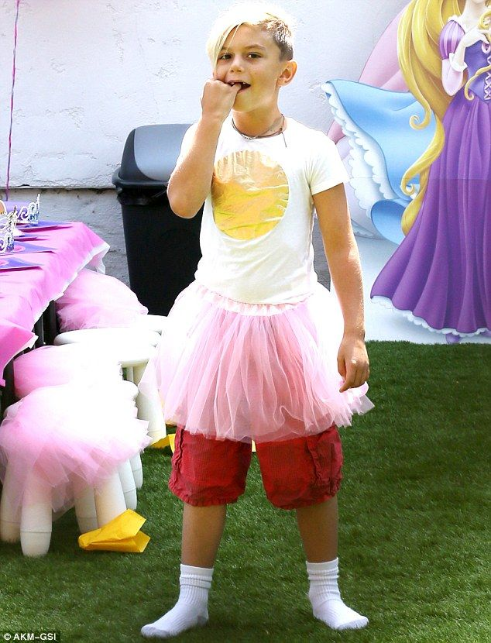

Slide 16
Pronouns

Slide 17
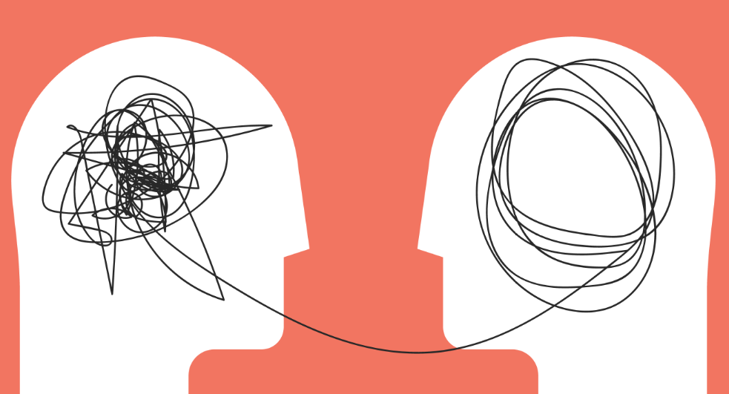
Empathy & Understanding

Slide 18
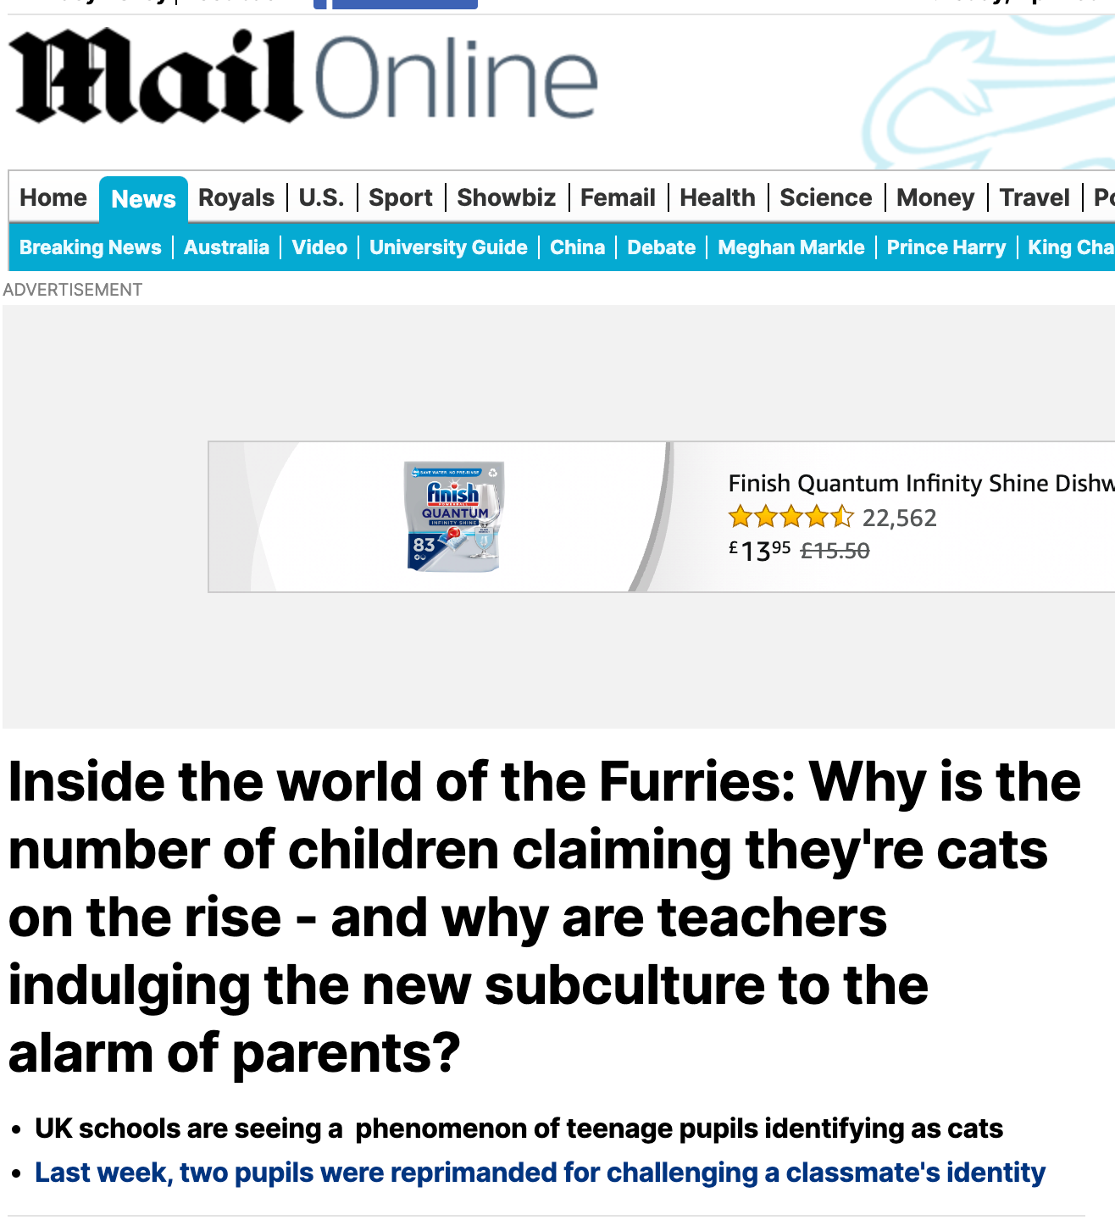
Furries
Furries are not a legally recognised identity
They are based on role-play, cosplay and costume
It is not a protected characteristic
It does not adhere to your uniform policy
Exception – Reasonable adjustments for SEND

Slide 19
Why does all this matter?

Slide 20
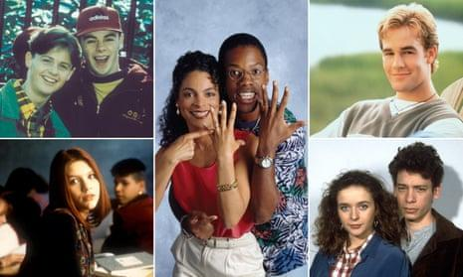
TV shows
Notes:
Byker Grove, A Different World, Dawson’s Creek, Press Gang, and My So-Called Life.
Byker Grove – first same sex kiss on children’s tv in 1994. Peck on the cheek.
Dawson’s creek – 2004 – first passionate kiss between two men
Before “Dawson’s Creek,” Will and Jack kissed on NBC’s “Will and Grace” to protest the fact that they had never seen two gay men kiss on television, and a few other shows, including “LA Law” and “Relativity” featured two women kissing. Yet, LGBTQ representation either generally wasn’t included or lacked nuance in earlier television eras. In the 1996 “Friends” episode “The One With the Lesbian Wedding,” for instance, the series did not show Susan and Carol kissing at their own wedding ceremony.
https://www.nbcnews.com/feature/nbc-out/two-decades-later-dawson-s-creek-actor-reflects-historic-gay-n1068741
All very exceptional and still seen as an event. Creation of an ‘other’ culture.

Slide 21
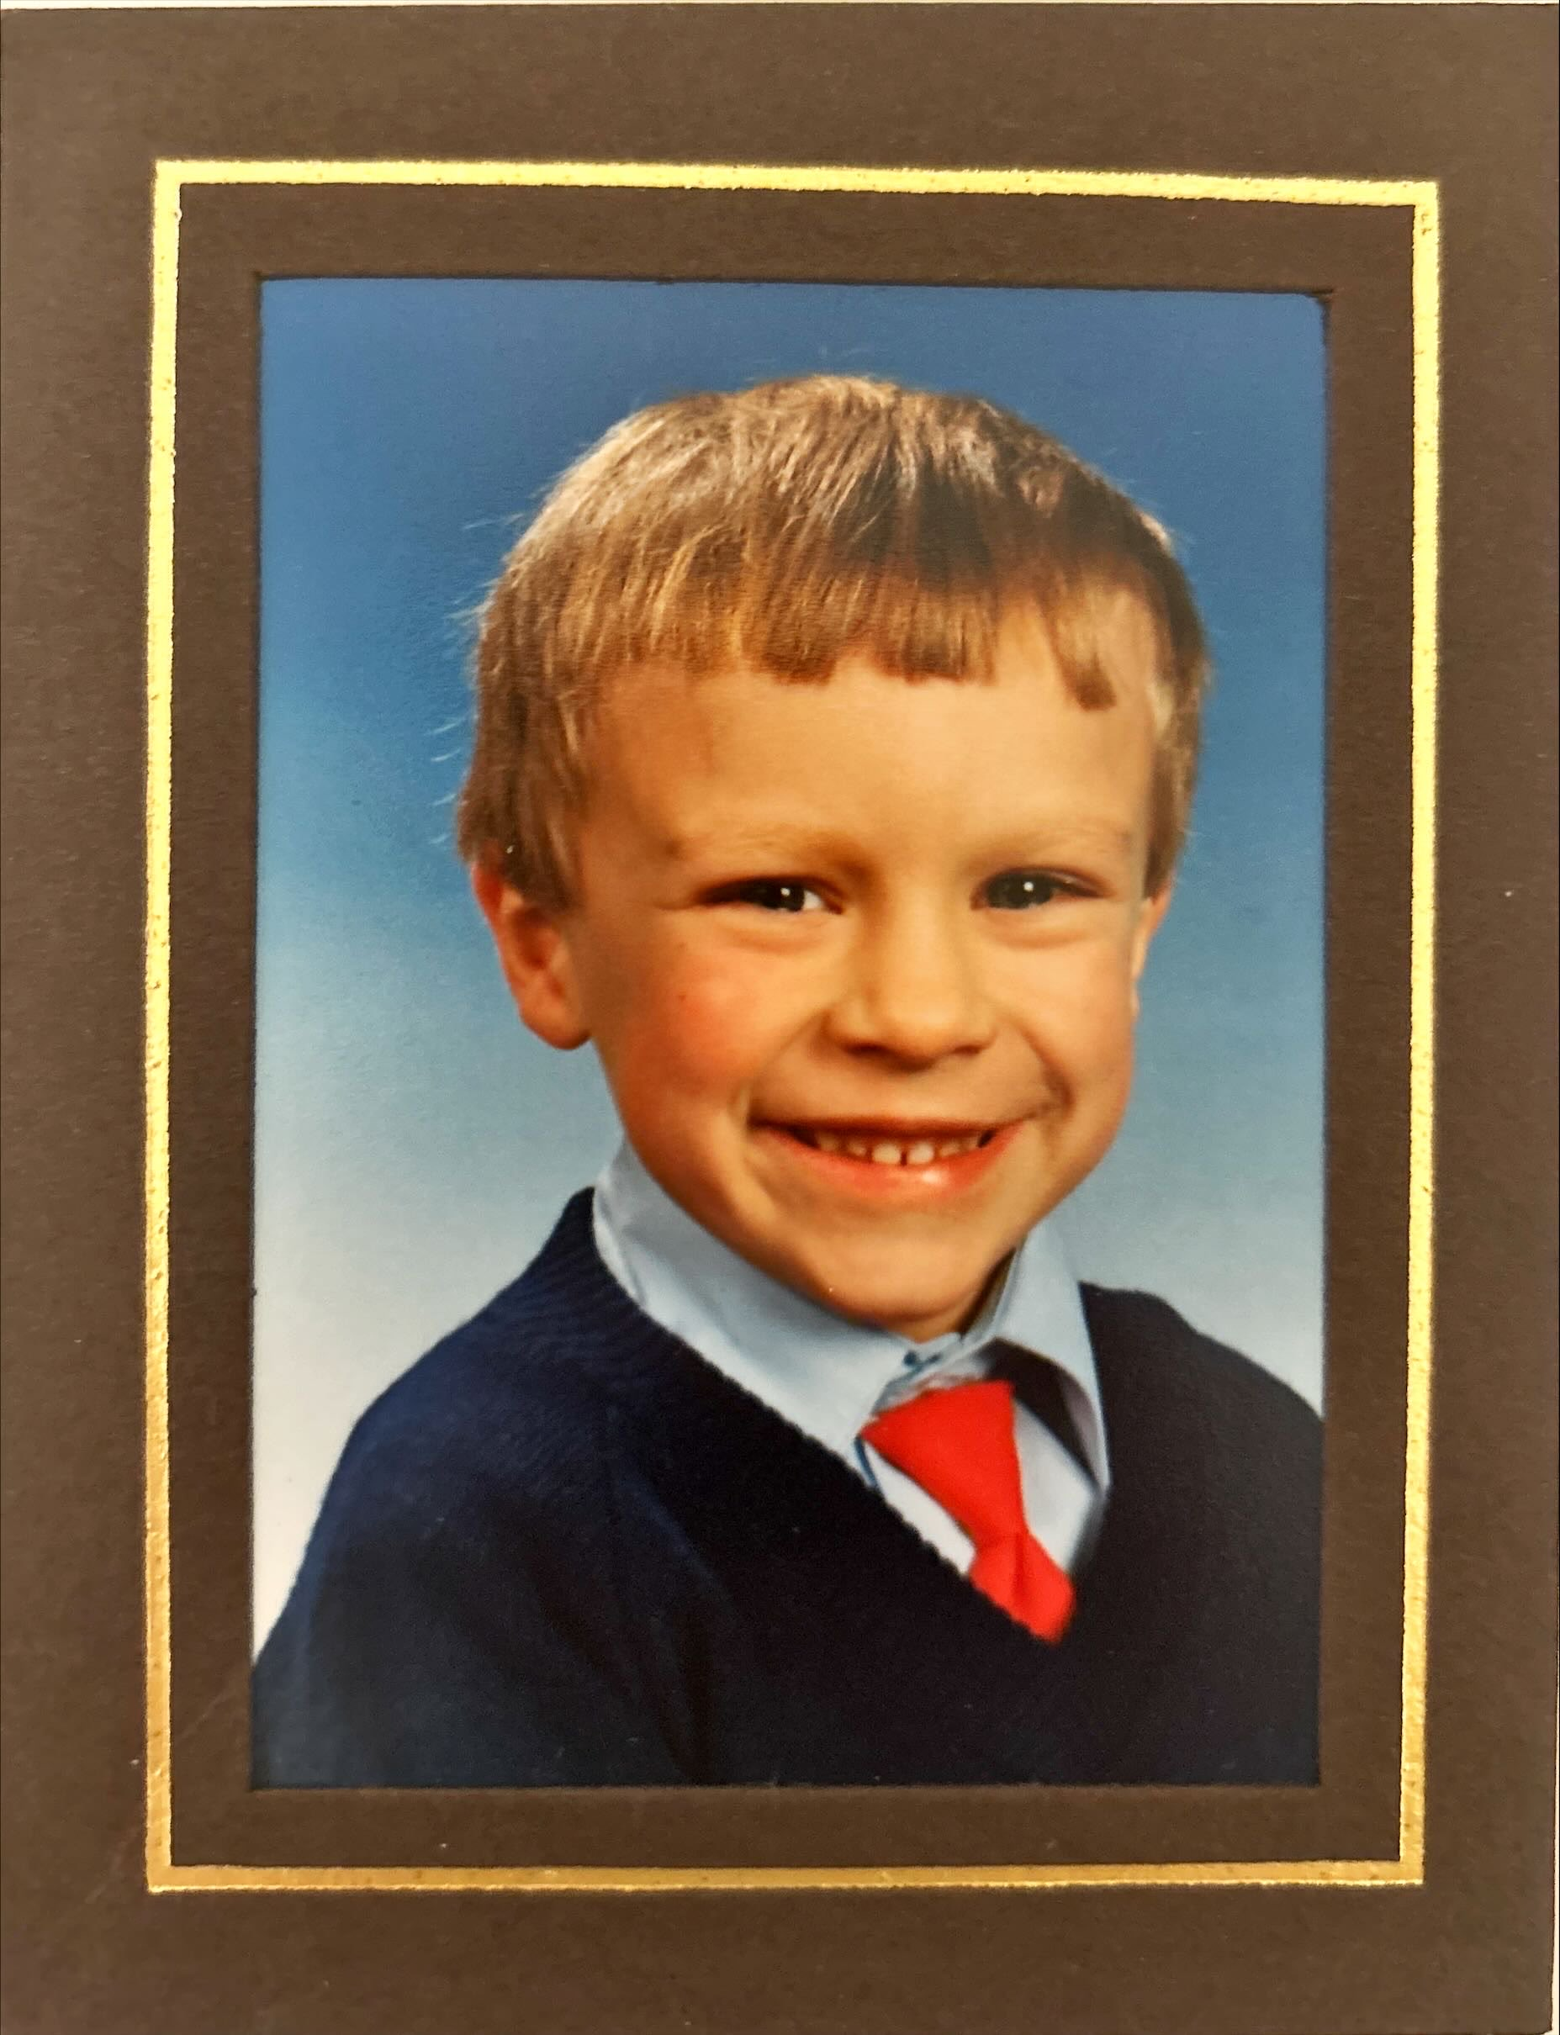
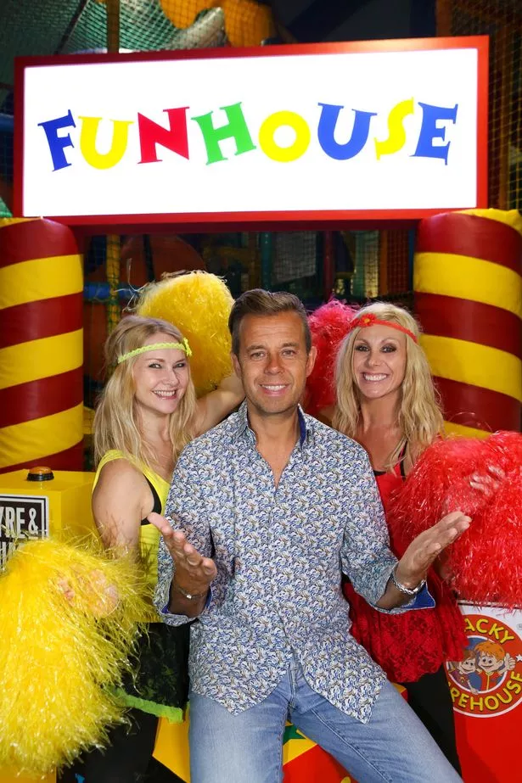
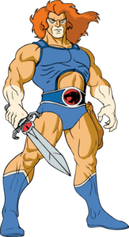

Slide 22
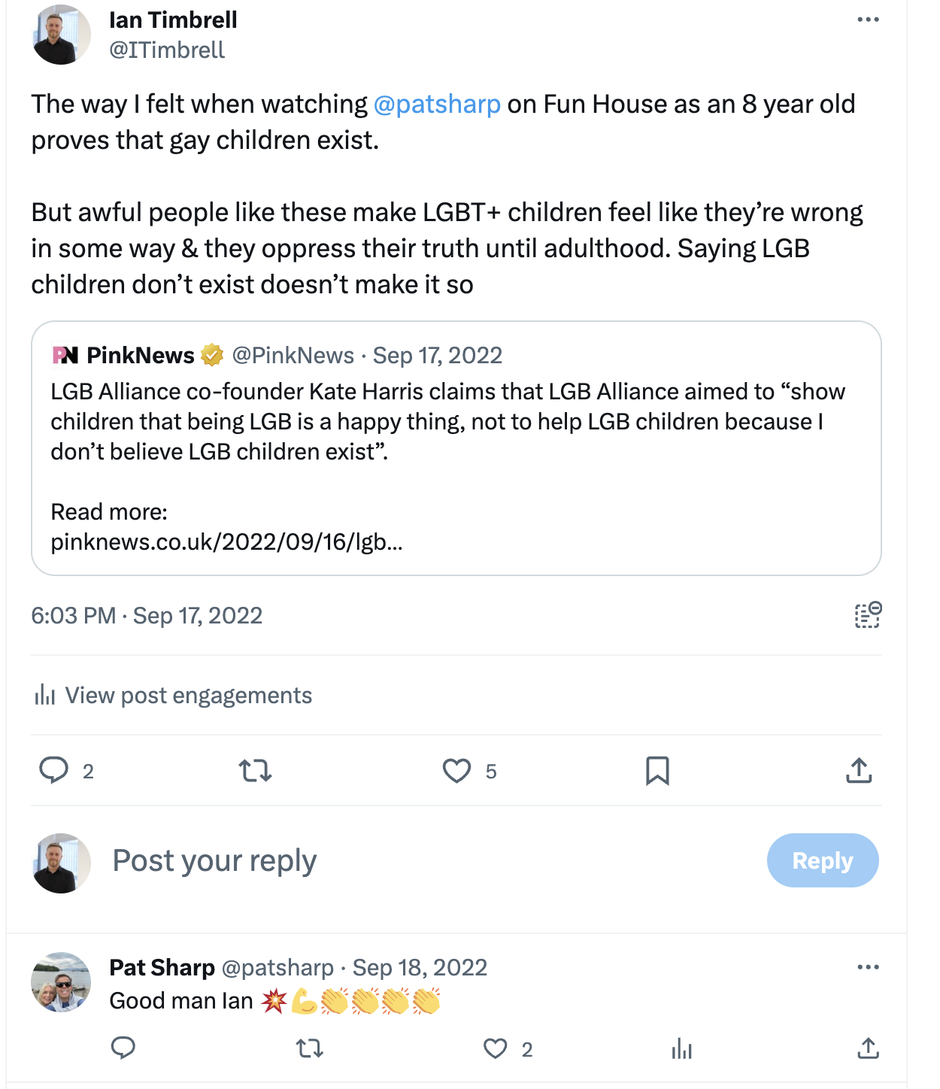
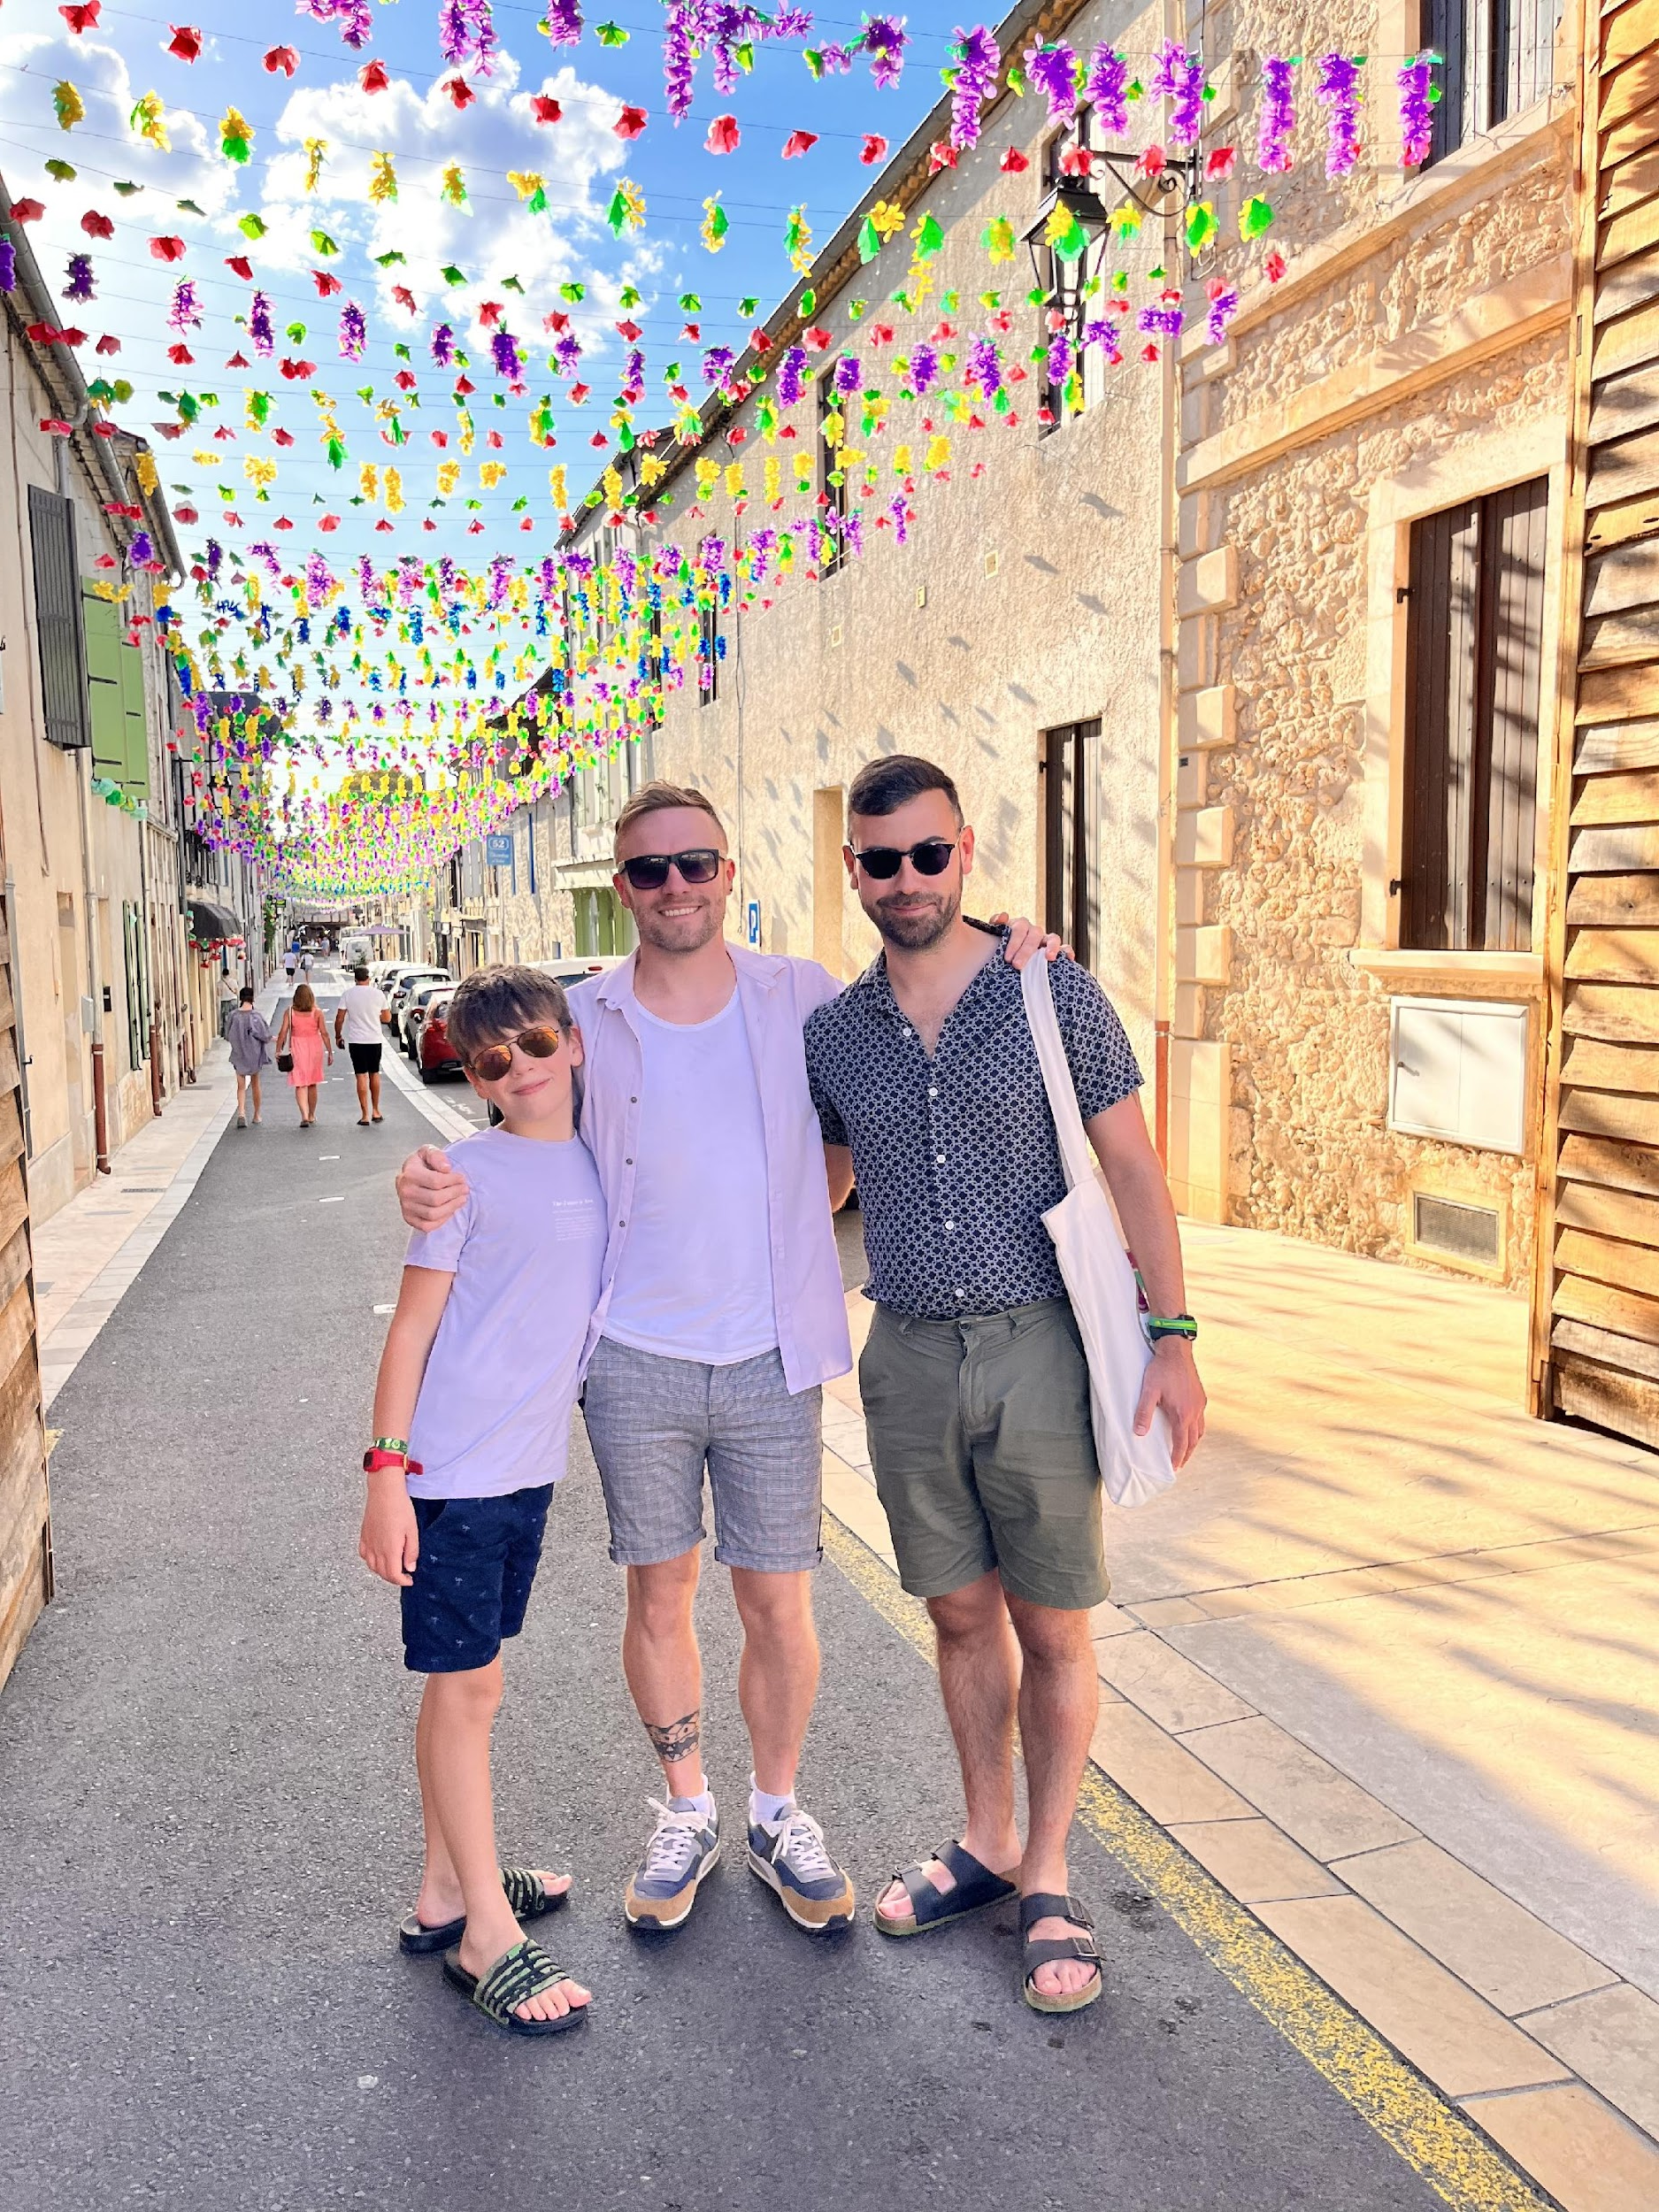
My Story

Slide 23
My Story
Powered By Diversity
PoweredByDiversity.org | @PBDiversity

Slide 24
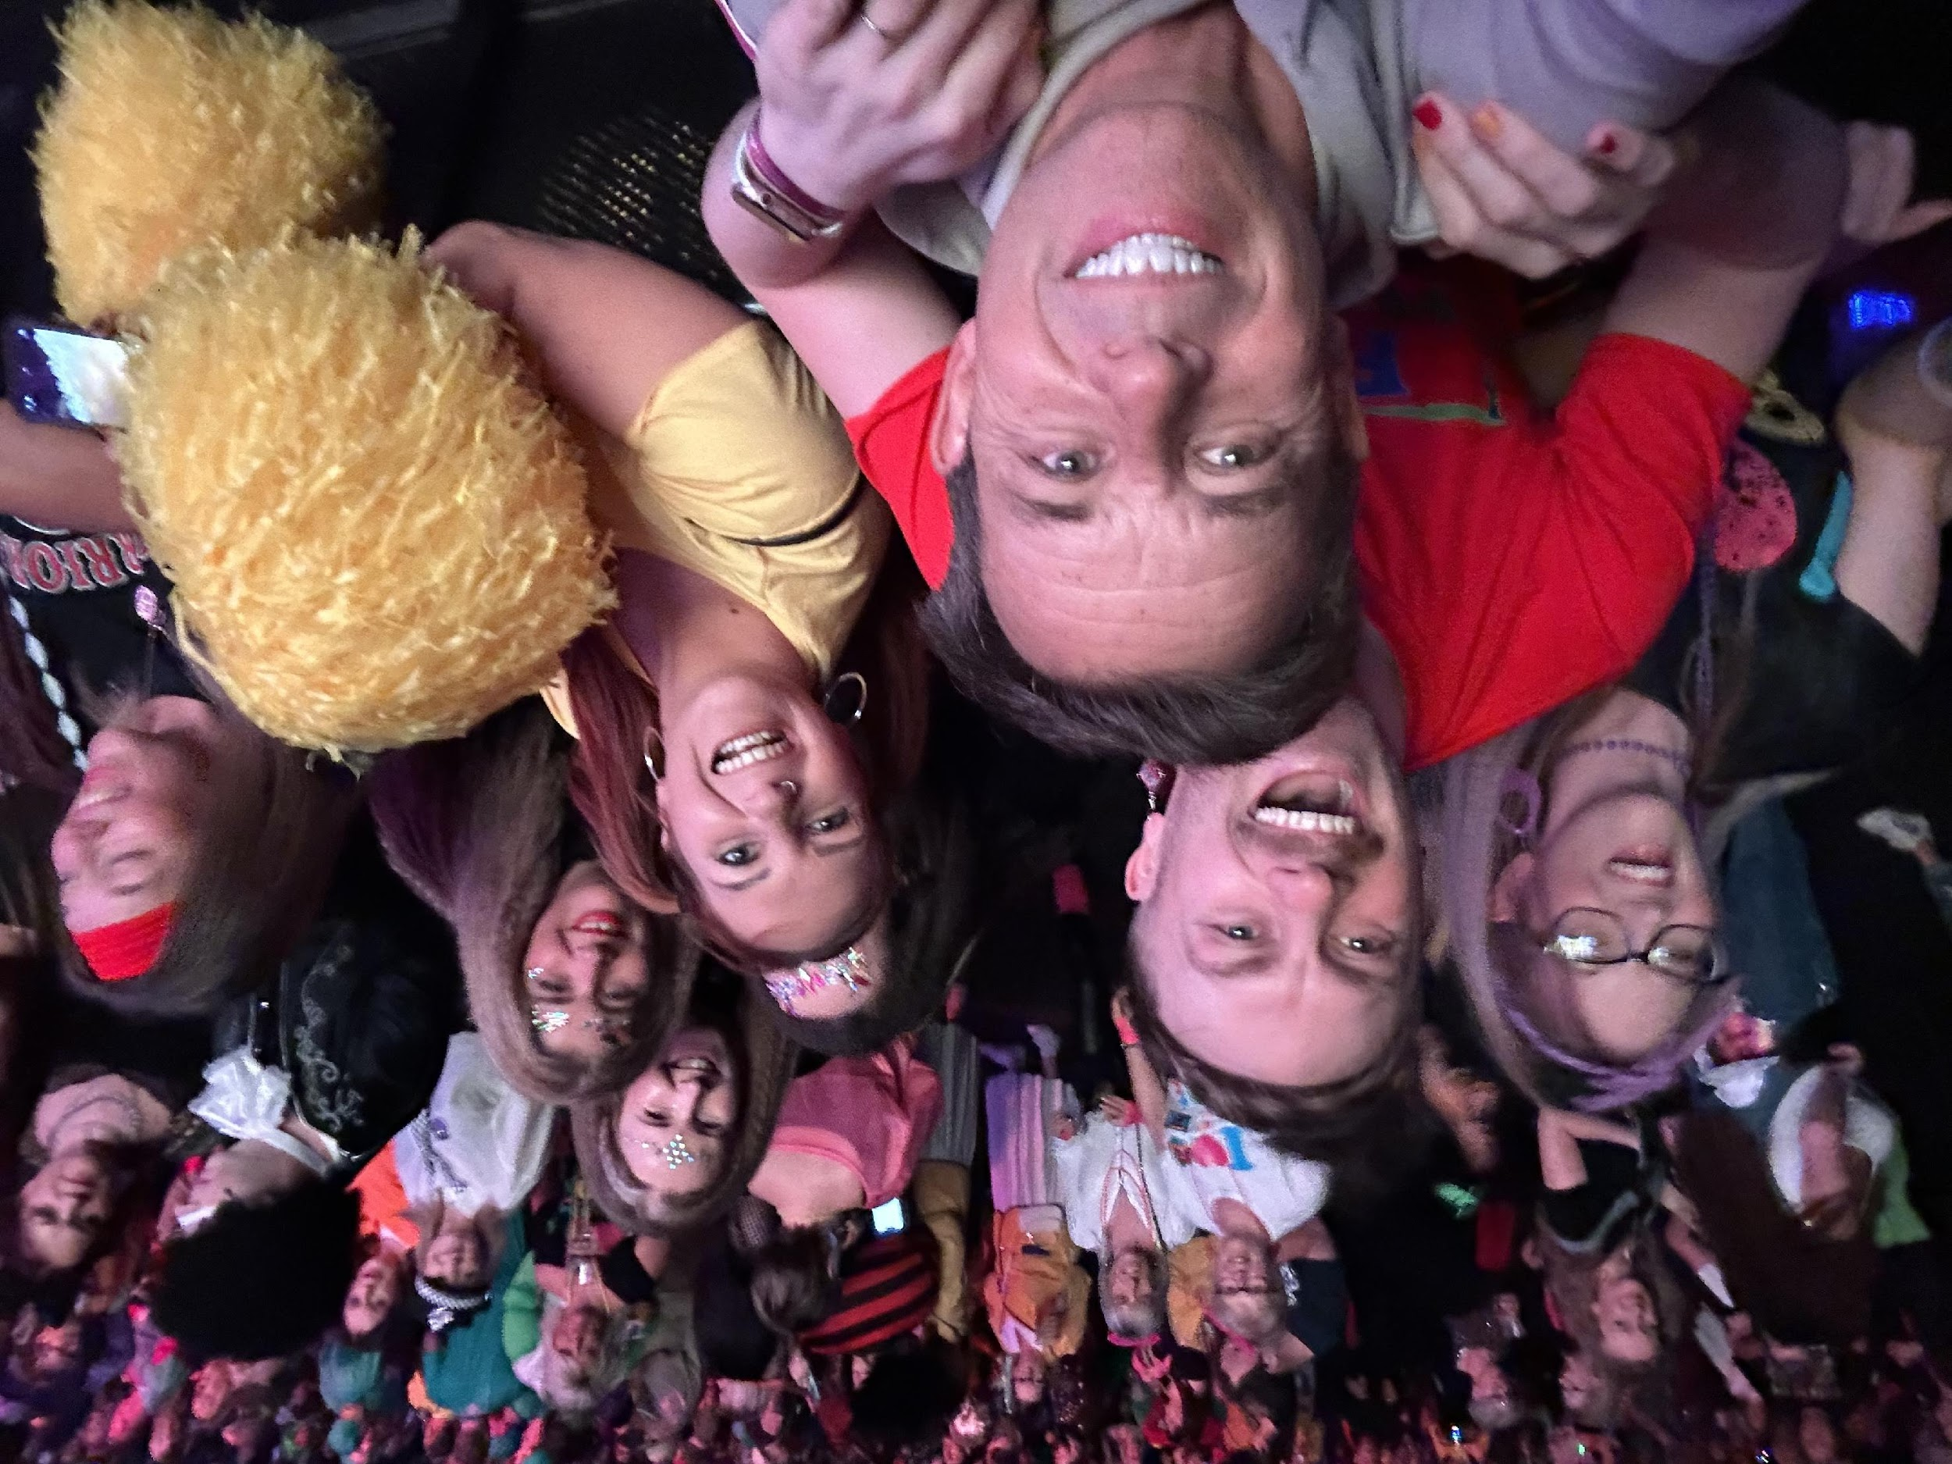
Notes:
https://blog.nationalarchives.gov.uk/queer-history-a-history-of-queer/
https://www.latrobe.edu.au/news/articles/2023/opinion/the-history-of-the-word-queer

Slide 25
Responsibility

Slide 26
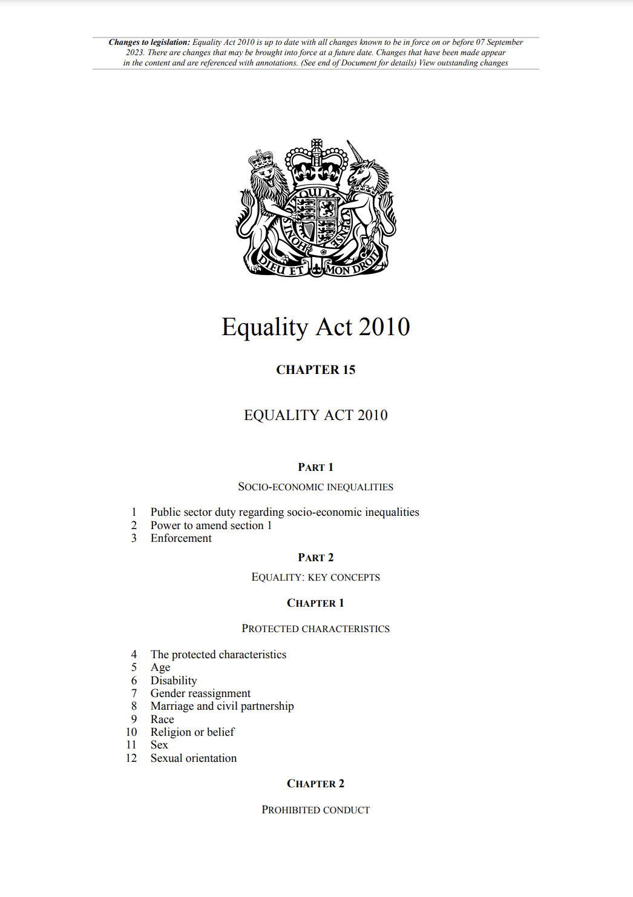
Legal Responsibility
A new Equality Act came into force on 1 October 2010.
It brings together over 116 separate pieces of legislation into one single Act.
The Act provides a legal framework to protect the rights of individuals and advance equality of opportunity for all.
It provides Britain with a discrimination law which protects individuals from unfair treatment and promotes a fair and more equal society.
https://www.equalityhumanrights.com/en/equality-act-2010/what-equality-act
Age
Disability
Gender Reassignment
Marriage and civil partnership
Pregnancy and maternity
Race
Religion or belief
Sex
Sexual Orientation

Slide 27
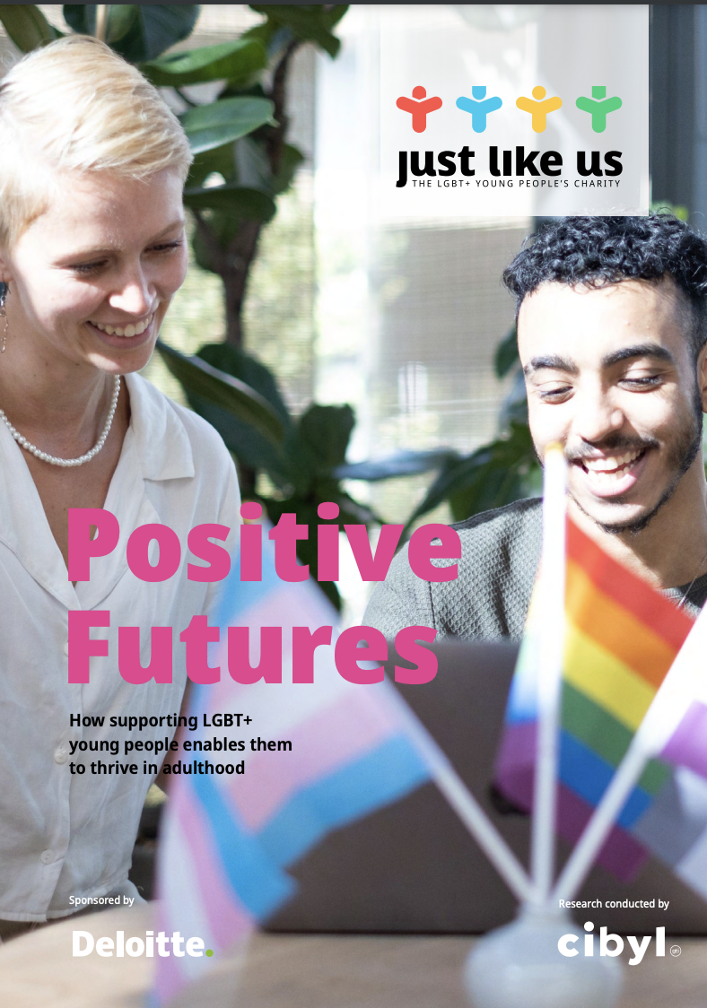
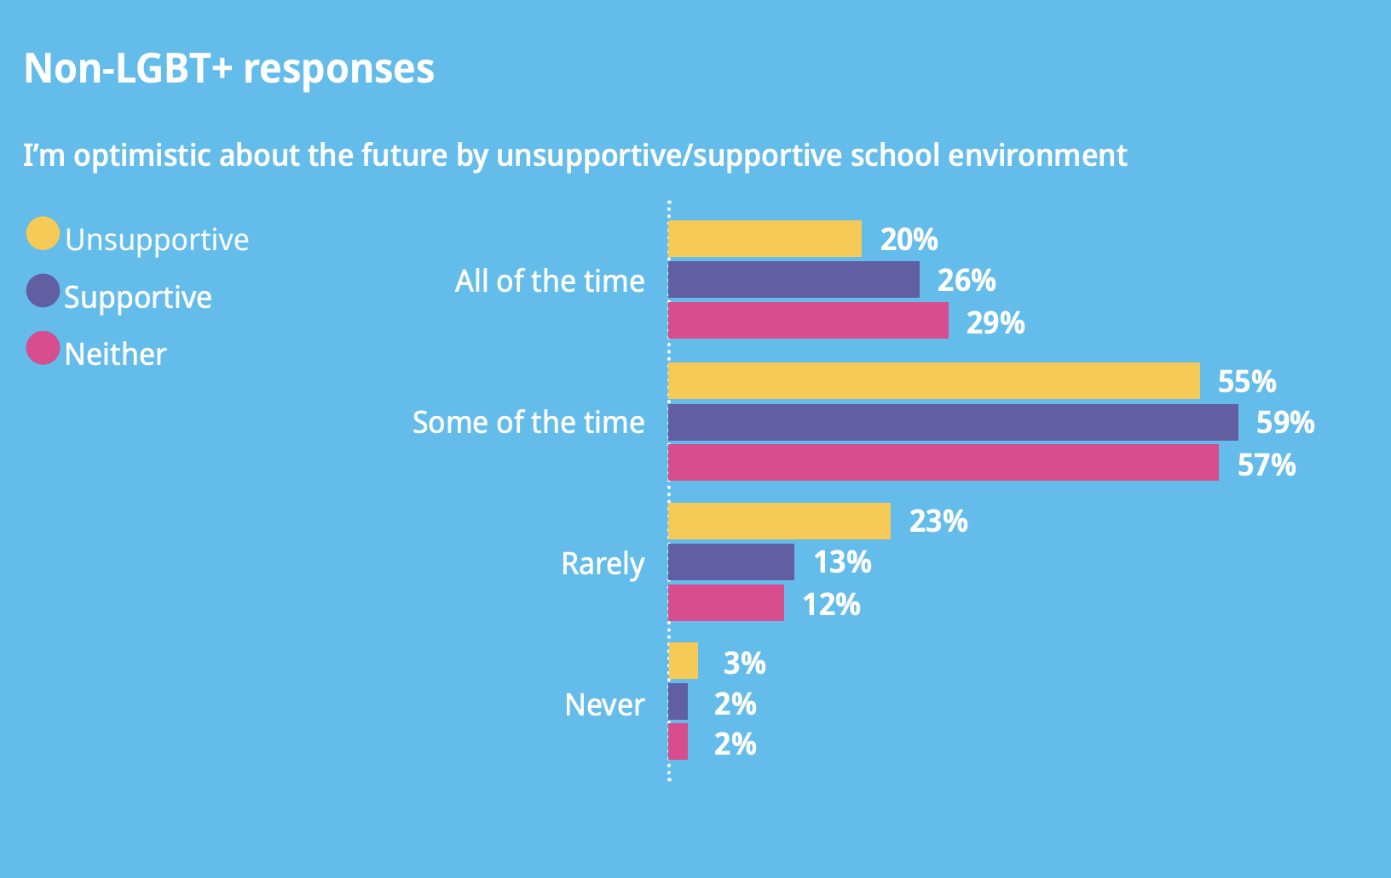
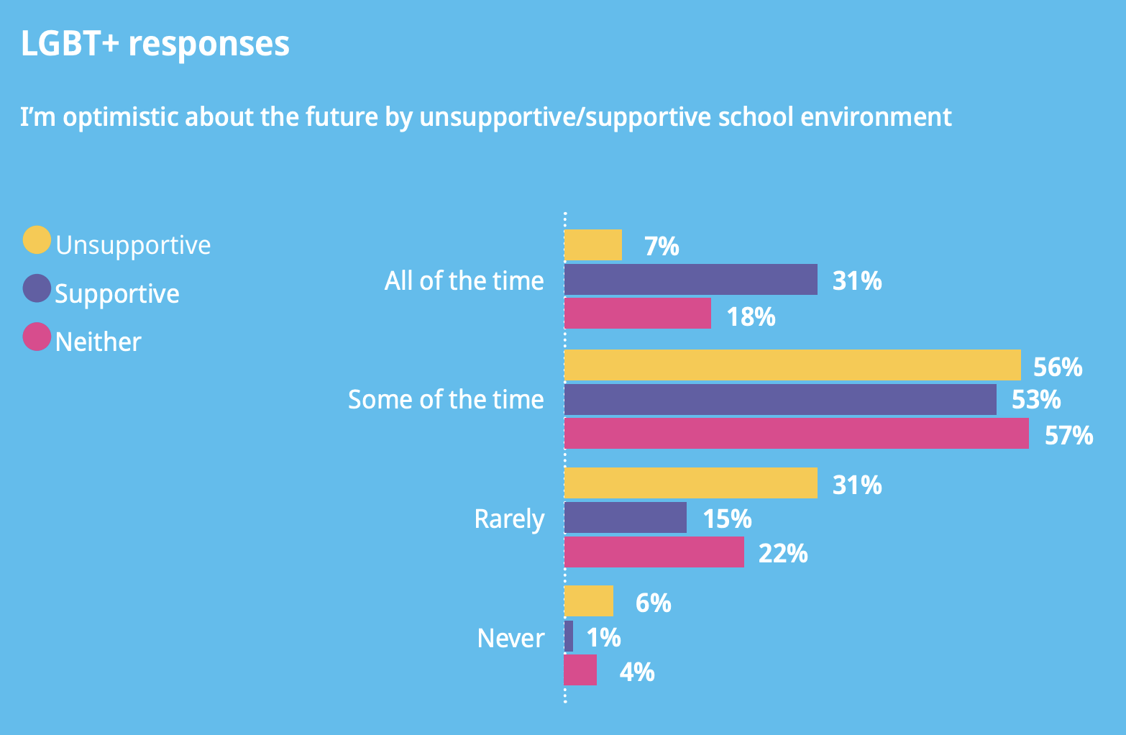
Moral Responsibility

Slide 28
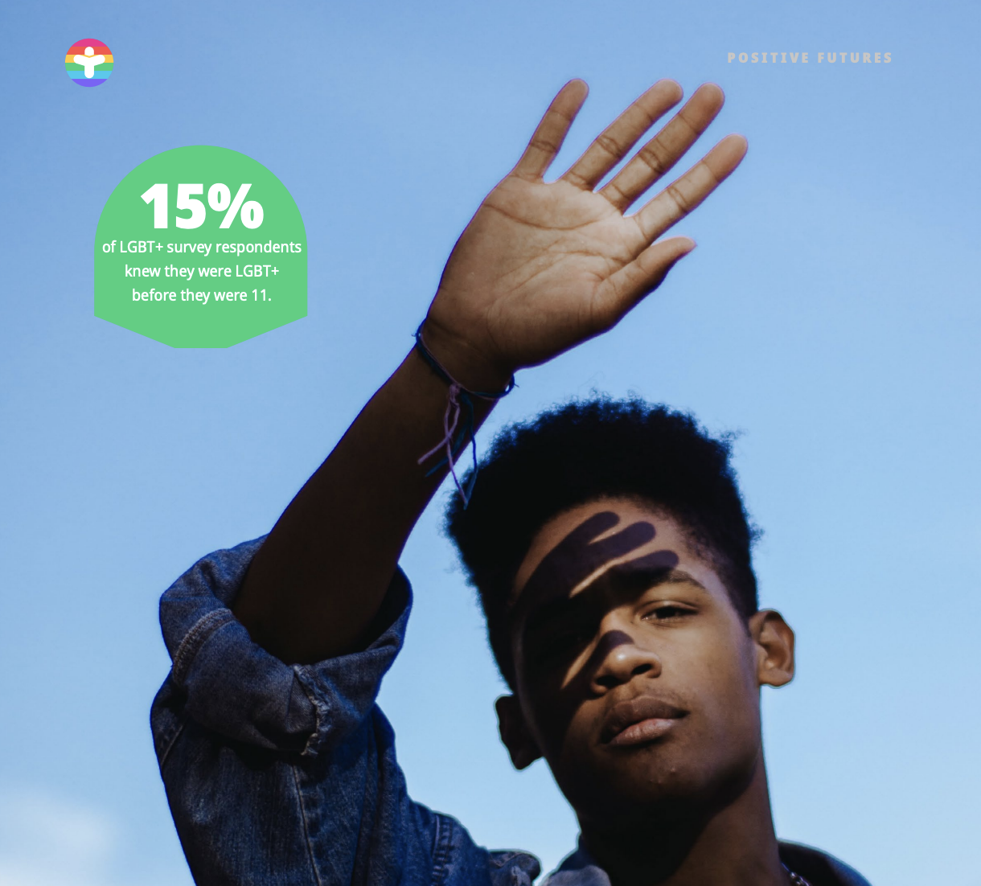

Slide 29
Moral Responsibility
3 times more likely to attempt suicide
More likely to have experienced youth homelessness
Up to 7 times more likely to use drugs
Twice as likely to binge drink at least once a week
Higher likelihood of substance dependency
Barriers to accessing support for substance use
Often reluctant to come out in mainstream services, for fear of discrimination and prejudice
9 times more likely to contract HIV

Slide 30
What causes these problems?
homophobia, biphobia and transphobia
stigma and discrimination
difficult experiences of coming out
social isolation, exclusion and rejection.
lack of representation
Mind.org.uk – February 2020
Notes:
About LGBTIQ+ mental health - Mind

Slide 31
Safe Challenging bullying

Slide 32
That’s so gay!
Is this bullying?

Slide 33
Steps to creating an inclusive environment
Steps to tackling bullying

Slide 34
Bullying
Personal journey
Misconceptions
Lack of empathy
Lack of education
Role models
Prejudice &
Bias

Slide 35
Immediate challenge
Find out all of the information
Support for the victim
Education and consequence
Record and report
What can we learn?

Slide 36
Seen Representation in books

Slide 37
What to teach and when?

Slide 38
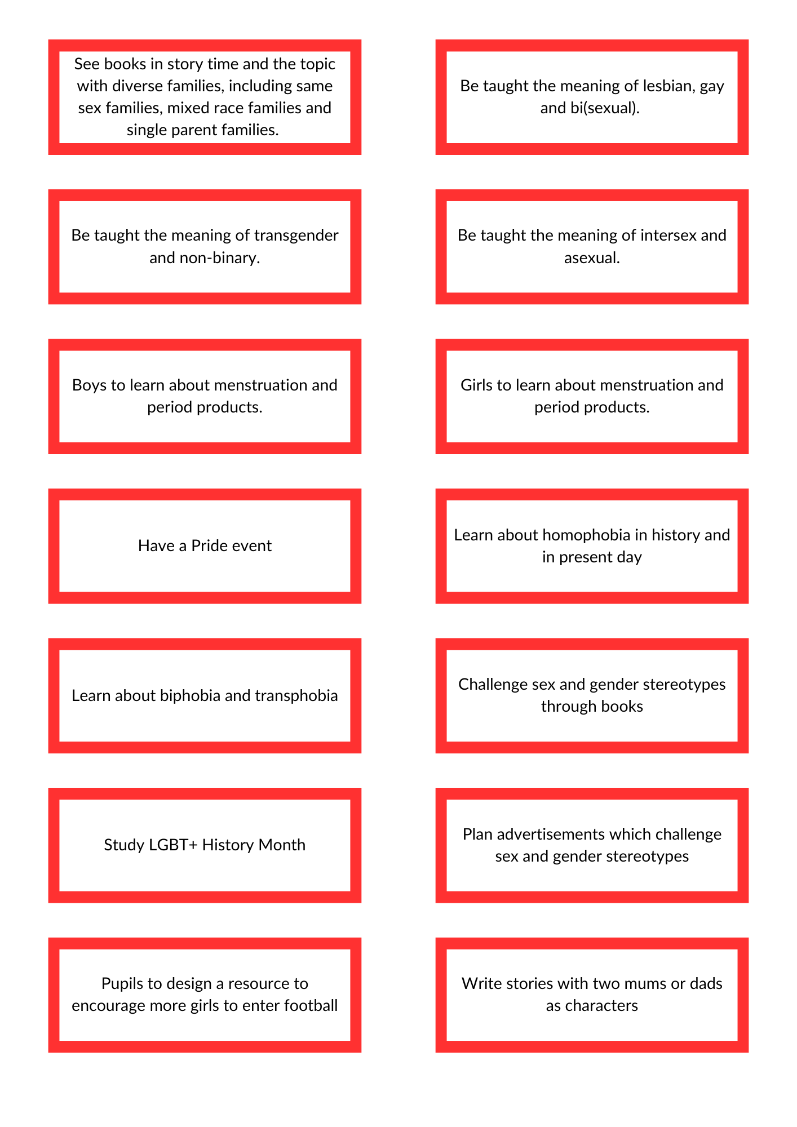

Slide 39
 | Representation |  | Role Models | Express Teaching
FP | Diversity of families | Disability Religion Race | Challenging gender, disability and racial stereotypes in their lives. | Diversity of families
Y3+4 | LG(B) Role Models |  | Challenging gender, disability and racial stereotypes in the UK. | LG(B) Vocabulary
Y5+6 | LG(BTQ+) Role Models |  | Challenging gender, disability and racial stereotypes in the world. History of stereotypes and equality. | (TQ+ Non-binary Vocabulary) Puberty Tackling homophobia bullying

Slide 40
Books
Express Teaching
Representation

Slide 41
What representation do we have in the books we use?
Age
Sex
Disability
Sexual Orientation
Gender Reassignment
The Protected Characteristics
Religion or Belief
Marriage and Civil Partnership
Race
Pregnancy and Maternity

Slide 42
What representation do we have in the books we use?
Representation
Race
Visible disabilities
Non-visible disabilities
Religion
Gender stereotypes
Same sex parents and LGBT role models

Slide 43
Good intentions or good inclusion?

Slide 44
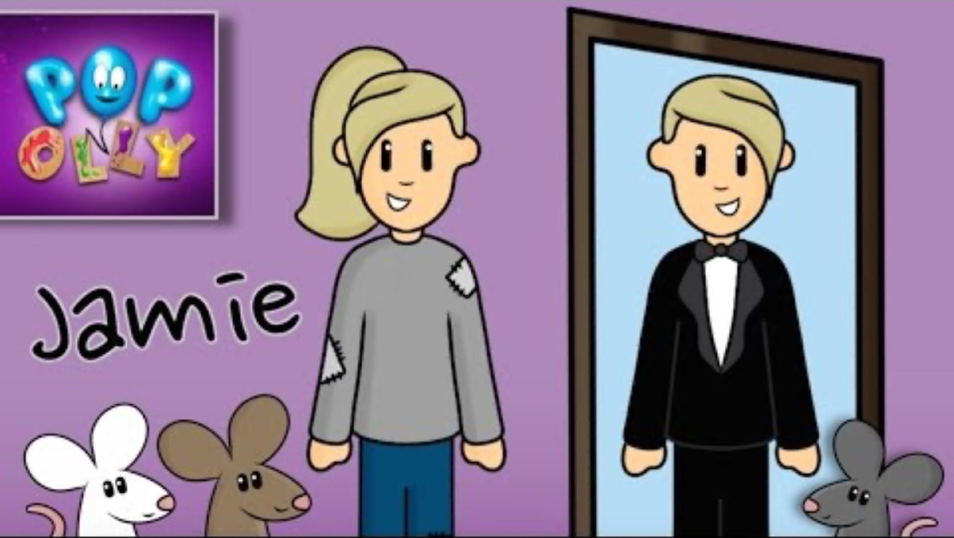
What are the positive messages?
What are the problematic messages?
Are any stereotypes reinforced?

Slide 45
Role Models

Slide 46
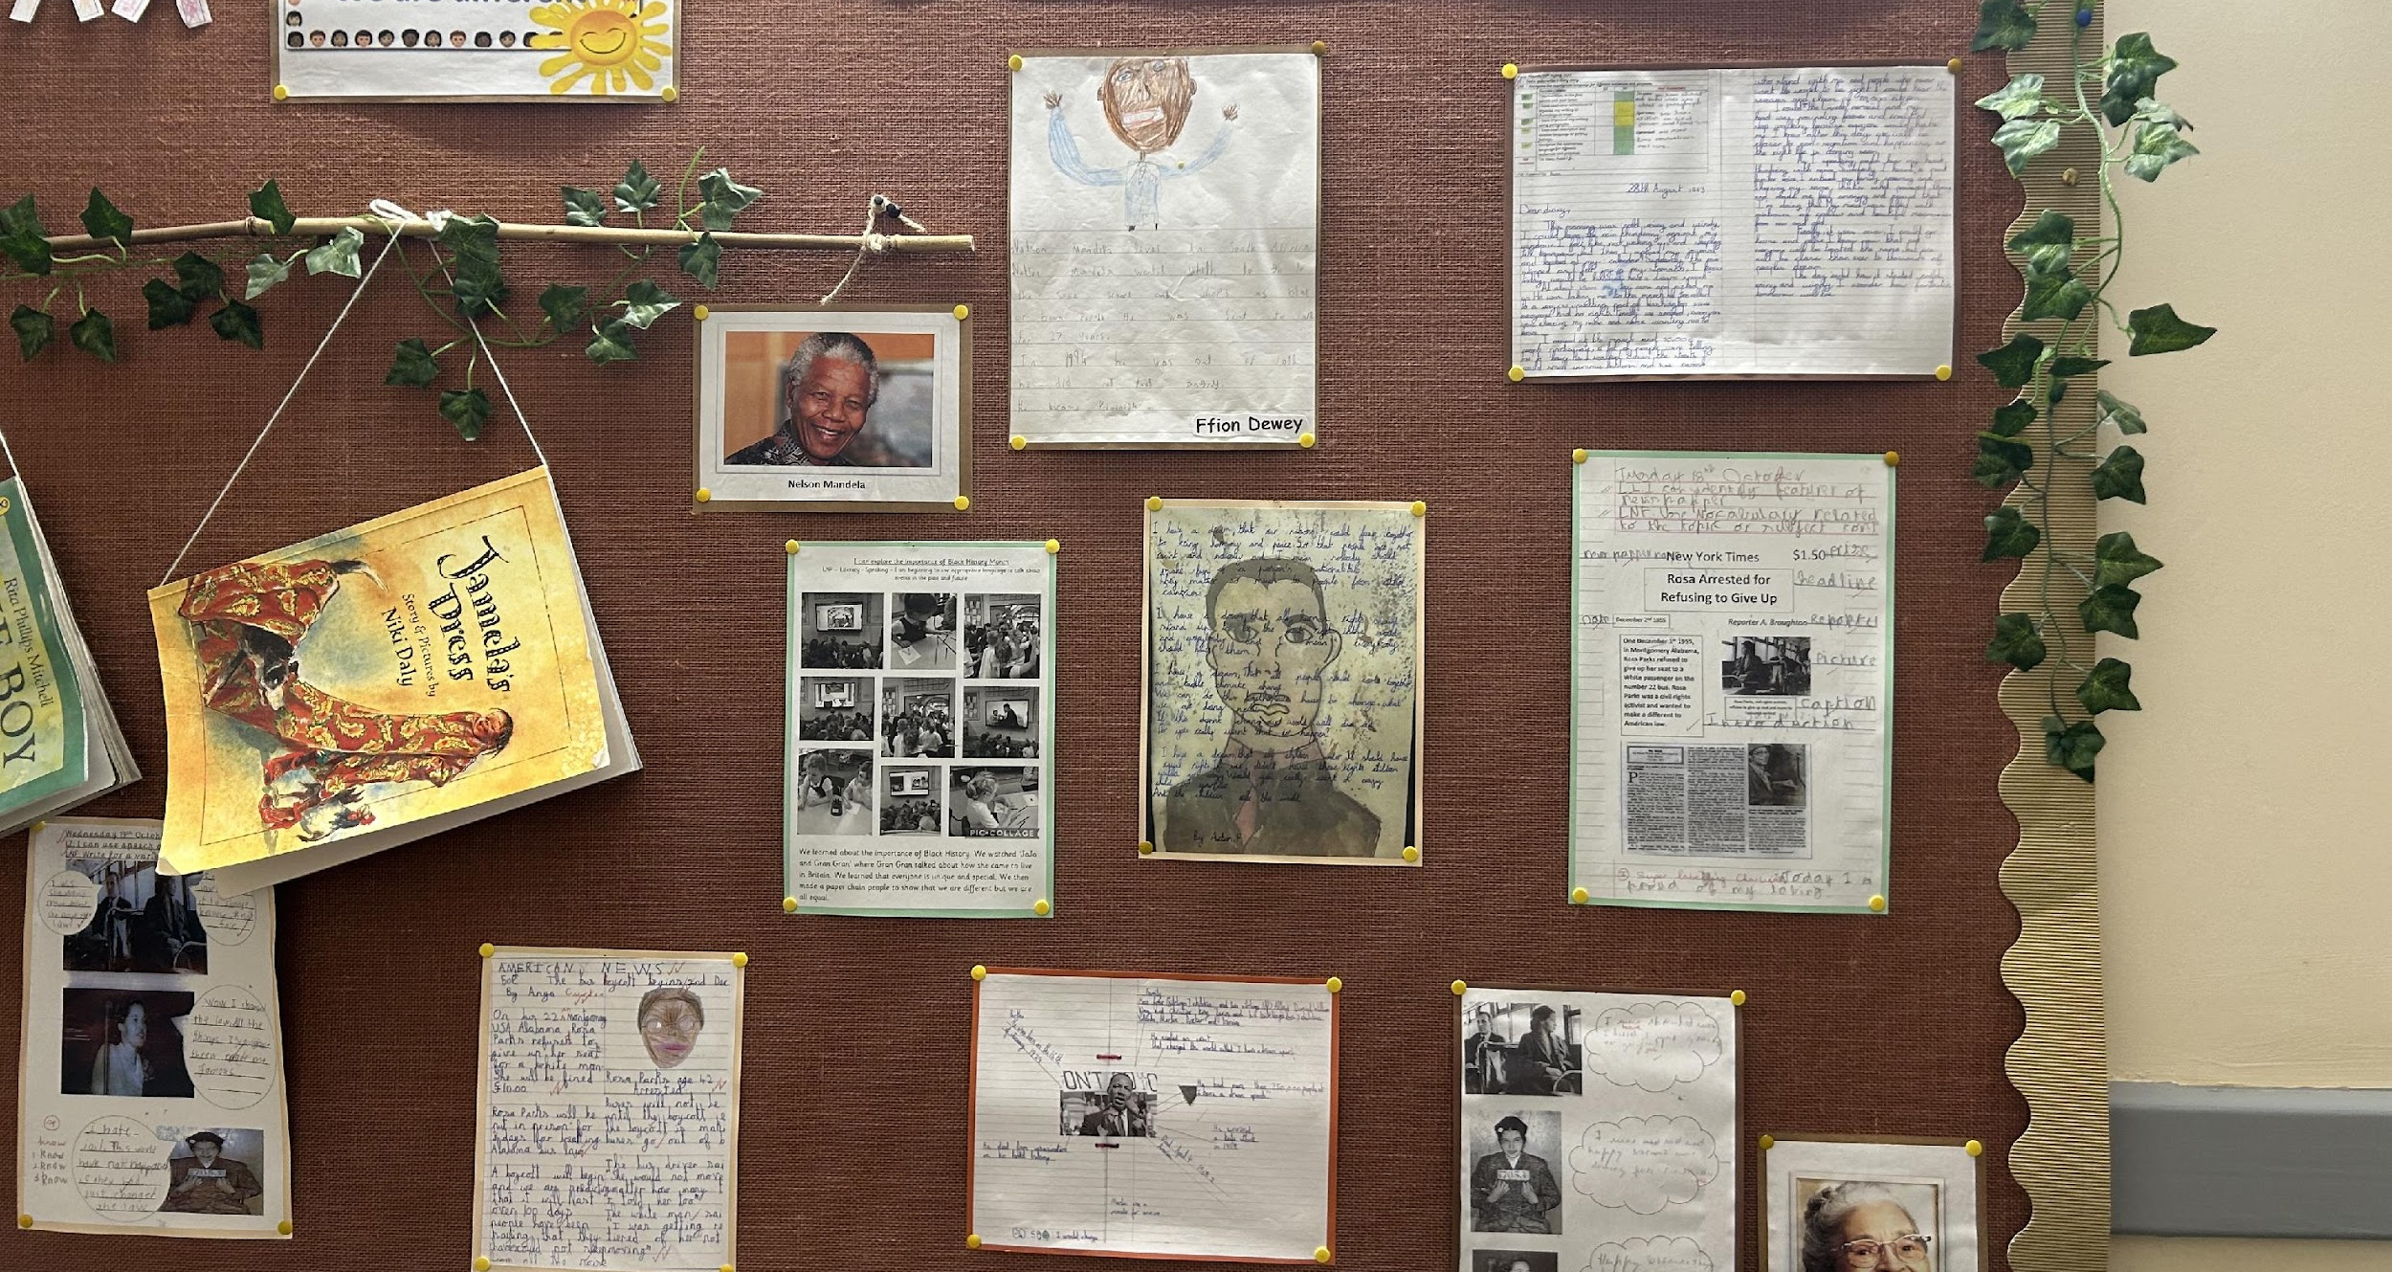
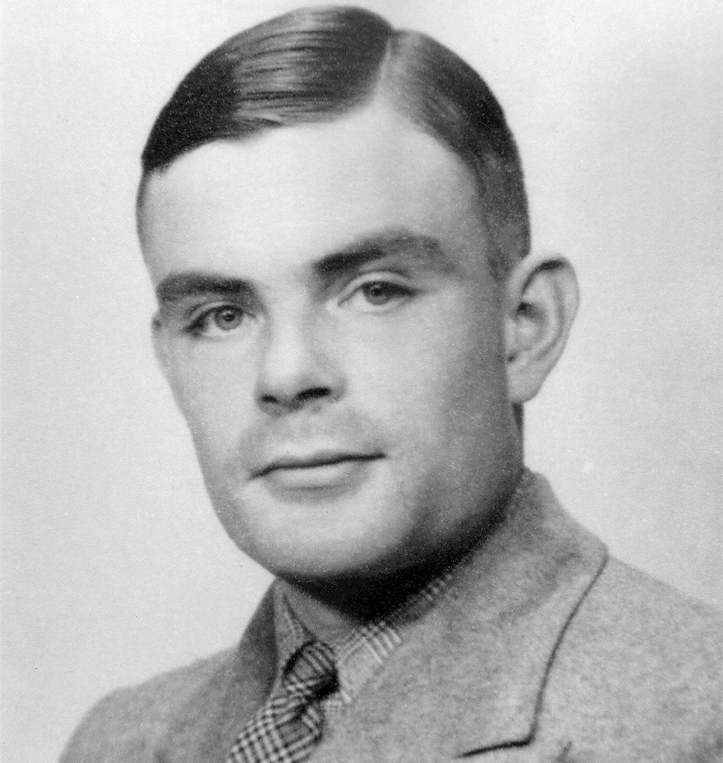
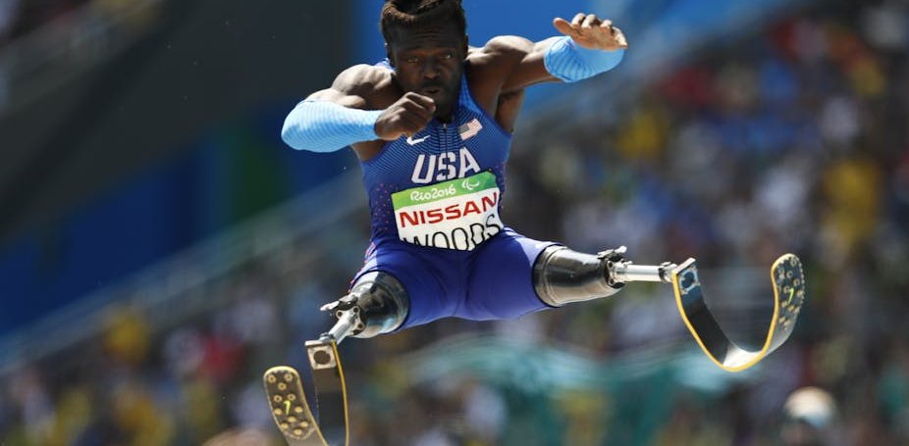

Slide 47
What is the relevance to the child?
Valerie Hanon
Thrive: The Purpose of Schools in a Changing World

Slide 48
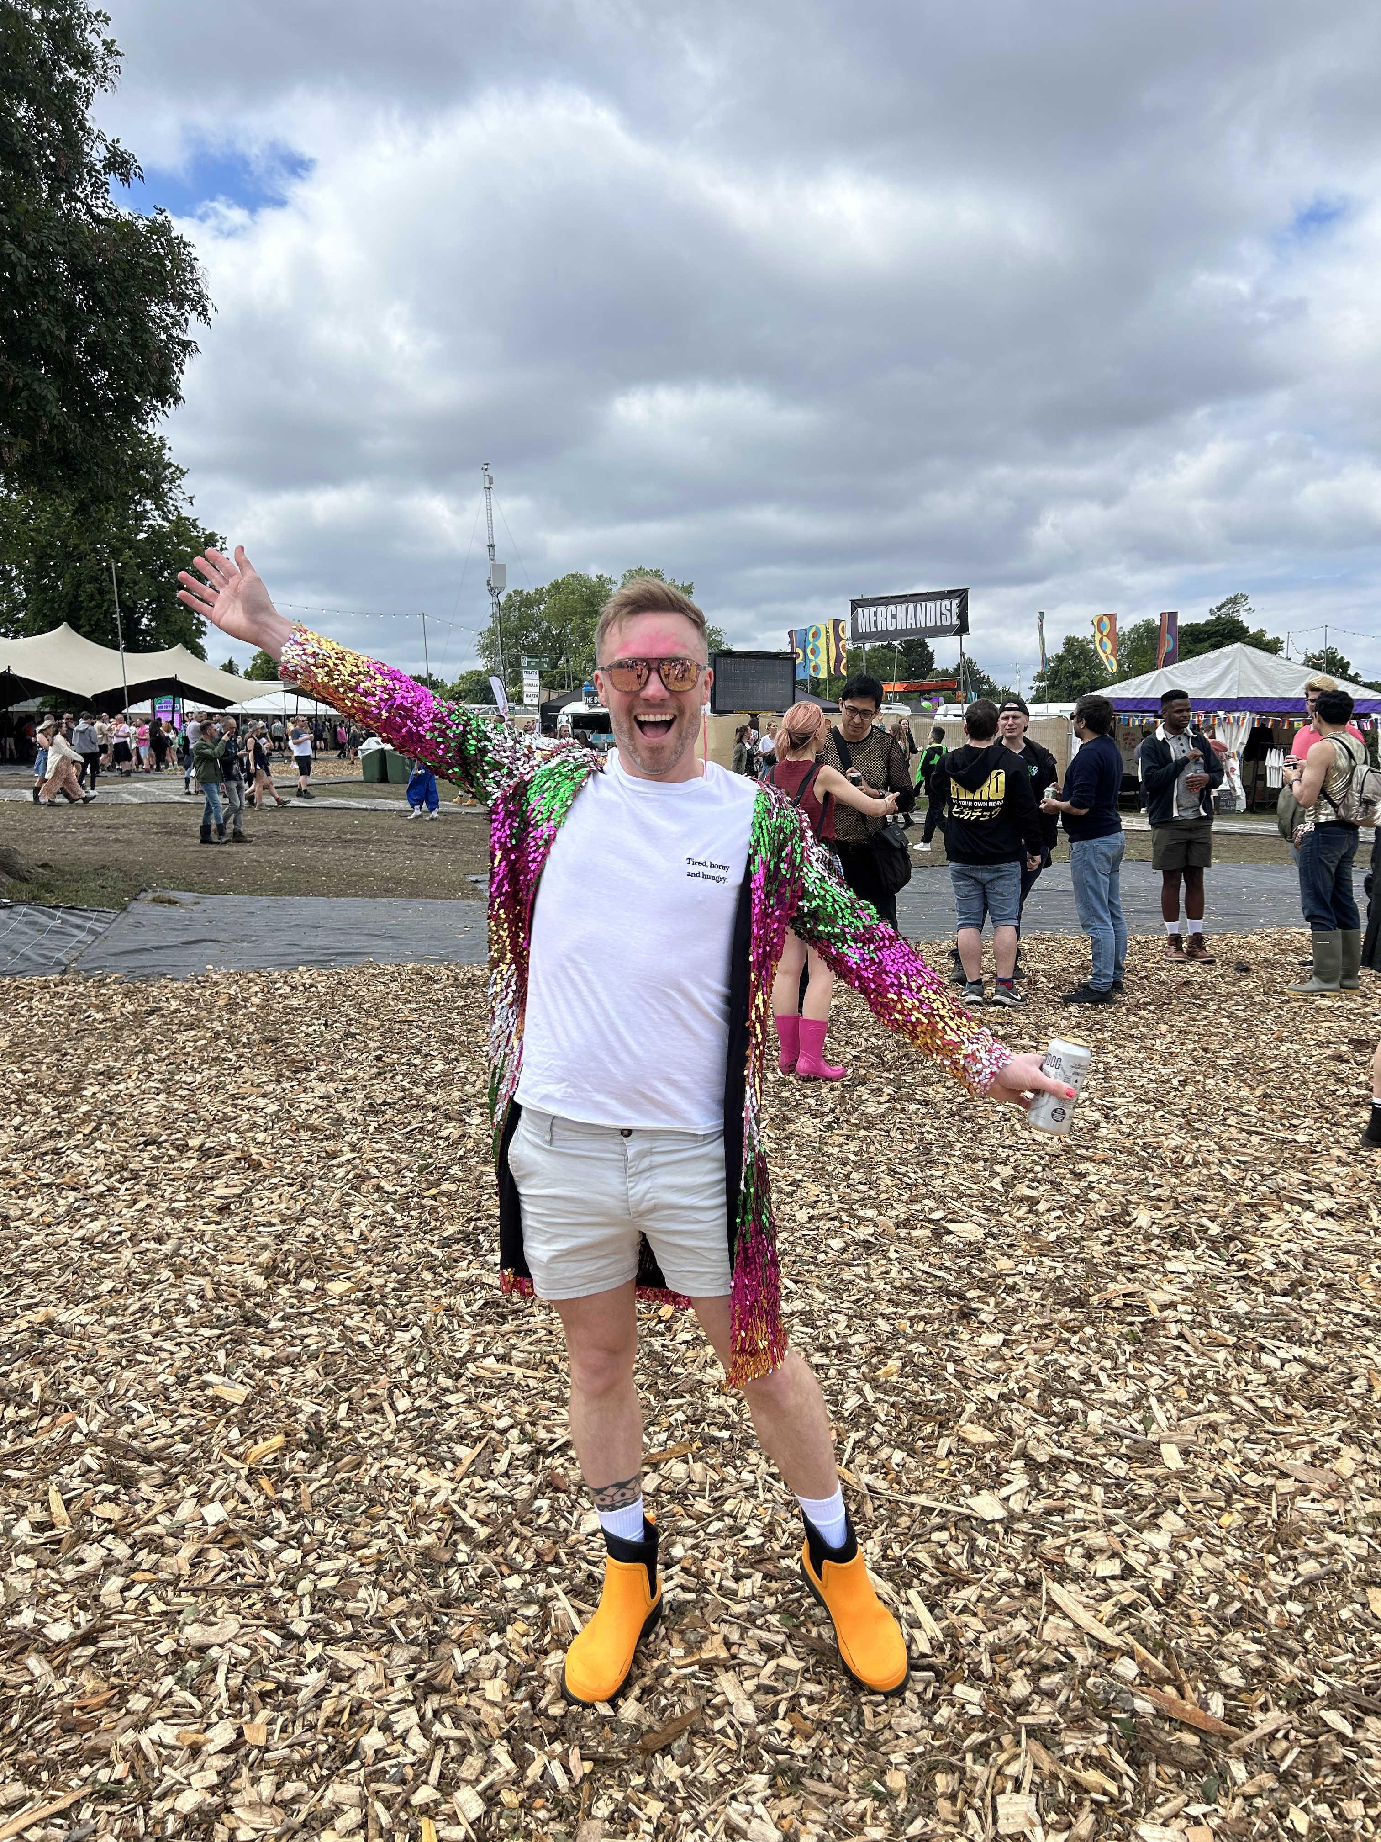
Introducing Vocabulary

Slide 51
Supported Coming out

Slide 52
Supporting pupils who come out

Slide 53
What if you don’t know what to do?

Slide 54
Gender questioning guidance

Slide 55
Confidentiality or secrecy?

Slide 56
Supported Working with parents

Slide 57
To Pride or Not to Pride?
What is Pride?
Why are you doing it?
Who is it for?

Slide 58
Creating a script
I’m concerned that you’re teaching my son to be gay.
I don’t want you teaching any of that trans stuff in school.
Please take my daughter out of any lessons that have gay people in.
The pupils are too young to be reading these books.
I don’t want my children exposed to these books.
Come up with answers for each. What do they have in common?

Slide 59
Our script
You have told me…
Our school values are…
We use this book/learn about this because…
If you want to talk about this in more detail…

Slide 60
Scenarios

Slide 61
Scenario
The word ‘gay’ is used regularly on the yard as a disparaging term. When it happens, you bring pupils in to educate them on the meaning of the word, but the number of incidents are not going down and there are several repeat offenders. What are the safeguarding concerns and what would you do?

Slide 62
Scenario
A member of staff tells you that a pupil, Andrew, has told them that they’re gay. Andrew told that member of staff that they didn’t want anyone else to know because they’re not ready to tell anyone yet. What are the safeguarding concerns and what would you do?

Slide 63
Scenario
Stacey came out as lesbian two years ago. She has been given ELSA and has had regular meetings with a designated member of staff. She still does not want her parents to know because she is worried about how they will react. What are the safeguarding concerns and what would you do?

Slide 64
Scenario
A pupil tells you that they want to transition and they want to change their name, pronouns and uniform, however, their parents do not give consent for any changes. What are the safeguarding concerns and what would you do?
Notes:
Gillick competence

Slide 65
Scenario
A parent comes to you and says that they think their child is trans because they play with girls toys. They want to change the name and pronouns on the register What are the safeguarding concerns and what would you do?
Notes:
Gillick competence

Slide 66
Scenario
A pupil with ASD has decided to transition. On the day they have decided, not all children are using the new names and pronouns and the pupil has become very distraught. Several other pupils have begun to target the pupil with upsetting comments. The parents are not aware of the transition and the pupil does not want them to know. What are the safeguarding concerns and what would you do?
Notes:
Gillick competence

Slide 67
Next steps

Slide 68
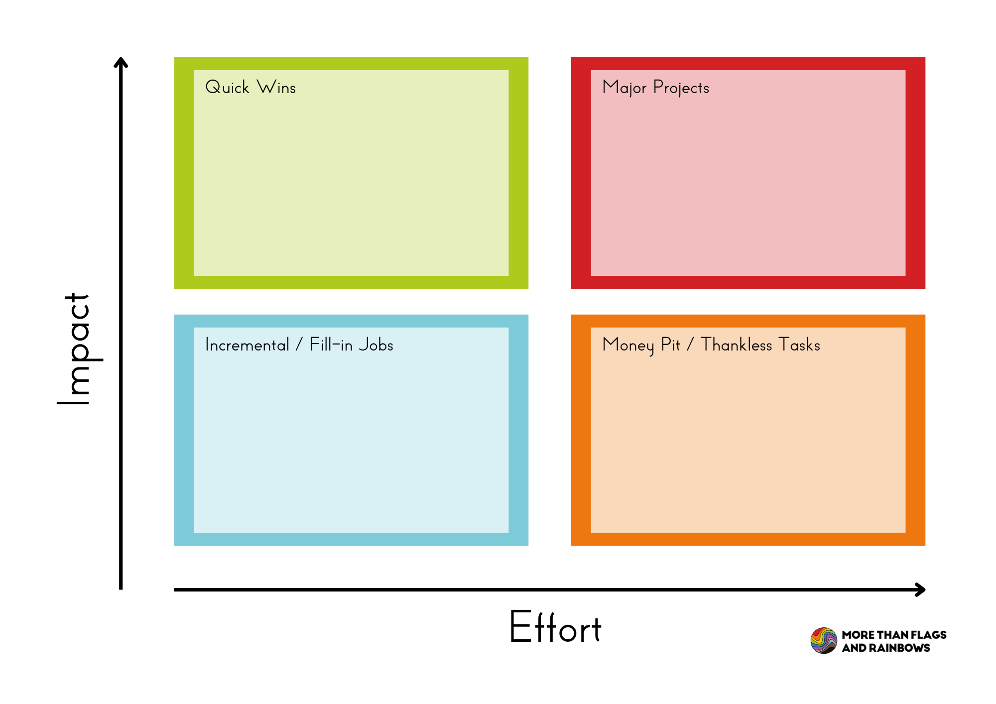
For example:
Map out books in each topic
Purchase additional books
Identify role models for each topic
Create non-negotiables for LGBTQ+ vocabulary
Hold a pride event
Read more inclusive stories in assembly
Write a policy for what happens when a pupil comes out

