Slide 1
Prescribing for Children and Young People ( CYP):
Competence, Complexity and Innovation
Teresa Johnson MSc, PGCHE, FHEA, BSc (Hons), RN (child), RGN Associate Professor University of East Anglia (UEA)
Paediatric advanced nurse practitioner/independent prescriber

Slide 2
Review the emerging contemporary themes of the revised Royal Pharmaceutical Society (RPS) Prescribing Competency Framework (2021) to develop evidence-based prescribing decisions
LEARNING
Explore the application of contemporary themes in paediatric prescribing to enhance evidence- based prescribing practice and outcomes for Children and Young People.
OUTCOMES

Slide 3
RPS ( 2 0 2 1 ) C O M PET EN C Y
FRA M EW O RK FO R A LL PRESC RI BERS

Slide 4
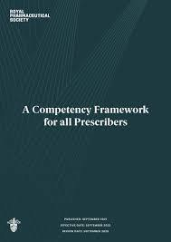
RPS ( 2021 ) Competency Framework for all
Prescribers
Prescribing competency framework is for all prescribers, but it must be contextualised to reflect different areas of practice and settings
Key is to prescribe within own scope of practice and there must be a clear patient benefit
Professional must also use their own professional Codes
of Conduct, standards and guidance

Slide 5
Emerging contemporary themes for children and young people’s
prescribing practice
C o n s u l t a t i o n s k i l l s a n d building rapport
S o c i a l p r e s c r i b i n g and w e l l b e i n g
Managing r i s k and m e d i c a t i o n s a f e t y
O f f l a b e l a n d u n l i c e n s e d m e d i c a t i o n s
Tr a n s f e r o f c a r e

Slide 6
Theme 1 ( competency 1)
consultation skills and
building rapport

Slide 7
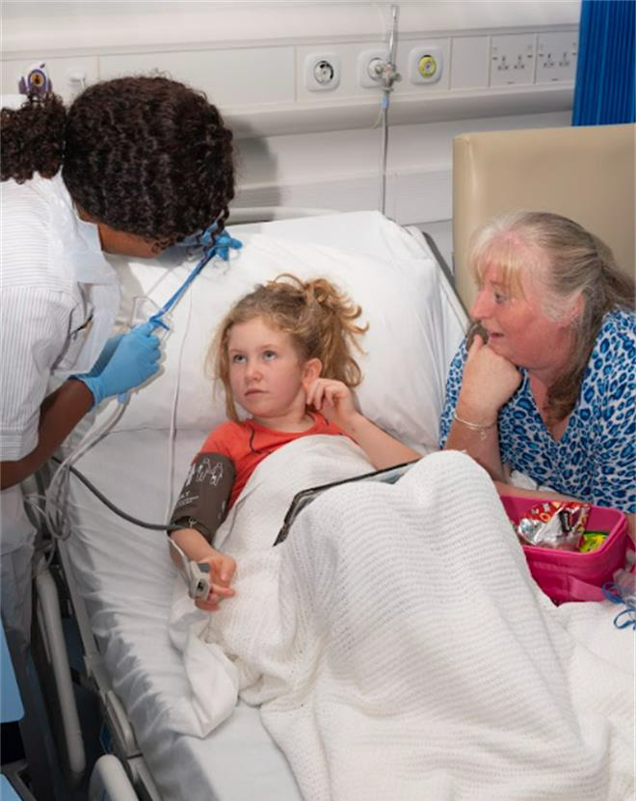
Consultation skills and building rapport
Triadic consultation is often considered standard in paediatrics and ‘carer’ is a term now prominent in the new 2021 framework
CQC (2021) Less than half (46%) of CYP (8-15 years) in hospital said they were involved ‘a lot’ in decisions about their care and treatment; 14% said they were not involved at all. Children aged 8 to 11 were less likely to say they were involved ‘a lot’ (43%) than children aged 12 to 15 (48%).
88% reported that staff had talked to them about how they would be cared for and 92% said they felt able to speak to a doctor or nurse without their parents
13,261 responses were directly from CYP

Slide 8
and for the
young
people………
Strengths School Home Activities
Drugs/substances
Emotions/eating/depressi on
Sexuality/safety
Home environment
Education/employment Activities
Drugs (including smoking)
Sexuality/suicide/depression

Slide 9
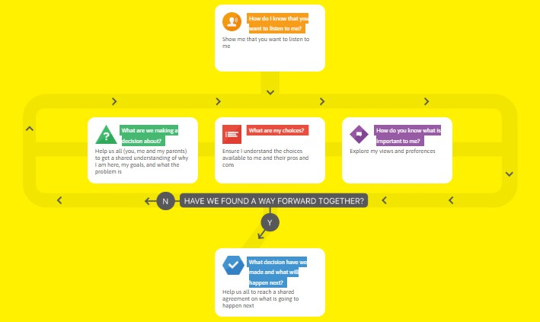
ME FIRST TOOLKIT
https://www.mefirst.org.uk/

Slide 10
Theme 2 ( l inked to
Social prescribing for children and young people is an evolving area of practice. It can be life changing allowing a voice about what matters to them, access the things they enjoy and can give them a route to achieve their ambitions
competency 2 )
Social prescribing
and wellbeing
It is an approach that connects people to activities, groups, and services in their community to meet the practical, social and emotional needs that affect their health and wellbeing (Jarvis and Mitchell 2024)
NB: you do not need to be a NMP to be a social prescriber, but it may be part of a non-pharmacological intervention for independent prescribers

Slide 11
Social prescribing evidence and strategic toolkit
“With many children and young people today living in families impacted by wider determinants of health such as inadequate housing, poverty or unemployment, well-delivered social prescribing offers support not just to children and young people but also the adults around them” (Children and Young People’s Social Prescribing Toolkit 2024)
National Academy for Social Prescribing (2023) demonstrates emerging evidence on the benefits for young people aged 12-18 years and especially for those over 17 years https://socialprescribingacademy.org.uk/resources/children-and-young- people-s-social-prescribing-new-evidence-review/

Slide 12
NATIONAL EXAMPLES OF SOCIAL
PRESCRIBING SUCCESS
Blackpool is one of the most deprived areas of the country. The Resilience Revolutions (RR) Annual Report demonstrates how ‘social prescribing’ is impacting on improving the lives for children, young people and families. An example is walk and talk where Youtherapy at Blackpool Teaching Hospital and the RR teamed up to deliver an alternative form of counselling to young people at risk of self-harming.
https://www.boingboing.org.uk/wp- content/uploads/2021/03/AnnualReport_201920_final.pdf

Slide 13
Social prescribing – discussion t ime
As experts in your field and specialisms are there any other experiences or suggestions that you can you offer or share regarding social prescribing for children and young people?

Slide 14
Theme 3 ( l inked to competency 4 ) managing r isk and
medication safety
( B M J Q U A L I T Y A N D S A F E T Y 2 0 2 0 )
More than 237 million medication errors are made every year in England
66 million are clinically significant. The additional cost to the NHS is upwards of £98 million
54% of errors are made at the point of administration
1708 lives are lost due to errors each year

Slide 15
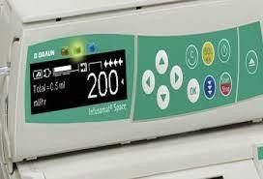
Prospective research Ghaleb et al (2010)
A prospective study of paediatric medication charts across five London hospitals found:
391 prescribing errors (13.2%). Errors included incomplete prescriptions; incorrect dosing were the third most common errors
429 medication administration errors (19.1%). Drug preparation and incorrect IV rates were the most common errors

Slide 16
•Drug doses are calculated based on a patient’s
age, weight or body surface area.
•Weight changes over time & recalculation of
drug doses is required, particularly in neonates.
Children are at greater risk
•Inadequate information.
•Inadequate availability of appropriate dosage
forms and concentrations.
•Fewer internal reserves to buffer any
medication errors which may occur.

Slide 17
Managing risk
How do you manage risk?
Patient level
Service level
National level

Slide 18
Theme 4 – Off- label and unlicensed medications
( competency 4)
4.11. Prescribes unlicensed and off-label medicines where legally permitted, and unlicensed medicines only if satisfied that an alternative licensed medicine would not meet the patient's clinical needs.
4.12. Follows appropriate safeguards if prescribing medicines that are unlicensed, off-label, or outside standard practice.
To obtain a license a clinical trial involving children needs to be conducted
file://ueahome3/stffmh1/vvz17vku/data/ Downloads/Unlicensed-medicines.pdf

Slide 19
Theme 5 ( l inked to competency 10 ) – Transfer of Care
C hild to adult t r ansitional healthcar e
Transitional healthcare isn’t about a ‘transfer of care’ but..”a purposeful, planned process that addresses the holistic needs of adolescents and young adults with chronic physical and medical conditions as they move from child-centred to adult-orientated health care systems.’ (DoH, 2006)
Transition from child and family focused services to adult services is a vulnerable time for all young people.
There are 1.7 million CYP in England with chronic health conditions (NICE 2024) and more than 40,000 young people under 18 have complex health needs due to a life-limiting or life-threatening condition (CQC 2017).

Slide 20
MEDICATION SAFETY IN TRANSITIONS OF CARE
Patient safety is one of the most important components of health care delivery and “unintended medication discrepancies affect nearly every patient that moves across
transitions of care” (WHO 2019)

Slide 21
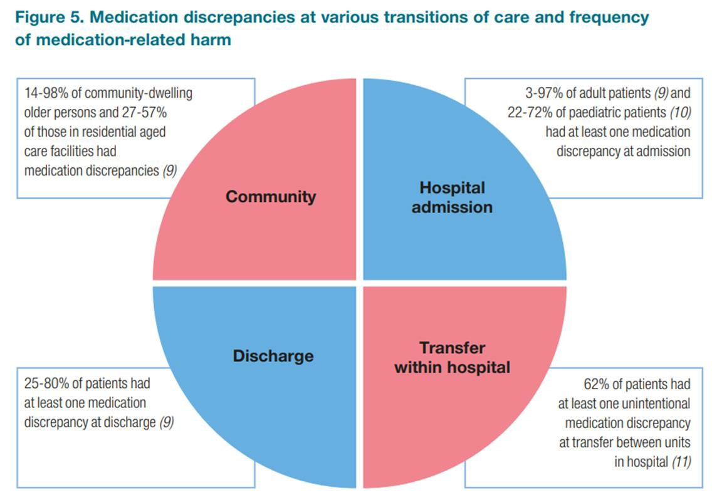
WHO FINDINGS ( 2019 )

Slide 22
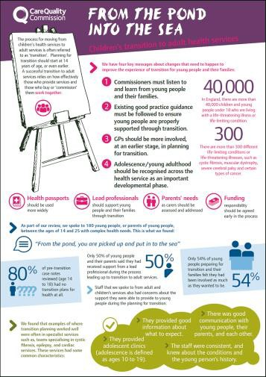
From the Pond into the Sea
Children’s Transition to Adult Health Services
(CQC Report, 2014)
Findings:
Many committed professionals provide excellent care.
Commissioners and providers of health & social care need to work together at every level.
Children's services stopping the care they provide before the equivalent adult services have started.
Adult services are unfamiliar (structured and funded differently).
Families feel confused & distressed by the lack of information & support.
http://www.cqc.org.uk/sites/default/files/CQC_Transition%20Report.pdf

Slide 23
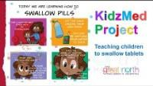
The process of transition –
considerations for independent prescribers
Empowering children to learn about and understand their own condition and medication at a developmentally appropriate stage for their individual needs
Monitor growth and development during adolescent; growth spurts mean more frequent medication reviews
Review medications in terms of suitability for their age; is there an alternative that could be considered?
Enable children the time to learn how to swallow tablets (where clinically or developmentally suitable)
Ensure a gradual process of transition and joined up working with adult services for a seamless continuation of medication

Slide 24
Thank you for l istening and participating – are
there any questions

Slide 25
REFERENCES AND FURTHER RESOURCES
BMJ Quality and Safety (2020) https://qualitysafety.bmj.com/lookup/doi/10.1136/bmjqs-2019- 010206
Care Quality Commission (2014) From the Pond into the Sea https://www.cqc.org.uk/sites/default/files/CQC_Transition%20Report.pdf
Care Quality Commission (2021) Children and Young People’s Survey https://www.cqc.org.uk/publications/surveys/children-young-peoples-survey-2020
Ghaleb et al (2010) The incidence and nature of prescribing and medication administration errors in paediatric inpatients. Arch Dis Child. Feb 95 (2), 113-118 https://doi.org/10.1136/adc.2009.158485
Gormley-Fleming E and Peate I (2019) Children’s Applied Pathophysiology: An Essential Guide for Nursing and Healthcare Students. Wiley Blackwell. West Sussex

Slide 26
REFERENCES AND FURTHER RESOURCES
Jarvis L and Mitchell D (2023) Children and Young People’s Social Prescribing Toolkit https://www.streetgames.org/wp-content/uploads/2023/12/Children-Young-Peoples-Social- Prescribing-Toolkit41.pdf
Medicines for Children https://www.medicinesforchildren.org.uk/
National Academy for Social Prescribing (2023) Children and young people’s social prescribing: new evidence review https://socialprescribingacademy.org.uk/resources/children- and-young-people-s-social-prescribing-new-evidence-review/
Peate I and Dryden P (2022) Fundamentals of Pharmacology for Children’s Nurses. Wiley Blackwell. West Sussex
Royal Pharmaceutical Society (2021) A Competency Framework for all Prescribers
World Health Organisation (2019) Medication Safety in Transitions of Care https://www.who.int/publications/i/item/WHO-UHC-SDS-2019.9

