Slide 1
Developing and Maintaining Competencies in Mental Health Prescribing
Kirsty Fishburn
Course Director for NMP and Lecturer in Mental Health at University of Hull

Slide 2
What to expect from this session
Why do we do NMP?
How do we improve prescribing practice?
How we maintain our own competency – using the RPS Framework?
Tools to help - SWOT, RAG Rating (others are out there)
Developing skills and recognising own limitations
What supports us as NMP’s?
What does the new DPP Framework mean? Impact on prescribing future
ACP in mental health and the NMP role
Reassessing our Competence and Confidence.
Ensuring our skills are updated and fit for practice.

Slide 3
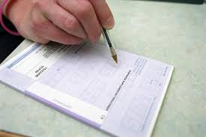
Why NMP-er…
My reasons… I realised I did not know a lot about medications. I knew the basic medications that were seen in most mental health units and wards.
I wanted to be a more active member of the MDT
Why does a tablet help you stop hearing voices?
How does it work?
Why does it work?
How can advocate for my patients?
Then I started the course and ‘mind blow’ – how had I not known this??!

Slide 4
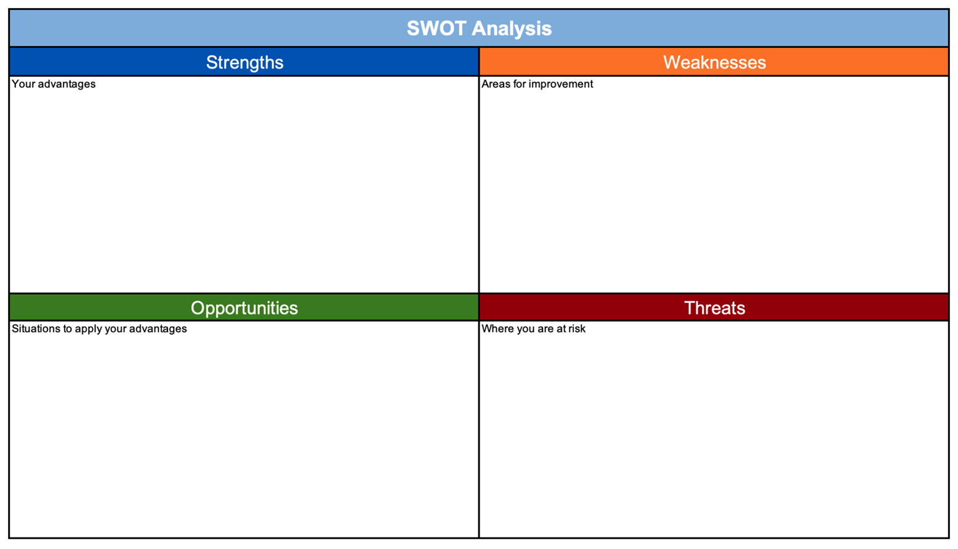
Why did you do it….
What were your reasons?
Are you happy to did it?
Did you learn…. a lot?
What were your main motivating factors?
What are your fears?
What do you think you need to support you?
& how can you access it?

Slide 5
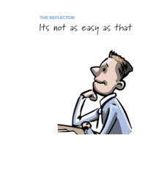
Reflection…
Thinking about you what are some of the models, tools, frameworks you currently use to inform your prescribing practice?
What would be the benefits from using a model designed for prescribing competence?
What would be the barriers?
Do you use, re-visit the RPS framework?
What helps you to keep your knowledge where is needs to be?
How do you evidence this?

Slide 6
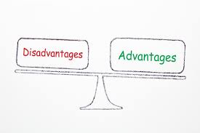
What are the benefits…?
What type of advantages does being an NMP help with?
Can you think of one advantage to non-medical prescribing?
Giving one example
How are you currently using non-medical prescribing

Slide 7
Let’s start at the beginning…….

Slide 8
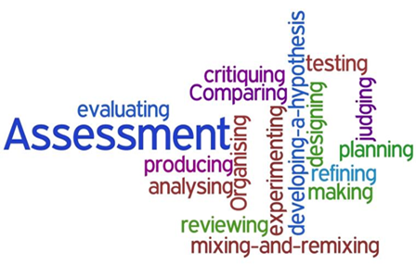
What is competency…
Royal Pharmaceutical Society - A Competency Framework for all Prescribers, (2021) define it as…
“A competency is a quality or characteristic of a person that is related to effective performance. Competencies can be described as a combination of knowledge, skills, motives and personal traits. Competencies help individuals and their organisations look at how they do their jobs”
What do we pick out there as key elements?

Slide 9
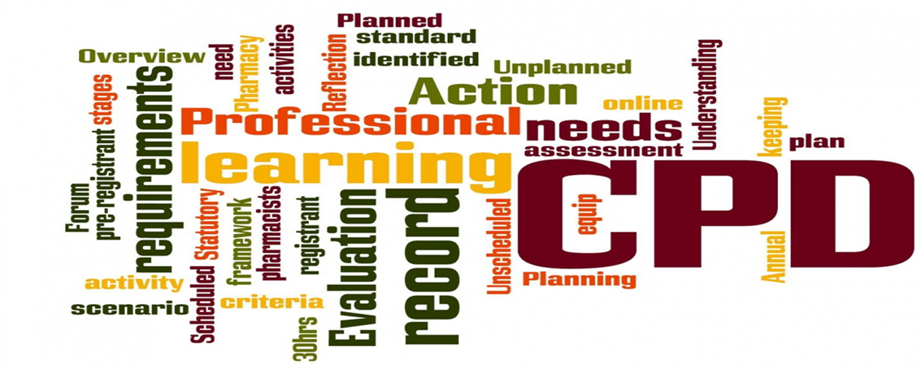
Key Components to Competency…
Effective performance
Knowledge
Skills
Motives
Personal traits
How does developing competency help??

Slide 11
Do we really understand it and meet it…
Competence can be described as the combination of training, skills, experience and knowledge that a person has and their ability to apply them to perform a task safely.
Competence means that you have the ability to do something well.
Other factors, such as attitude and physical ability, can also affect someone's competence.
Professional values
Communication and interpersonal skills
Nursing practice and decision-making
Leadership and management

Slide 12
Well, you knew it was coming…

Slide 13
What does it say for maintaining competence and developing skills…
Prescribers identify strengths and areas for development through self-assessment, appraisal
Keeps up to date with emerging safety concerns related to prescribing.
Accepts personal responsibility for prescribing and understands the legal and ethical implications.
Works within the NHS/organisational/regulatory and other codes of conduct when interacting with the pharmaceutical industry.
Reflects on own and others prescribing practice, and acts upon feedback and discussion.
Negotiates the appropriate level of support and supervision for role as a prescriber.

Slide 15
A closer look…. 1-6:TheConsultation…
1. Assess the patient – history taking – full holistic assessment - investigations
2. Identify Evidence-based treatment options - nonpharmacological options – risk Vs benefits – keep knowledge up to date
3. Present options and reach a shared decision – involve patient – explores views – health beliefs
4. Prescribe – understand adverse effects – effective use of prescribing systems – dosages, availability of drug
5. Provide information – manage expectations – explanation and gauge understandings – be clear and use reliable sources
6. monitor and review – efficacy – management plan – further referral.

Slide 16
7-10 Prescribing Governance…
7. Prescribe safely – maintains own scope of practice – knows about medications and common errors – minimise risk
8. Prescribe professionally – be confident – knows legal and ethical frameworks – recognises influences
9. Improve prescribing practice – reflective on own practice – use networks to develop – impact of prescribing
10. Prescribe as part of a team – ensures continuity of care – respect of roles on the prescribing journey – provides advice and support

Slide 17
Infrastructure needed… as an NMP?
What do we need?
What would help?
Policies?
Mentorship – supervision? Assessment?
Line Management – as a Practitioner and/or as an NMP?
NMP Meetings? Case Reviews?
Leads?
CPD events within the organisation?
What do you already have?

Slide 18
Moving onto….

Slide 19
Who can be a DPP…?
Any prescriber taking on the DPP role must be registered with their professional regulator. All NMPs undertaking the DPP role should have the necessary annotation for a prescriber as required by their regulator.
The expectation of any registered health professional practitioner acting in the DPP role is the ability to demonstrate they meet all competencies within the Competency Framework for all Prescribers.
Actively prescribing
Minimum time period of qualification and area of expertise

Slide 20
What is DPP….
It acts as an umbrella term to bring a number of different profession-specific titles together for the framework. The titles, used by professional regulators, that are covered by the term DPP (when applied in the context of prescribing training) are:
Designated Medical Practitioner (DMP)
Designated Prescribing Practitioner (DPP)
Named Practice Supervisor
Practice Assessor
Practice Educator

Slide 21
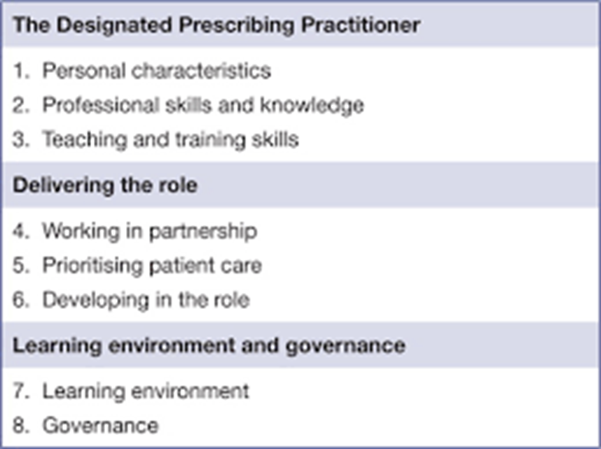
RPS States….

Slide 22
“To oversee, support and assess the competence of non-medical prescribing trainees, in collaboration with academic and workplace partners, during the period of learning in practice”
(A competency framework for designated prescribing practitioners)

Slide 23
Do we meet the criteria….
Registered professional? - NMP qualification annotated on the relevant register?
No sanctions or restrictions on the register?
Is an experienced prescriber? Usually 3 years as an active prescriber.
Relevant field of clinical practice?
Patient facing role?
Experience and competence in clinical and diagnostic assessment?
Can provide supervision?
Teaching experience?
Impartiality?
Governance and organisational support

Slide 24
How do we adopt this new role…
Prioritise time for own development – outside your normal clinical role
Knowing our own strengths and limitations
Signposting to other professionals
Having networks in place
Time for the student
Developing our existing skills and knowledge

Slide 25
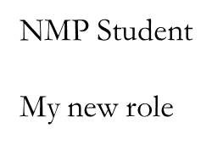
Do we need an…

Slide 26
Underpinning Purpose…
Support prescribers in expanding their knowledge, skills, motives and personal traits, to continually improve their performance, and work safely and effectively.
Help healthcare professionals to be safe and effective prescribers who support patients in getting the best outcomes from their medicines
Bring prescribing professions together to ensure consistency in the competencies required of all healthcare professionals carrying out the same role.

Slide 27
AP in Mental Health…
Health Education Publish
*Advanced Practice Mental Health Curriculum and Capabilities Framework*
demonstrate expertise in their scope of practice
manage defined episodes of clinical care independently
including admission, referral or discharge or care at home
full range of duties in relation to individuals’ physical and mental healthcare and in acute, primary, urgent and emergency settings (including hospitals, general practice, individuals’ homes, schools and prisons, and in the public, independent, private and charity sectors).
combine expert clinical skills with research, education and clinical leadership within their scope of practice.
work innovatively on a one to one basis with individuals as well as part of a wider team.

Slide 28
Re-visiting ‘Competency Language….’
Knowledge
Skills
Motives
Personal traits
Improve
Safety
Consistency
Best outcomes
Required
Effective
Help
Support

Slide 29
What can we do, to support ourselves…
Be part of and get involved in….
On-going continuing education and development programmes, as well as revalidation processes.
Inform the design and delivery of education programmes
Prescribers identify strengths and areas for development through self-assessment, appraisal and as a way of structuring feedback from colleagues
Stimulate discussions around prescribing competencies and multidisciplinary skill mix at an organisational level
Provide professional organisations or specialist groups with a basis for the development of levels of prescribing competency, from ‘recently qualified prescriber’ through to ‘experienced prescriber’.
Policy development
Organisational culture towards prescribers

Slide 31
Thinking of difficult areas….
Pharmacology
Decision Making
Co-morbidity
Drug Interactions
Do not have to be a medic to assess practice anymore….?
……… Making a plan, developing, improvement!

Slide 32
How do we know we are Competent…?

Slide 33
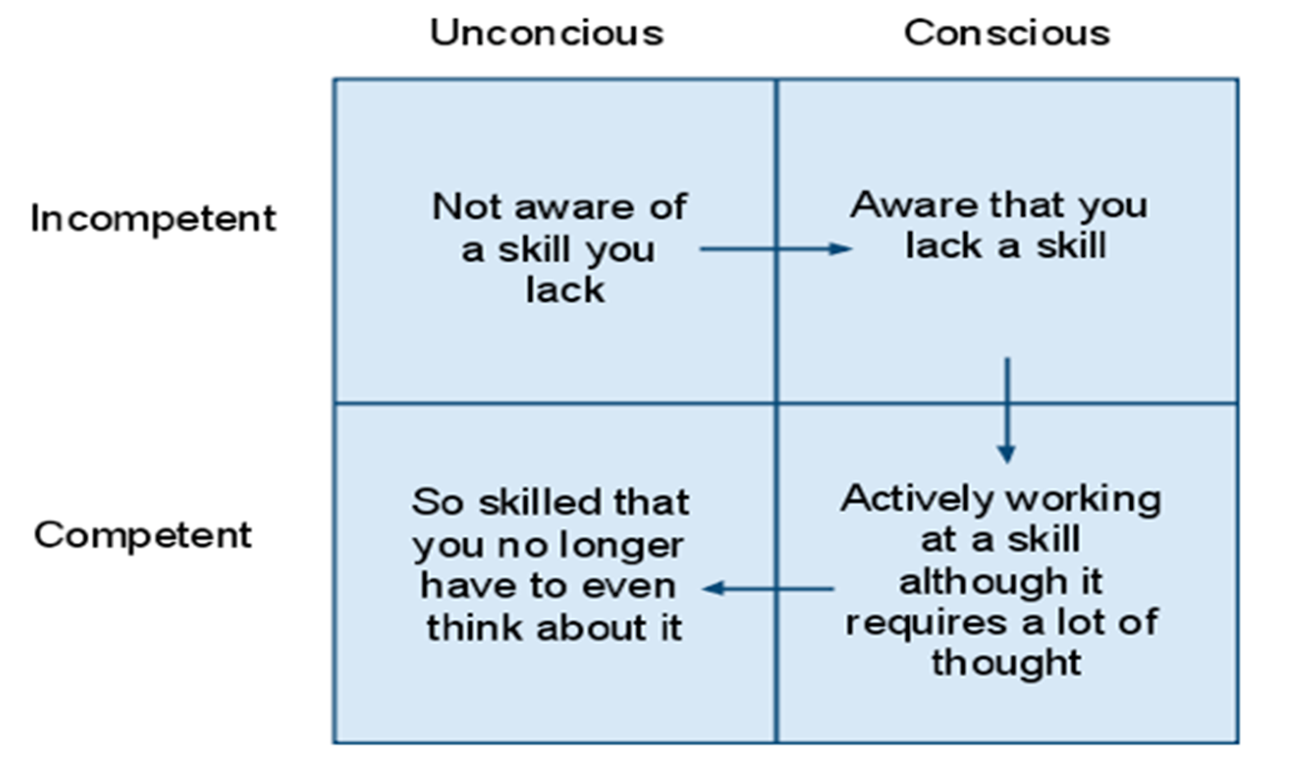

Slide 34
Where are you….?

Slide 35
Ask yourself….
Do you feel ready to take on a new role?
If you were to do the NMP course or become a DPP, what support would you want to be successful in this role?
Reflecting on your own previous training or NMP training, what did your PA/PS/DMP do well? And perhaps not so well?
How will you make sure this experience informs your own practice as an NMP student? or in your DPP assessing role?

Slide 36
Measuring ‘competence’ – Benner
Frameworks – Benner’s old novice to expert and more recent move to developing clinical wisdom.
Novice - Advanced beginner - Competent -Proficient – Expert
Then from expert – evolves ‘wisdom’ - expert professionals apply scientific knowledge, professional experience, and a careful attention to each patient's changing condition to underpin excellent care.
Within our area of competence

Slide 37
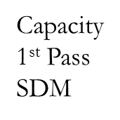
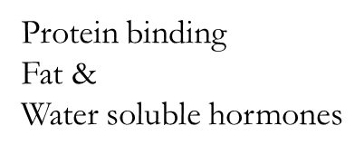
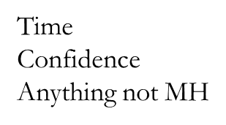
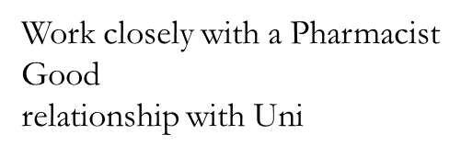

Slide 38
Keeping up to date….
Sign up for alerts – but keep them relevant and READ THEM!
Supervision with an NMP, DPP and Medical Prescriber
Schedule in 1 hour per month to have a browse…?
Attend CPD events
Link in with other organisation, Trusts, Charities and HEI’s
Attend networks, forums. Conferences…. where time and finances allow.

Slide 39
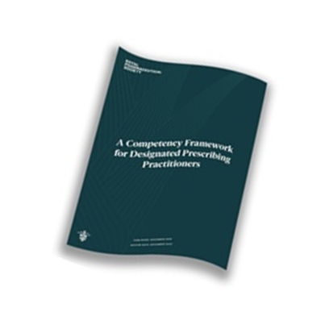
What is new and how do we know….?

Slide 40
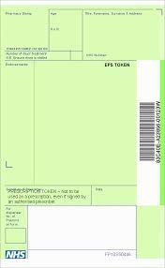
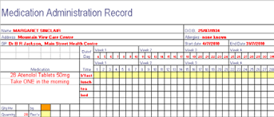
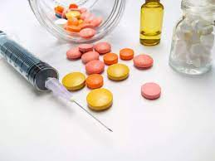
Thank you…
any questions…?

