Slide 1
The role of the non-medical prescriber in deprescribing psychiatric medicines
12th July 2024
Caroline Parker
Lead Pharmacist – Community Mental Health Teams
Independent Prescriber

Slide 2
Overview
NMPs
Deprescribing
working with people to reduce dependence on medication and de-prescribe
stopping psychotropic medication
managing side effects and withdrawal symptoms

Slide 3
Non-medical prescribing
2006 – nurses & pharmacists could prescribe independently
Premise for NMPing was to:
improve patient care without compromising patient safety
make it easier and quicker for patients to get the medicines they need
increase patient choice in accessing medicines
make better use of the skills of health professionals
contribute to the introduction of more flexible team working across the health service
To improve patient care in a range of settings e.g.
management of long term conditions
medicines management / medication review
mental health services
Notes:
Non-medical prescribing was intended to provide patients with quicker and more efficient access to medicines, thus maximizing benefits to patients and the National Health Service (NHS)
1986 = >30 years ago

Slide 4
Responsibility of NMPs
Independent Prescriber
‘responsible and accountable for the assessment of patients with undiagnosed and diagnosed conditions and for decisions about the clinical management required, including prescribing’
Nurse and pharmacist independent prescribers
are able to prescribe any medicine for any medical condition within their competence.
includes unlicensed medicines and any controlled drug in Schedule 2,3,4 or 5
Notes:
Non-medical prescribing is an umbrella term comprising of different types of prescribers that are not identified as doctors.
Non-Medical Prescriber, refers to any health care professional that has completed the relevant training AND has their qualification recorded on their relevant professional register; eg NMC, GPhC and the Health Care Professions Council (physiotherapists, optometrists, podiatrists)
Nurses successfully completed an NMC Independent Nurse Prescribing Course, also known as v200 or v300 course.
Physiotherapists, podiatrists or chiropodists:
any licensed medicine within their area of competence and scope of practice
can also prescribe off-label medicines and from restricted lists of controlled drugs.
cannot prescribe any unlicensed medicines

Slide 5
The role of NMPs in de-prescribing?
Notes:
NON MEDICAL DEPRESCRIBING is not needed.
Deprescribing full stop is needed.
Why?
- pts focussed safety
50% of meds for long term conditions are not taken propoerly – Q what risks does that pose?
No health gain
- continued health risks
- actual damage
Evidence suggests paternalistic model is not the best way to approach the health professional – patient partnership
“Estimated” – why????
Definition of compliance varies between studies.
How do yo u measure? Pill counts?
On time?
Self reports?

Slide 6
Context - Overprescribing
“National Overprescribing Review” – Prof Tony Avery, National Clinical Director for Prescribing, NHS England, GP, Professor of Primary Care & NIHR Senior Investigator
Notes:
Why would you want to stop antidepressants?

Slide 7
Deprescribing
Definition:
“Deprescribing is the planned and supervised process of dose reduction or stopping of medication that might be causing harm, or no longer be of benefit.
Deprescribing is part of good prescribing – backing off when doses are too high, or stopping medications that are no longer needed.”
Notes:
So what is Deprescribing?
Nothing special! Two sides of the same coin. Rxing and deprescribing.
Summarise Why would you want to stop antidepressants?
Probbaly over prescribed
not always reviewed for onfgoing need
Polypharmacy that leadsto interactions? Problems? Non adherence?

Slide 8
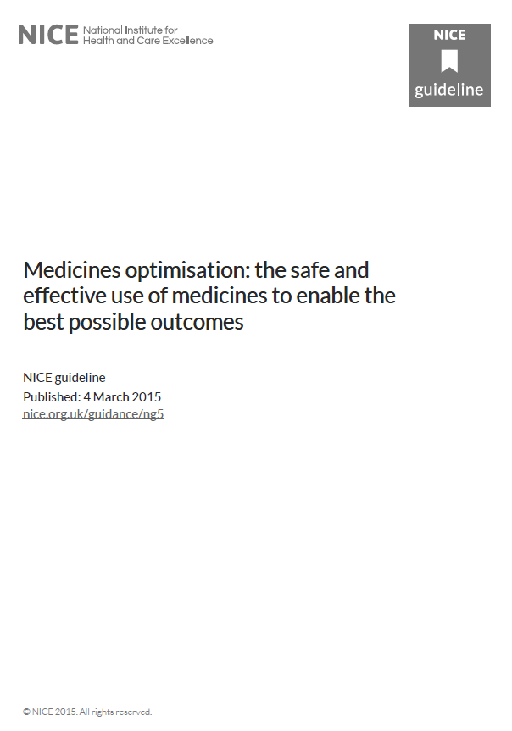
Medication Adherence is crucial:
16% people take medicine as prescribed with no problems & all info needed
A third are not adherent by 10 days after starting new medicine
people are not getting the most out of their medicines, less than optimal health gain, and inappropriate use of NHS resources
NICE Guidance:
Medicines optimisation the safe and effective use of medicines to enable the best possible outcomes (NG5), March 2015
Notes:
Over 2 years, 90% of people on polytherapy stopped >1 drug
National Audit of Schizophrenia: 18% (7-35%) >1 antipsychotic
1/5 -2/3 not sufficiently involved in decisions about treatment
Side effects – not managed (properly)
Risk factors for non-adherence:
Lack of insight
Negative attitudes to treatment
Lack of positive therapeutic relationship
Poor subjective wellbeing
Poor aftercare
Shorter duration of illness
Persistent comorbid substance misuse
50% of meds for long term conditions are not taken propoerly – Q what risks does that pose?
No health gain
continued health risks
actual damage
Evidence suggests paternalistic model is not the best way to approach the health professional – patient partnership
“Estimated” – why????
Definition of compliance varies between studies.
How do you measure? Pill counts?
On time?
Self reports?

Slide 9
Polypharmacy
Problematic or inappropriate polypharmacy
involves prescribing multiple medicines to a patient, where the risks of treatment using the prescribed combination outweigh the perceived benefits
Appropriate polypharmacy
Notes:
There is no standard definition of polypharmacy

Slide 10
Identification of problematic polypharmacy
Notes:
STOPP (Screening Tool of Older Person’s Prescriptions) and START (Screening Tool to Alert doctors to Right Treatment)

Slide 11
Beers criteria for potentially inappropriate medication use in older adults | The original prescribing indicator reference. In some respects the 66 indicators are US specific. There are regular updates of the 1991 indicators; the indicators have been tested in a variety of situations worldwide. | Beers (2012). ‘The American Geriatrics Society Updated Beers criteria for potentially inappropriate medication use in older adults’. Journal of the American Geriatrics Society, vol 60, no 4, pp 616–31.
PINCER Indicators | 10 UK indicators validated in general practice. The PINCER trial demonstrated the effectiveness of a pharmacist-led IT-based intervention to reduce hazardous prescribing. Odds ratios for error were significantly lower in intervention grp (0.51 to 0.73) | Avery AJ et al (2012a). ‘A pharmacist-led information technology intervention for medication errors (PINCER)’ The Lancet, vol 379, pp 1310–9.
RCGP indicators | 34 prescribing safety indicators developed and designed for use in UK general practice. Using a similar process, an updated list of 56 indicators has recently been identified (currently unpublished). | Avery AJ et al (2011). ‘Development of prescribing-safety indicators for GPs using the RAND Appropriateness Method’. Br J of Gen Prac, vol 61, no 589, pp 526–36.
Scottish – inappropriate prescribing to vulnerable patients | 15 RAND UCLA-derived indicators that were developed in Scotland and tested on general practice data from 1.7 million patients. A composite indicator was found to be the most reliable measure of a practice’s performance. | Guthrie B et al (2011). ‘High risk prescribing in primary care patients particularly vulnerable to adverse drug events: cross sectional population database analysis in Scottish general practice’. BMJ, vol 342, d3514.
STOPP/START criteria | 87 indicators developed by consensus methods in Ireland. They have been validated extensively in the UK setting. Many of the STOPP criteria were included in the RCGP indicator set. | Gallagher P et al (2008). ‘STOPP and START. Consensus validation’. International Journal of Clinical Pharmacology and Therapeutics, vol 46, pp 72–83.
Notes:
STOPP (Screening Tool of Older Person’s Prescriptions) and START (Screening Tool to Alert doctors to Right Treatment)

Slide 12
Polypharmacy
- review tools
NHS Scotland
7 steps to good medication review
a guide to structure the review process
http://www.polypharmacy.scot.nhs.uk/polypharmacy-guidance-medicines-review/for-healthcare-professionals/principles/the-7-steps-medication-review/

Slide 13
NHS England » National medicines optimisation opportunities 2023/24
16 are suggested, of which ICBs have to select at least 5 including:
Addressing inappropriate antidepressant prescribing
Improving valproate safety

Slide 14
De-prescribing psychiatric medicines

Slide 15
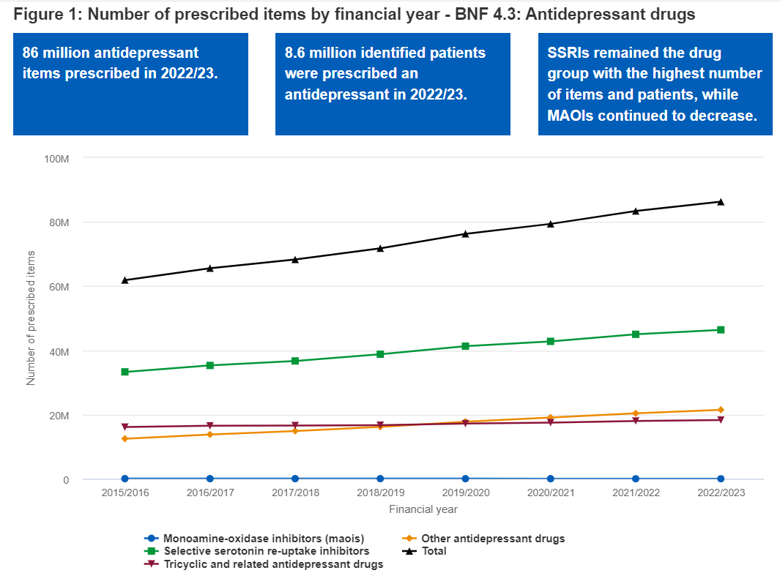
Prescribing rates of antidepressants
MUMH England (nhsbsa-opendata.s3.eu-west-2.amazonaws.com)

Slide 16
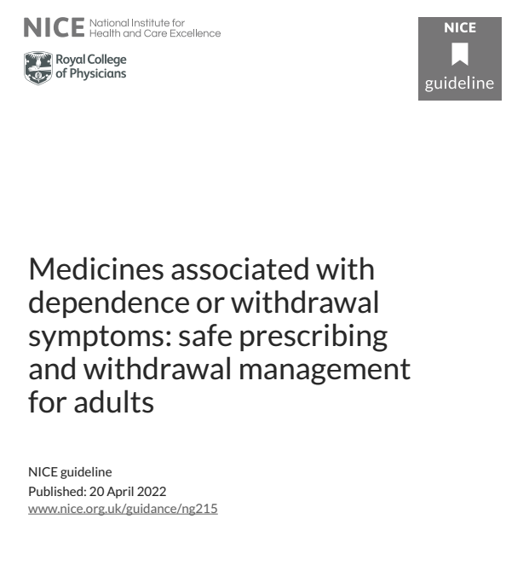
NICE NG215
(2022)
- “…. include benzodiazepines, Z-drugs, opioid, gabapentin and pregabalin. Antidepressants….”
- Avoid starting….
https://www.nice.org.uk/guidance/ng215

Slide 17
- Make shared decisions
- Stop if:
- no longer of benefit
- problems with dependence
- the condition has resolved
- harms outweigh benefits
- the person wants to stop
- Explain benefits & risks
- Expect some resistance and provide reassurance
- Plan the reduction (weeks - months)
- explain and discuss withdrawal symptoms
- Strategies if withdrawal cannot be agreed or is unsuccessful
- aim to stop any further dose escalation
- plan to attempt dose reduction again later

Slide 18
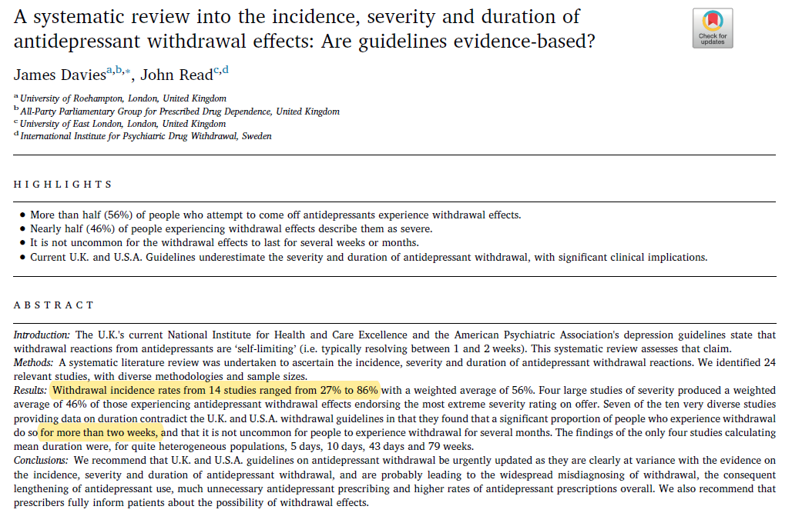
https://doi.org/10.1016/j.addbeh.2018.08.027
Notes:
Since 2018 increasing evidence published

Slide 19
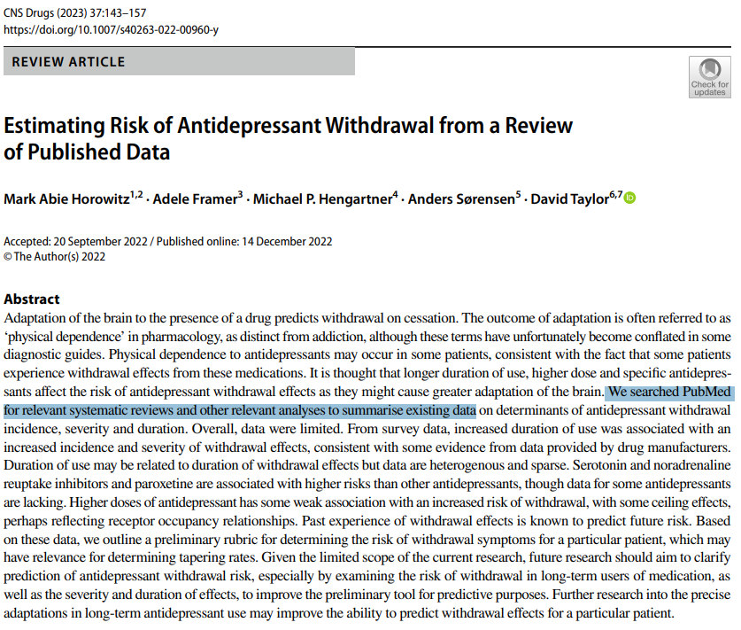
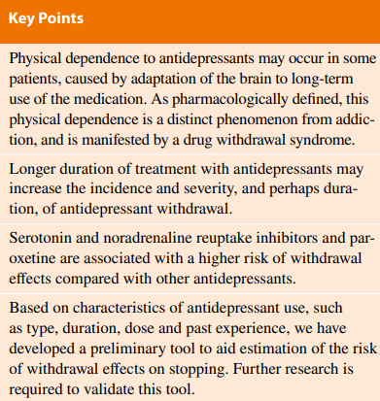
https://link.springer.com/article/10.1007/s40263-022-00960-y
Notes:
The authors comment that data is limited
the authors state:
A 2019 systematic review identified 14 relevant studies from which to calculate the incidence of antidepressant withdrawal symptoms (see paper for ref). The incidence rates ranged from 27 to 86%, with a median of 55% and a weighted average of 56.4%
= Davies J, Read J. A systematic review into the incidence, severity and duration of antidepressant withdrawal efects: are guidelines evidence-based? Addict Behav. 2019;97:111–21.
A potential limitation of this review was that, in addition to RCTs and observational studies, it included three online surveys; critics point out it is possible that surveys may capture a skewed sample of patients motivated to answer the survey because of their experience with more severe withdrawal symptoms than average, and withdrawal symptoms were reported by patients rather than using objective withdrawal questionnaires (see paper for refs). However, the weighted average incidence of withdrawal symptoms was similar in the six RCTs (53.9%) to the five observational studies (52.5%) and the three online surveys (57.1%) (see paper for ref).
Restricting analysis to studies of SSRIs, the most widely used class of antidepressants, discontinuation syndromes occurred with a median rate of 53.6%, and a weighted average of 50.5% (see paper for ref).
However, around half may experience long-lasting and severe symptoms of withdrawal which may subsequently lead to inappropriate long-term use (Horowitz et al, 2023).
Sample was papers on withdrawal symptoms

Slide 20
Evidence for problematic withdrawal
Withdrawal incidence: up to 12% of people on placebo, up to 32-56% of people receiving antidepressants.³⁻⁵
- Not everybody
From practice - lots of people just stop their antidepressant on their own; never renewing prescriptions.⁶
Venlafaxine and paroxetine, are known to be problematic.¹
Newer antidepressants studies choose paroxetine as a comparator²
Many discontinuation studies don’t distinguish between relapse & discontinuation symptoms
Very few studies compare different discontinuation strategies
References
1. Haddad PM. Antidepressant discontinuation syndromes: Clinical relevance, prevention and management. Drug Safety 2001;24(3):183-97
2. Montgomery SA, Kennedy SH, Burrows GD, et al. Absence of discontinuation symptoms with agomelatine and occurrence of discontinuation symptoms with paroxetine: A randomized, double-blind, placebo-controlled discontinuation study. International Clinical Psychopharmacology 2004;19(5):271-80. doi: 10.1097/01.yic.0000137184.64610.c8
3. Jauhar S, Hayes J. The war on antidepressants: What we can, and can't conclude, from the systematic review of antidepressant withdrawal effects by Davies and Read. Addictive Behaviors 2019;97:122-25.
4. Davies J, Read J. A systematic review into the incidence, severity and duration of antidepressant withdrawal effects: Are guidelines evidence-based? Addictive Behaviors 2019;97:111-21.
5. Henssler J, Heinz A, Brandt L, et al. Antidepressant Withdrawal and Rebound Phenomena. Deutsches Arzteblatt International 2019;116(20):355-61.
6. Burton C, Anderson N, Wilde K, et al. Factors associated with duration of new antidepressant treatment: analysis of a large primary care database. British Journal of General Practice 2012;62(595):e104-12.

Slide 21
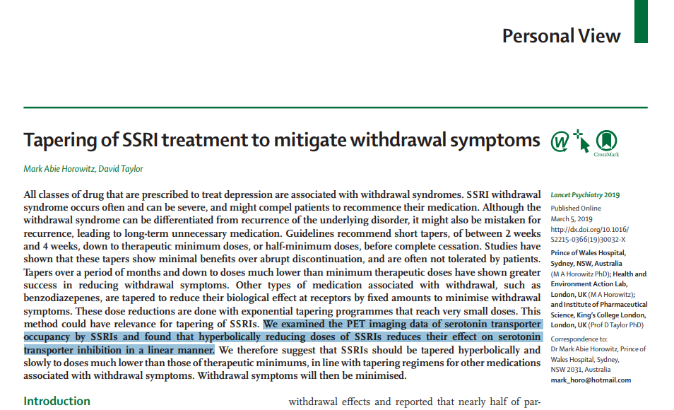
Evidence – Hyperbolic reduction theory
Tapering of SSRI treatment to mitigate withdrawal symptoms - The Lancet Psychiatry
Theoretical perspective - potentially helps to inform discussions and alternative options.
May not be suitable or necessary for everyone as not everybody will experience withdrawals.³⁻⁵

Slide 22
Primary care deprescribing pilot
Rotherham (NHS South Yorkshire ICB) deprescribing pilot:
People on antidepressants for >2 years (without a history of repeat depressive episodes or relapse) = 8,446
Self-referred to service = 692
Eligible to be reviewed = 657
Outcomes:
Stopped taking antidepressants = 405 (62%)
Reduced antidepressant dose = 252 (38%)
Conclusion:
The pilot clinic successfully stopped or reduced antidepressant dose of in 100% of 657 patients
Only 8 reporting adverse effects (1.2%)
Did not create additional work for GP Practices.
NHS England » Optimising personalised care for adults prescribed medicines associated with dependence or withdrawal symptoms: Framework for action for integrated care boards (ICBs) and primary care
Notes:
High users of antidepressants
Pilot programme for supporting people come off antidepressants

Slide 23
Who can stop and who can’t?
Stopping is not difficult for all patients
Harder for long standing antidepressants (years+++)
Venlafaxine and paroxetine particularly causal
Higher doses of SSRIs may be more problematic¹
Vortioxetine can be stopped abruptly ²
More previous episodes & residual symptoms of depression were associated with increased likelihood of relapse³
Yasui-Furukori N, Hashimoto K, Tsuchimine S, et al. Characteristics of escitalopram discontinuation syndrome: a preliminary study. Clin Neuropharmacol 2016;39:125–7. doi:10.1097/ WNF.0000000000000139
Baldwin et al, J Psychopharmacol 2016; 30: 242– 52
Duffy, L., Lewis, G., Marston, L., Kendrick, T., Kessler, D., Moore, M., . . . Lewis, G. (2023). Clinical factors associated with relapse in depression in a sample of UK primary care patients who have been on long-term antidepressant treatment. Psychological Medicine, 1-11. doi:10.1017/S0033291723002659
Notes:
Vortioxetine: * This can be stopped abruptly as there are no clinically relevant withdrawal symptoms over 2/52 (UK SmPC, s = 11, RCT, d/b, p/c, Baldwin et al, J Psychopharmacol 2016; 30: 242– 52; FFT), even with abrupt discontinuation after 6–12 or 24–64 weeks of treatment.

Slide 24
History | Green flags | Red flags
Indication | Life event, bipolar, insomnia, pain | Recurrent depression, OCD
# Previous episodes | One, >1yr ago | Two or more over several years (>5 very red flag)¹
Current dose | Standard or subtherapeutic | Higher than standard
Antidepressant | Tricyclic | Venlafaxine, paroxetine
Side effects | Inhibit lifestyle Attribution testing | Manageable More side effects at start
Current mood | Stable long-term, sleeping well, few residual symptom | Residual symptoms (consider switch), imminent life events
Previous medicine history | Stopped without consequence previously Currently not taking | Never stopped Stopped & deteriorated/ relapsed 3-12 months later
# Prior antidep | Only one | Several
Other medicines? | No potential significant interactions | Significant potential interactions
Notes:
Higher doses hint at greater severity
Attribution testing
Duffy: Results: Primary outcome was available for 468 participants. Time to relapse in those with more than five previous episodes of depression was shorter, hazard ratio (HR) 1.84 (95% confidence interval [CI] 1.23-2.75) compared to people with two episodes; HR 1.57 (95% CI 1.01-2.43) after adjustment. The residual symptoms of depression at baseline were also associated with increased relapse: HR 1.05 (95% CI 1.01-1.09) and HR 1.06 (95% CI 1.01-1.12) in the adjusted model. There was evidence of reduced rate of relapse in older age of onset group: HR 0.86 (95% CI 0.78-0.95); HR attenuated after adjustment HR 0.91 (95% CI 0.81-1.02). There was no evidence of an association between duration of the current episode and residual anxiety symptoms with relapse.
Conclusions: The number of previous episodes and residual symptoms of depression were associated with increased likelihood of relapse. These factors could inform joint decision making when patients are considering tapering off maintenance antidepressant treatment or considering other treatments to prevent relapse.

Slide 25
Practicalities
Clinician barriers¹ – discuss with the patient
Discuss options with patient when planning to reduce & stop²
Time to do it - when?
Flexibility
How to seek support – if needed
Medicines formulations - Lots of issues about the practicalities of these: availability, many are unlicensed; costly….
Bowers HM Williams SJ, Geraghty AWA,et al. Helping people discontinue long-term antidepressants: views of health professionals in UK primary care. BMJ Open 2019;9:e027837. doi:10.1136/bmjopen-2018-027837
https://www.nice.org.uk/guidance/ng215

Slide 26
Planning
Agree a speed but be flexible, the slower the better:
“As you go lower, go slower”
Higher doses for longer times need much slower (may have been more seriously depressed)
Drop to standard dose and stabilise first, if necessary, then move on to further reductions
Settle between reductions
10% drop each time, hyperbolic reduction
Notes:
It’s all about… timing
Stopping medicines can leave you very fragile or vulnerable to stresses
Coming off can destabilise you
Beware of stopping antidepressants before time
Hyperbolic tapering - Dose reduction in unequal steps which become smaller and smaller as the dose gets lower and lower; 28 day roll
A tapering strip consists of antidepressant or other medication, packaged in a 28-day roll of daily pouches, each with the same or slightly lower dose than the one before. Previous studies demonstrated 70% real-world effectiveness of tapering strips.

Slide 27
Deprescribing Antipsychotics? - don’t stop!
Open, parallel-group, randomised trial
Primary outcome: social functioning at 24 months
Principal secondary outcome: severe relapse, defined as admission
Table 2 | Dose reduction (n=126) | Maintenance (n=127) | Treatment effect (95% CI)
Severe relapse at any time to the end of the trial | 34 (27%) | 17 (13%) | OR 2·39 (1·25 to 4·56)
Non-severe relapse at any time during 24 months | 20 (16%) | 11 (9%) | OR 1·99 (0·91 to 4·35)
Any relapse at any time during 24 months | 52 (41%) | 28 (22%) | OR 2·48 (1·43 to 4·30)
“Antipsychotic reduction increased the risk of relapse compared with continuing maintenance treatment, although most people did not relapse; 32 (25%) people from the reduction group had a severe relapse compared with 17 (13%) from the maintenance group,…..
Moncrieff J et al. Antipsychotic dose reduction and discontinuation versus maintenance treatment in people with schizophrenia and other recurrent psychotic disorders in England (the RADAR trial): an open, parallel-group, randomised controlled trial - The Lancet Psychiatry 2023
Notes:
Participants randomly assigned to maintenance treatment were requested not to make major reductions in the dose of their antipsychotic medication during the trial period, but minor reductions to address adverse effects were permitted.
The researchers concluded: “Compared to continuing with maintenance treatment, gradual, monitored, reduction of antipsychotic medication over a period of months does not improve social functioning in the medium term and increases the risk of relapse in people with recurrent psychotic disorders or a first episode of psychosis”.

Slide 28
Patient Advice:
Stopping medication
“Aim to foster a collaborative, trusting and supportive relationship…”
Don’t stop suddenly
Discuss it with your prescriber
Discuss it with someone you trust
[If possible seek help from a support group]

Slide 29
Patient Advice when stopping
Unpleasant withdrawal effects - set expectations
Physical withdrawal effects
May be there for a long time after the medicine is stopped (but less common)
Risks to your mental health
symptoms might come back (relapse)
especially if you have been taking them a long time

Slide 30
Approaches to stopping psychotropic medication
How to do it
Apply your knowledge of:
pharmacology
pharmacokinetics
Go slow:
avoids withdrawal effects
don’t rush

Slide 31
Stopping
benzodiazepines and Z-drugs
Ashton’s manual: https://www.benzo.org.uk/manual/index.htm
Dose equivalent table: https://www.benzo.org.uk/manual/bzcha01.htm
Other Resources
https://www.sps.nhs.uk/articles/choosing-equivalent-doses-of-oral-benzodiazepines/
https://www.gov.uk/government/publications/drug-misuse-and-dependence-uk-guidelines-on-clinical-management

Slide 32
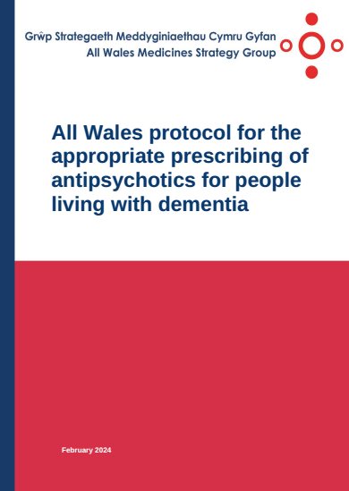
Stopping antipsychotics
in dementia
https://awttc.nhs.wales/medicines-optimisation-and-safety/medicines-optimisation-guidance-resources-and-data/prescribing-guidance/all-wales-protocol-for-the-appropriate-prescribing-of-antipsychotics-for-people-living-with-dementia/

Slide 33
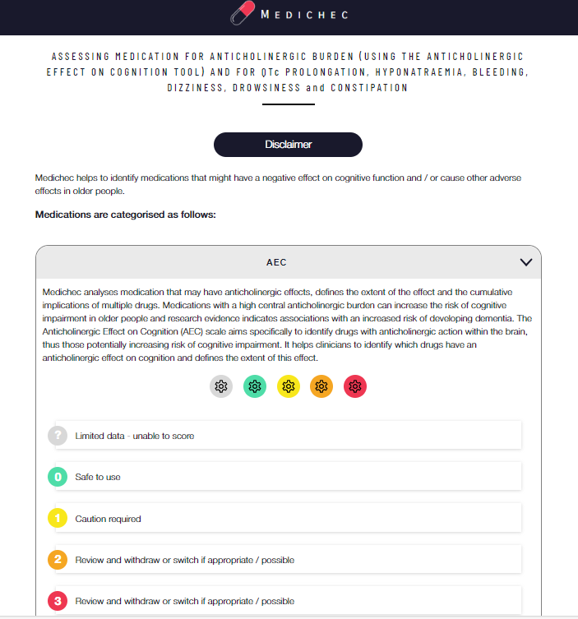
Anti-
Cholinergic
Burden
(ACB) Scales
https://medichec.com/
or via SPS: https://www.sps.nhs.uk/articles/using-tools-to-support-medication-review/

Slide 34
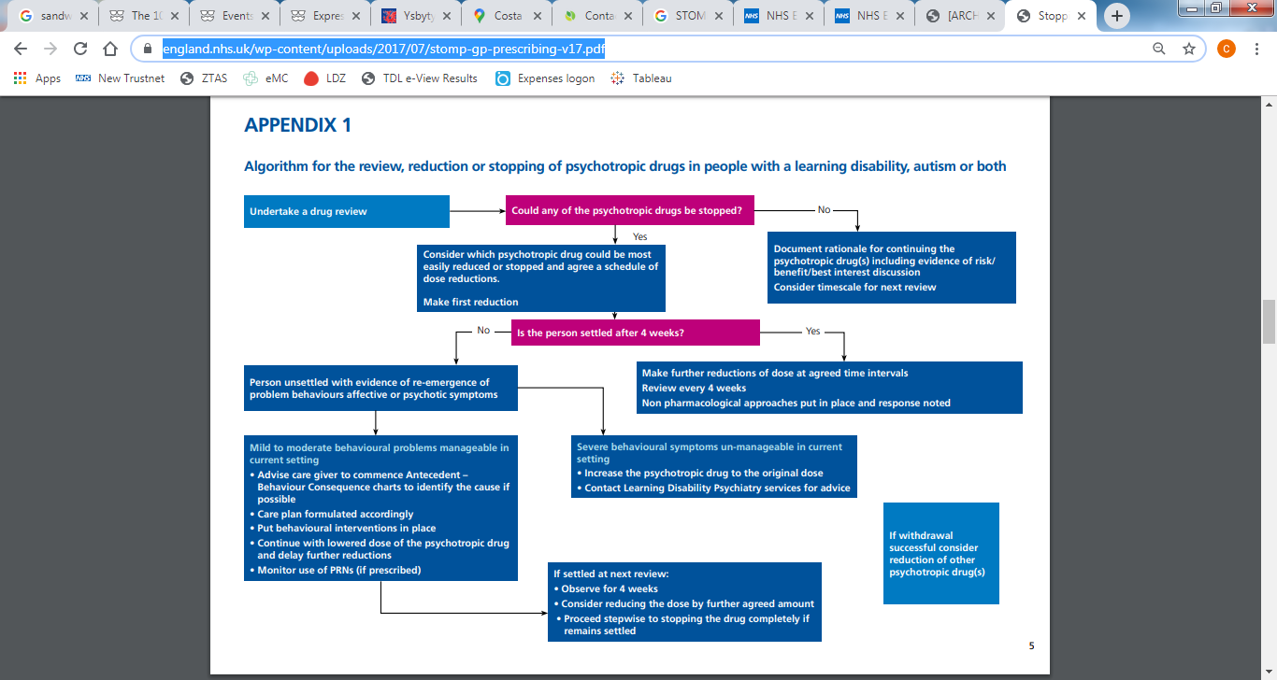
STOMP (2016)

Slide 35
STAMP (2018)
Supporting Treatment and Appropriate Medication in Paediatrics

Slide 36
Summary
Deprescribing is part of prescribing
Optimising medicines use
Applies to NMPs and Drs alike
Know your medicines - how they work
There’s lots of supporting resources for deprescribing
DO de-prescribe
Go slowly, there’s no rush.

Slide 37
Tools and resources
https://www.england.nhs.uk/long-read/national-medicines-optimisation-opportunities-2023-24/
NICE Meds Associated with dependence Overview | Medicines associated with dependence or withdrawal symptoms: safe prescribing and withdrawal management for adults | Guidance | NICE
RCPsych Stopping antidepressants | Royal College of Psychiatrists (rcpsych.ac.uk)
NHSE NHS England » Optimising personalised care for adults prescribed medicines associated with dependence or withdrawal symptoms: Framework for action for integrated care boards (ICBs) and primary care
SPS collated resources: https://www.sps.nhs.uk/articles/deprescribing-of-antidepressants-for-depression-and-anxiety/ and https://www.sps.nhs.uk/articles/using-tools-to-support-medication-review/
Maudsley deprescribing book (Feb 2024)

