Slide 1
Improving Standards of Safety Incident Responses through Accreditation 19th June 2024
Dr Elena Baker-Glenn, Clinical Director, ELFT and Chair of SIRAN Accreditation Committee
SIRAN@rcpsych.ac.uk

Slide 2
Overview
Background of RCPsych work in patient safety
Safety Incident Response Accreditation Network
Our standards
Findings from peer reviews
Patient safety workshops
SIRAN@rcpsych.ac.uk

Slide 3
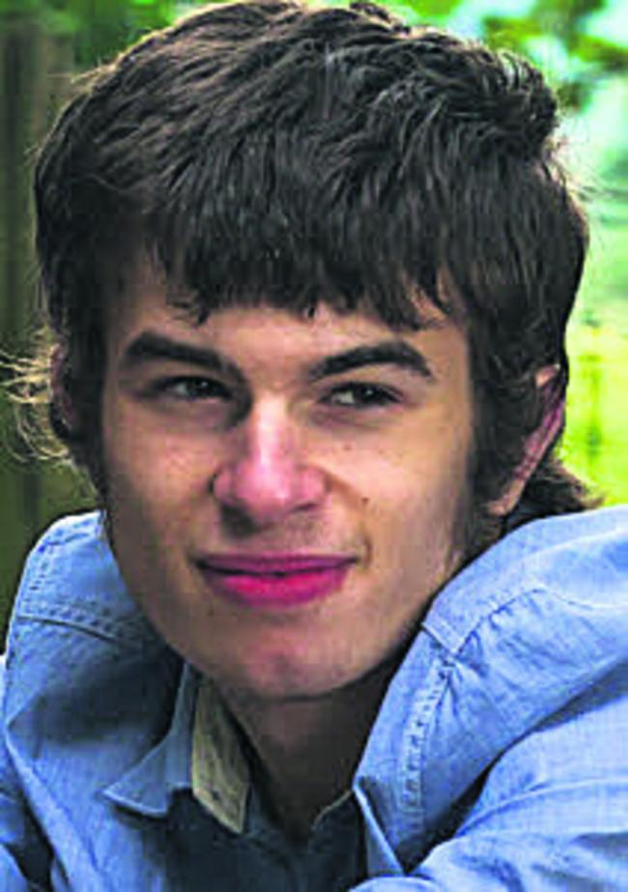
SIRAN@rcpsych.ac.uk

Slide 4
Mortality Review Programmes
National Clinical Outcome Review Programmes
Child health clinical outcome review programme 2006
Learning disability mortality review programme 2015
Maternal, newborn and infant outcome review programme 1952
Medical and surgical outcome review programme 1988
Mental health outcome review programme (suicide and homicide) 1996
National child mortality database (NCMD) 2019
RCP national mortality case record review programme 2016– 2019
SIRAN@rcpsych.ac.uk

Slide 5
PSIRF
Replace Serious Incident Framework 2015
Across all organisations in England
Not applying to devolved nations
Compassionate engagement and involvement of those affected by patient safety incidents
Application of a range of system-based approaches to learning from patient safety incidents
Considered and proportionate responses to patient safety incidents
Supportive oversight focused on strengthening response system functioning and improvement
SIRAN@rcpsych.ac.uk

Slide 6
Scene setting for SIRAN
2016 – Need for principles for investigation was recognised
2017 – early pilot with 3 Trusts to review investigation process 2018 – Principles document was published in consultation with IRS and other key stakeholders
2018 – 10 Trusts plus Scotland completed self audit against standards – standards revised
2018 – Peer audit against standards – standards revised
2019 – Peer visits piloted – standards revised
SIRAN@rcpsych.ac.uk

Slide 7
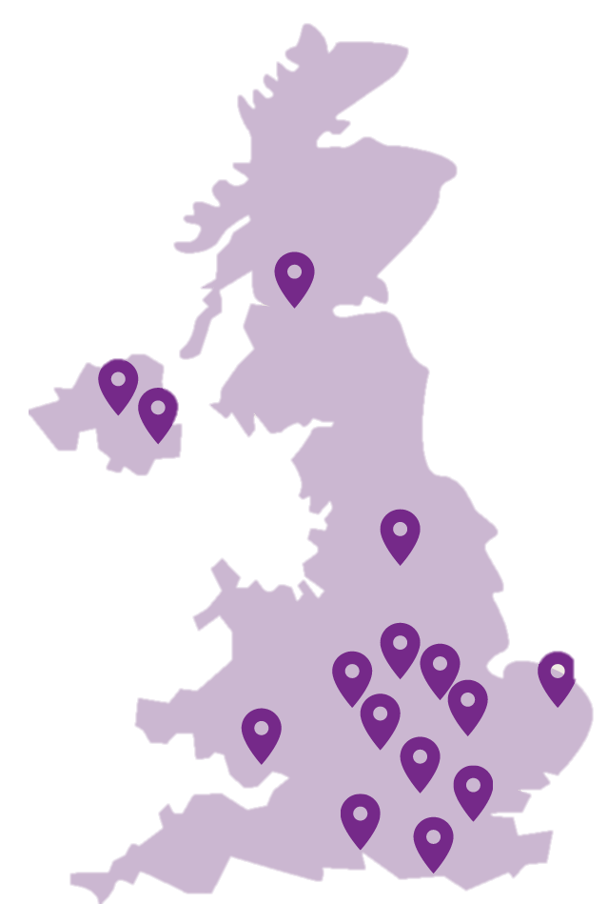
The Safety Incident Response Accreditation Network
Launched in January 2020
Designed to support organisations carry out high quality serious incident reviews
Accreditation network using a peer review model
17 members* across all devolved nations
*See our website for a list of all our members.
SIRAN@rcpsych.ac.uk

Slide 8
From SI to Safety
SIRAN@rcpsych.ac.uk

Slide 9
SIRAN standards
Developed in consultation with a range of stakeholders
Revised every two years to reflect changes in good practice and legislation i.e. PSIRF
59 standards, across 5 different domains
Recent key changes:
Staff support
Family support (including FLO’s)
Learning lessons
Available on our website

Slide 10
Standard domains
Domain
Organisational processes
Incident review processes
Reports
Involvement of clinical staff
Involvement of patients and families

Slide 11
SIRAN Review Cycle
Accreditation Process
Join as Member
Self-review
Peer Review
Local Report
Presentation to AC
Accreditation Decision
Notes:
Holly
I’ll be talking through the accreditation process very briefly.
Once your organization joins as a member, you will be contacted by a member of our team to begin your self-review. This is a self-assessment process where you will consider how you are meeting or not meeting the SIRAN standards. You’ll also be asked to upload some documentation including 10 SI reports and it’s important to ensure this is all anonymized.
You’ll then have a peer-review visit which will be online, using MS Teams in most cases. This review day will be attended by a peer-review team and consists of professionals working in a similar field and are also from SIRAN member organisations. The peer-review is intended to be a supportive process to share learning, to highlight what you are doing well and where there might be room for improvement.
Findings from your peer-review will be compiled into a comprehensive local report, outlining any areas fori mprovement and what the recommendations are.
Your local report and any additional evidence you’ve provided will be presented to an AC (consisting of stakeholders/professionals in the field that guide and provide decisions on accreditation). Finally, there will be an accreditation decision and this marks the end of the review cycle.

Slide 12
Typical peer review team
Review teams are made up of a representative from SIRAN, staff from other organisations and a carer representative (in most cases).
Professionals
Carer Representative
QN Rep
Host Service

Slide 13
Findings from our reviews
Notes:
Discussing some findings from our peer reviews so far, which will be captured in our aggregated report from last year

Slide 14
Aggregated Report (2023)
Highlights from the SIRAN peer reviews
Good practice examples
Commonly unmet standards
Recommendations and QI suggestions
SIRAN@rcpsych.ac.uk
Notes:
Holly
Service challenges:
-Timescales: Organisations struggle to meet agreed timescales for completing the report. In line with standards, we recommend to revise some of the timescales and set realistic expectations that can be met.
-Informing of delays: We also noticed organisations sometimes forget to update staff, patients, and families on the progress of the review. Waiting for the outcome of a review can cause a lot of anxiety to both staff members/ families and patients. As part of our standards we want all services to communicate any delays but also give a reason for them.
-Staff input: Some other standards that have been quite difficult to meet; how staff can review their own contributions to the process. Staff members that were involved in the care of a patient, are often interviewed as part of the review process. But they don’t always see how this is then translated into the report until after it's published. As part of our standards, we want staff members to be able to check their input both for factual accuracy but also having the opportunity to contribute before this is finalised.
-Reports; Organisations don't always consider how review can consider wider learning/ they tend look at it in isolation. If a type of incident is recurring; some have completed thematic reviews to identify wider lessons-learned and introduce mechanisms to prevent these types of incidents in the future.
-Feedback: Org ask feedback from families around the incident itself, however we want them to also ask feedback about review process. This feedback needs to be asked at the right time and form; it can be invaluable in improving the experiences of going through that review process and make it more considerate and family and patient friendly.

Slide 15
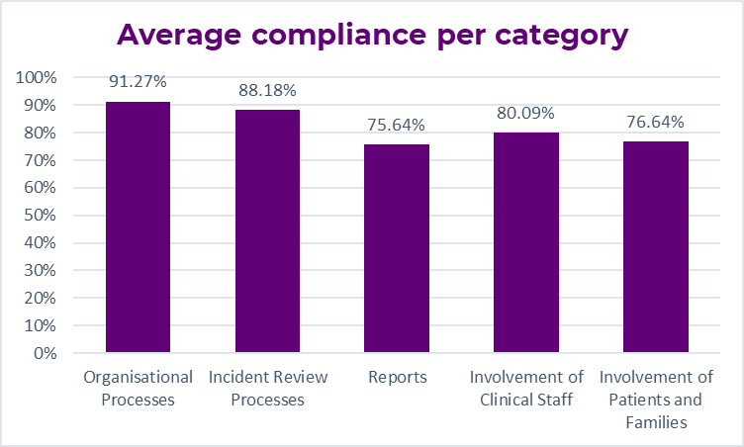
Aggregate report
Notes:
Holly
Context – aggregated report collates all the information we have gathered from peer reviews but pays particular focus on areas of good practice we’ve identified, as well as common challenges and unmet standards. The report can also be used my member organisations to benchmark themselves against others. Last report published 2021.
This slide demonstrates an overall compliance of how organisations met our standards, according to each of the SIRAN standard domains which are indicated at the bottom of the chart.
It is clear from the chart that organisations performed quite well overall across our different domains.
We have found that organisations tend to do really well in meeting the organisational processes standards (covering things like having standardised policies/procedures that they follow)
Some more variation was seen in the categories around reports and involving patients/families. I will be covering some of the specific challenges in each of these categories shortly.

Slide 16
Good practice
Separate team of investigators/ reviewers
Family Liaison Officers
Organisational quality priorities
Pen portrait
SIRAN@rcpsych.ac.uk
Notes:
Holly
Here are some of the good practice examples we have identified over the peer reviews. There are many more included in the full report.
-When organisation conduct reviews; it helps having a separate team of investigators. Organisations have staff that work internally; e.g., clinical team members being given reviews on top of their usual workload. This can be challenging; both in terms of time/expert knowledge around the investigation processes and patient safety. Services that employ a dedicated, independent team of reviewers scored higher across the board. They had the dedicated time and experience to deal with these reviews with the support of clinical experts.
-FLO. This can be a very tough time for families; it's very helpful to have someone in place who has the capacity to communicate in a sensitive manner; they can offer calls, keep the families/patients updated, go through the outcome of the review together. Signpost to other services if more support is needed.
-Quality priorities: In terms of recommendations in reports, we have seen organisations think about how to implement any learning in relation to the organisations quality improvement plan. It has been positive to see QI knowledge being brought into organisations action planning and some organisationss that have done this well have evidenced on their action plan what QI branch or priority it links to.)
Pen portraits. If a patient passes away, organisations gave the opportunity for the family to write some kind words about their loved ones; include a summary of who the person was, what they liked, their hobbies; make the report more personal and humane; and it was a very thoughtful idea that also includes families in a meaningful way.

Slide 17
Challenges
Informing staff, patients and families of progress and delays
Review of input by staff
Lessons learned in reports
Feedback from patients and families
Meeting agreed timescales
SIRAN@rcpsych.ac.uk
Notes:
Holly
Service challenges:
-Timescales: Organisations struggle to meet agreed timescales for completing the report. In line with standards, we recommend to revise some of the timescales and set realistic expectations that can be met.
-Informing of delays: We also noticed organisations sometimes forget to update staff, patients, and families on the progress of the review. Waiting for the outcome of a review can cause a lot of anxiety to both staff members/ families and patients. As part of our standards we want all services to communicate any delays but also give a reason for them.
-Staff input: Some other standards that have been quite difficult to meet; how staff can review their own contributions to the process. Staff members that were involved in the care of a patient, are often interviewed as part of the review process. But they don’t always see how this is then translated into the report until after it's published. As part of our standards, we want staff members to be able to check their input both for factual accuracy but also having the opportunity to contribute before this is finalised.
-Reports; Organisations don't always consider how review can consider wider learning/ they tend look at it in isolation. If a type of incident is recurring; some have completed thematic reviews to identify wider lessons-learned and introduce mechanisms to prevent these types of incidents in the future.
-Feedback: Org ask feedback from families around the incident itself, however we want them to also ask feedback about review process. This feedback needs to be asked at the right time and form; it can be invaluable in improving the experiences of going through that review process and make it more considerate and family and patient friendly.

Slide 18
Membership benefits
Promote quality improvement and share best practice
Help services plan improvements for the future
Build a community of organisations who can learn from one another
Allow services to benchmark their practices against other similar services
Demonstrate the quality of the organisation's processes through accreditation
Encourage a culture of openness and create a model of engagement
Notes:
Holly

Slide 19
Free patient safety workshops
SIRAN are hosting a series of patient safety workshops throughout 2024!
Embedded Patient Safety Partners - Thursday 19th September (14:30-15:30)
Safety Team Structures and Role Composition - Friday 11th October (09:30-10:30)
Staff Involvement and Support - Tuesday 3rd December (10:30-11:30)
Contact us for booking information.
SIRAN@rcpsych.ac.uk

Slide 20
How you can get involved
Membership recruitment is open all year round
Email us for more information about signing up including costs and timeframes
SIRAN@rcpsych.ac.uk
0208 618 4061
Notes:
Holly

Slide 21
Thank you for listening!
SIRAN@rcpsych.ac.uk

