Slide 1
The Parliamentary and Health Service Ombudsman
The Ombudsman’s Complaint Standards
Cameron Kennedy – Liaison and Training Manager
Jo Power - Liaison and Training Officer

Slide 2

Overview
Who we are, what we do
How we investigate complaints
The NHS Complaint Standards
Questions

Slide 3



Who we are
Parliamentary Commissioner Act 1967
Health Service Commissioners Act 1993
18%
82%
Complaints about UK government departments and public organisations
Complaints about the NHS in England

Slide 4

What we do - NHS complaints second and final stage
Under Regulation 14(2)(c) and Regulation 14(2)(d), the local response must tell the complainant of their right to take the complaint to the Ombudsman
The Local Authority Social Services and National Health Service Complaints (England) Regulations 2009

Slide 5


Our numbers – 2022-23
129,346 enquiries received
24,984 complaints were not ready for us
35,662 decisions were made, including:
  27,492 decided after initial checks
  74 cases resolved through mediation
  7,484 decided at primary investigation
  612 decided after detailed investigation

Slide 6
Recommendations in 2022-23
We recommended 361 apologies | We made 298 service improvement recommendations
We recommended 98 other actions to put things right | Financial remedy recommendations totalled £401,847

Slide 7

The complaint journey
When we first receive a complaint
We check that:
  It’s about an organisation and a matter we can investigate
  It has finished the organisation’s complaint procedure

Slide 8

The complaint journey
Primary investigation
Has the complaint been made within a year of the person knowing about the issues?
Is there an alternative legal remedy?
Is another organisation better suited to deal with the complaint?

Slide 9
The complaint journey
Primary investigation – the final questions
Does it look like the organisation may have made a mistake or given a poor service?
Does it look like the mistake or poor service may have had an impact?
Does it look like there is more that needs to be done to put things right?

Slide 10

The complaint journey
Can we resolve the complaint now without the need for an investigation?
Would the complaint be suitable for dispute resolution?
https://www.ombudsman.org.uk/making-complaint/how-we-deal-complaints/dispute-resolution

Slide 11

The complaint journey
Detailed investigation
Proposal to investigate - early opportunity to tell us what lay behind clinical decision making
Gathering the evidence
- speak to both sides
- clinical records
- CCTV, phone records
  - witness statements, visits, interviews

Slide 12

Our casework process - investigation
Our approach
We look to see if what happened was in keeping with relevant regulations, standards, policies and published guidance.
Our decision
If it wasn’t, we look to see how significant the shortfall is and what impact it has had and, if it has caused hardship or injustice, has that already been remedied by the organisation.

Slide 13

The NHS
Complaint Standards

Slide 14

Research found three core issues:
No consistency
No core training/support
Complaints not valued

Slide 15
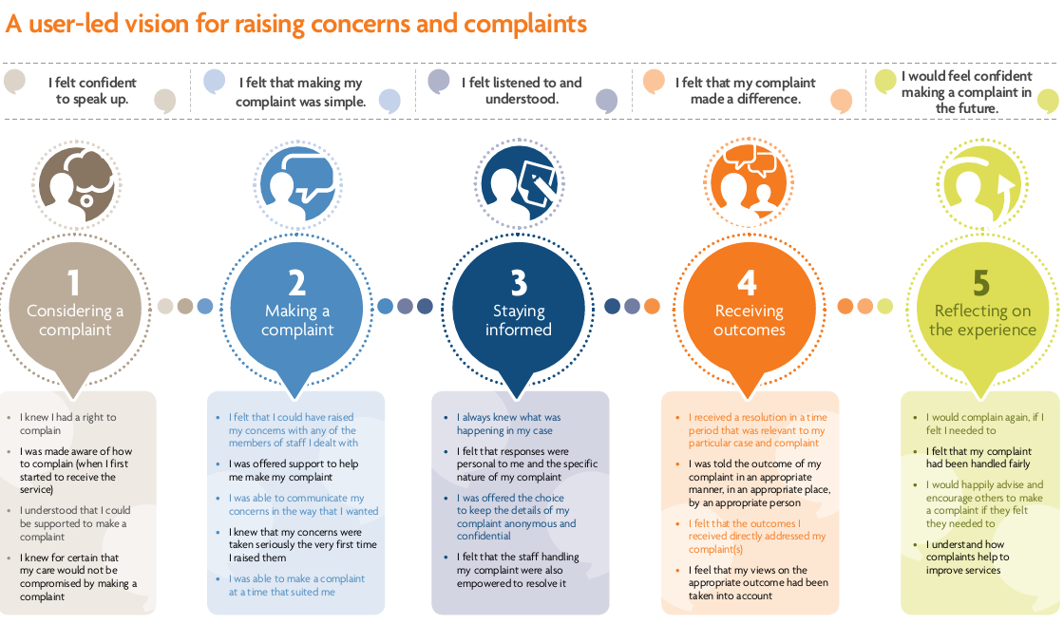
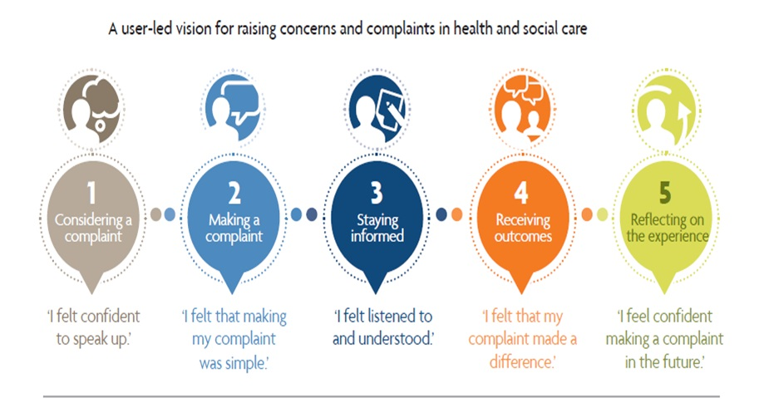
My Expectations

Slide 16



Slide 17

Three Steps
How to work with your team and resolve complaints early where you can
If needed, how to carry out a full and fair investigation
If something has gone wrong, how to put things right and ensure learning is captured, embedded and services improve

Slide 18

How will this help?
One set of Standards and one procedure for all of the NHS to follow so everyone is clear
Focus on working together and supporting colleagues to resolve complaints as they arise, saving time and resources
Focus on learning and improving services for everyone

Slide 19
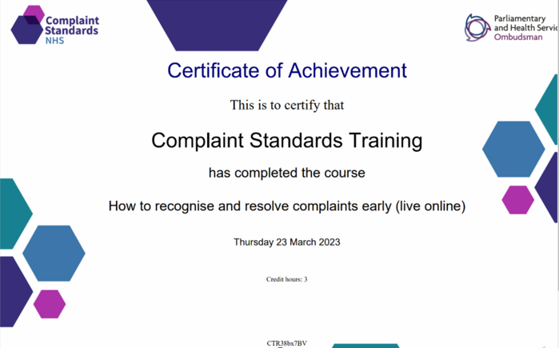
Free Complaint Standards training
CPD certified
Ombudsman approved

Slide 20
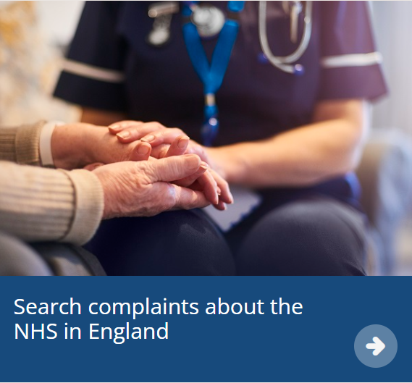
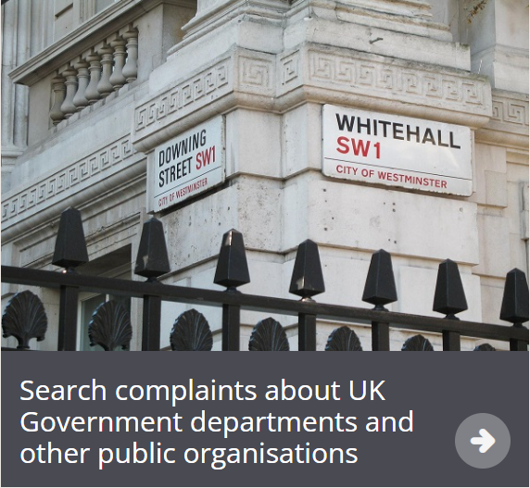
Embedding the Standards in our casework

Slide 21

Casework update
We are embedding the Complaint Standards into all of our casework
This is a staggered roll out and we have rolled out to all casework teams with three specialist teams remaining
Standards and MCHP taking over as main guidance for complaint handling

Slide 22
Casework update
We are using the Standards as a reflective guide for good practice in complaints handling, rather than a stringent ‘rulebook’
We are referring to the Standards in an advisory way, particularly referring to them in any recommendations we may make on improving complaint handling

Slide 23
Casework update
We will continue to work with stakeholders to determine how PHSO will report on progress in embedding the Complaint Standards ensuring we highlight best practice alongside reporting on broad themes we have seen on complaints handling through our casework.

Slide 24
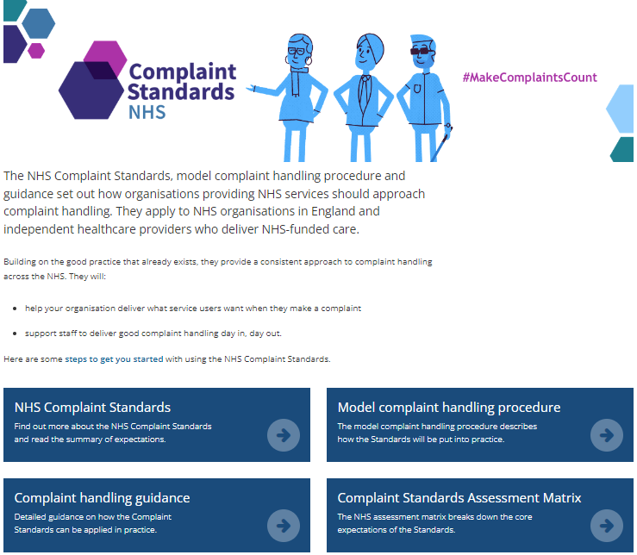
You can find the procedures and guidance on our website.
www.ombudsman.org.uk/complaint-standards

Slide 25
Community of practice
Share experiences with other NHS organisations
To join, email Liaisonmanagers@ombudsman.org.uk

Slide 26




Thank you
Website
www.ombudsman.org.uk
@PHSOmbudsman
Helpline
0345 015 4033
8.30 - 5.00 Monday to Thursday
8:30 –12:00 Friday
Parliamentary and Health Service Ombudsman
Email
liaisonmanagers@ombudsman.org.uk
Radio Ombudsman Podcast

