Slide 1
Integration of Knowledge, Improvement and Research Services.
Case study: The Academy of Research and Improvement.
Dr Colin Barnes Head of Improvement

Slide 2
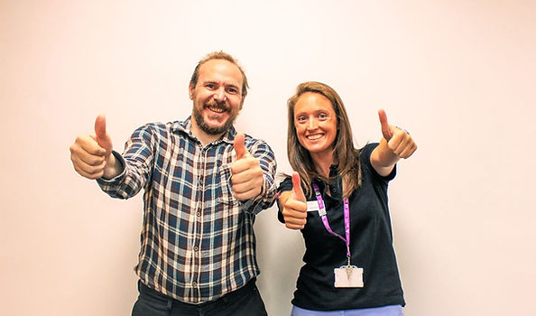
What I will cover today
Introduction to the Academy of Research and Improvement
How integration provides for topic and staff development
The range of workstreams we offer and examples of how they connect
The importance of patient and public involvement
Our networks
The researcher development programme and pathway
The essential components of our way of working

Slide 3
Context
Solent NHS Trust. A community trust serving Portsmouth and Southampton with some services in Basingstoke and the Isle of Wight. Employing 4,500 staff. Adults and children’s community services plus sexual health, mental health, GP and dental services.
From 1st April we are merging with Southern Health and the community services from the Isle of Wight leading to a combined staff of approx. 12,000 providing all community services in Hampshire.
My background: Adult Speech and Language Therapist for 28 years with clinical and academic specialism in dementia care. PhD in 2016. Continuing academic interests. Working as the Head of Improvement in the Academy for the last 6 years.
Notes:
A bit like national audit benchmarking – compare the context

Slide 4
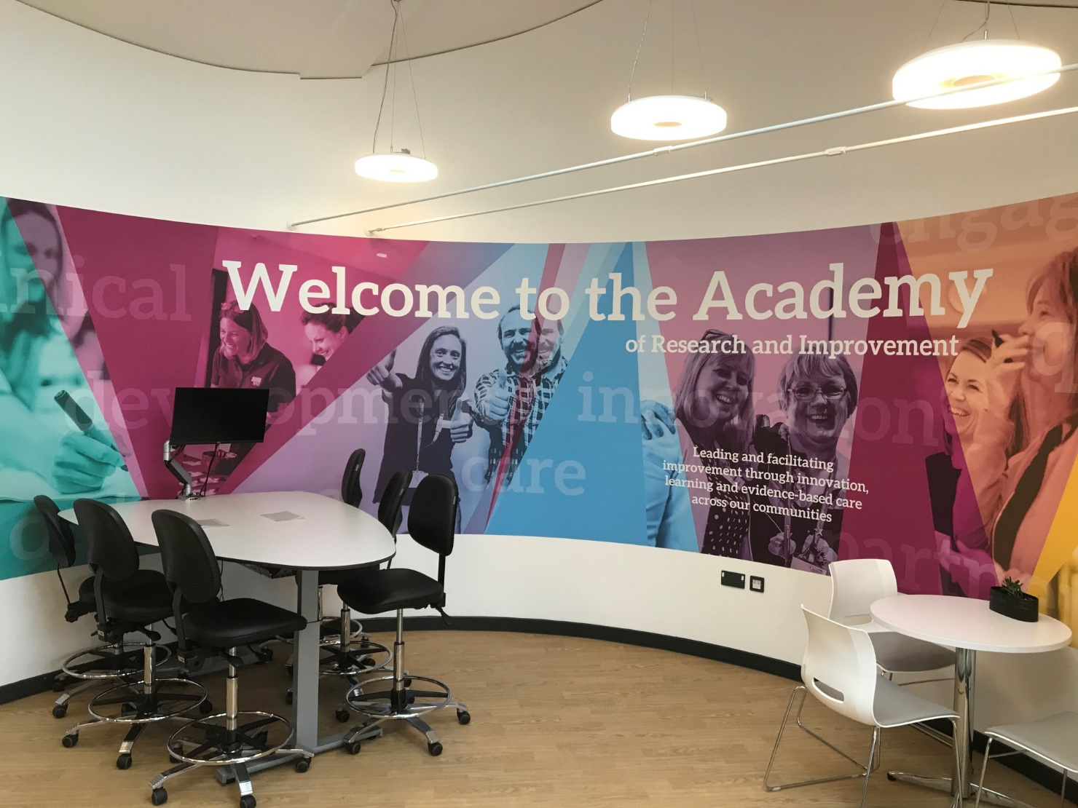
The Academy of Research and Improvement
A Solent NHS trust central team.
Academy
Focus on excellence and learning. Physical as well a virtual space (website, intranet, virtual workshops, social media).
Research
We are one of the leading community trusts for research delivery recruitment numbers and complexity. NIHR portfolio and clinical academics involved in local research. Research and researcher development as well as research delivery.
Improvement
Bringing together Clinical Audit, Service Evaluation, Quality Improvement and NICE into one team with a focus on improvement, impact and learning (the “so what”). We also provide external evaluations.
Patient Engagement
Engaging and involving patients and public representatives in all of our work, in particular with our Side-by-Side network.
Notes:
A brand – an entity to hang things on. Physical space, name, place, uniform, colour code, recognisable material.

Slide 5
What we do
Library services
People Participation and co-production
Clinical Audit
Service Evaluation
External Evaluation Hub including peer researcher programme
Quality Improvement
Research development and delivery
Innovation - Solent NHS Dragons Den
Welcome to the Academy of Research and Improvement (solent.nhs.uk)

Slide 6
Strategy

Slide 7
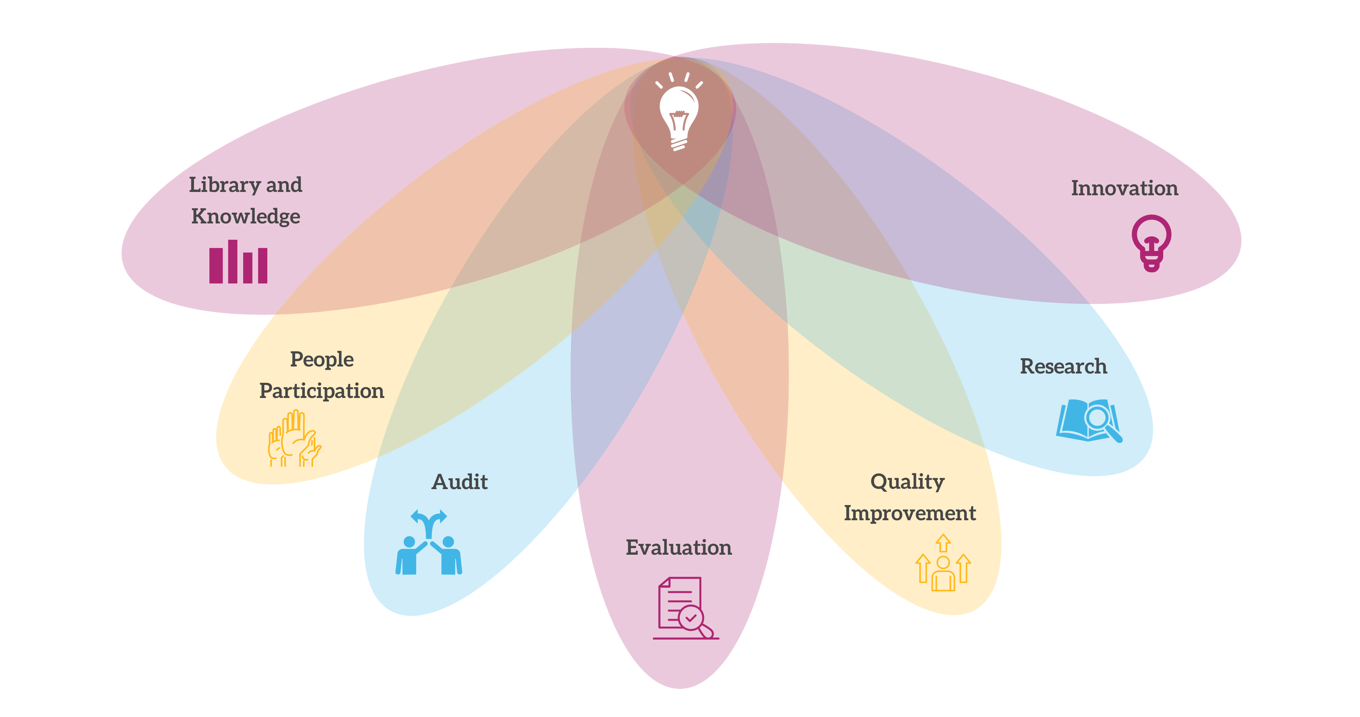
What We Do
Notes:
At the academy are services are very much integrated, many of our services cross over, for example there may be learning coming out of an audit that can become a QI initiative
Library & Knowledge – what is already known
People participation – how do we involves patients in everything we do
Audit – what are we currently doing
Evaluation – what difference does it make, what do people want
Quality Improvement – how do we make things better
Research – What is new
Innovation – dragons den, supporting people

Slide 8
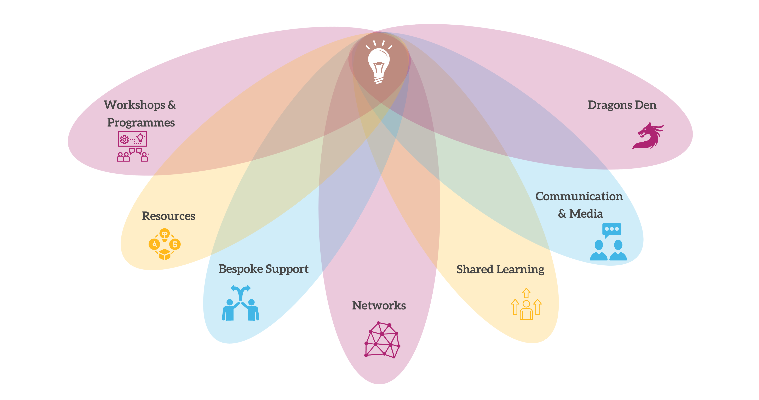
How we do this
Notes:
Researcher development programme
QI practitioner, foundation, HWL’s, Green
Qi Leaders and academics
Website, can find all resources and links to useful websites
Have a research or QI idea, then please contact us

Slide 9
Integration
We sit together and regularly meet together with away days including our Side-by-Side group
Staff within the Academy can represent each other's specialities, many have dual roles
Topics can develop from evidence right through to new research (and be better informed by audit, evaluation and QI on the way)
Staff within the trust can develop their skills across the full range of these activities providing for topic, service, team and career development
We also work closely with other corporate teams to ensure our work is connected
This also enables feasibility for delivery and development as we have a wider group of staff working “on the ground” who know what is possible.

Slide 10
Networks
Are essential
We are decentralised – every service line has a lead and their own network for all our workstreams
We meet together to plan and include patients in this, co-producing these sessions
QI Leaders network
Research Active network
ACP and Consultant practitioners
Preceptees
Friends of the Academy
We work closely with other corporate services

Slide 11
Communications
Comms and admin are essential members of the team – often present during our workstream activities
Good communications and marketing extend our reach
Web design skills take you beyond fixed templates
Social media including Facebook, X, LinkedIn, TikTok and blogs
Friends of the Academy and subgroups for targeted emails
Communications plans for campaigns and events

Slide 12
Knowledge Service
The starting point – what is known, what is missing, how can research be improved
Integrated librarian and knowledge service as part of the Academy team
Digital service supported by Hampshire wide network of libraries
Knowledge specialist present at many of our face-to-face programmes helping people identify topics and search terms
Evidence searches and summaries worked on together
Corporate as well as research and improvement evidence
Range of workshops as well as individual support
Academy team trained on library use

Slide 13
Evaluation Maturity
Evaluation programme supported by a range of workshops
Approx 50 internal service evaluations conducted annually
Local ethical approval utilising proportionate informed consent – experience leads to precedents and confidence in accepting risk
External evaluation hub providing support and skills in rapid evaluation
Experience of conducting system wide and third-party evaluations
Range of resources including “how to guides and videos”

Slide 14
Active Sharing and Learning
Something for everyone
Not just passive listening
Midday learning
Celebration events
Social media and blogs
Summaries and posters
Videos and infographics
Conferences and unconferences

Slide 15
Patient and Public involvement team

Slide 16
Workshop programme
In addition to and planned to compliment programme days for QI, co-production and researcher development
Supplemented by NHS Elect programme
Over 100 sessions per annum reaching over 500 people
Topics include
Intro to evaluation
Intro to surveys
Intro to interviewing and focus groups
Outcome measures
Publication including writing days
Research methods
Social media
Research careers
Journal clubs
Open to all
But some workshops tailored to specific groups e.g. ACPs writing at masters level

Slide 17
Researcher Development Programme
Started in 2022 with 8 people, repeated in 2023 with 16 people
2024 currently running at two venues for 38 people
Timed to coincide with regional ARC internships then NIHR PCAF applications
3 days training with a range of Academy team members plus support and workshops between
PADLET used for materials and to keep us informed who is doing what

Slide 18
Research Careers
Researcher development programme is great, but we need to provide a career structure with a range of options including clinical academic roles
Internships local, regional and national
Go and see fund
Drop-ins and individual coaching
Support with internship and grant applications
Timely sharing of opportunities
Advice from across the Academy team “who knows best”
Networking meetings and collaboration with local universities

Slide 19
Key components of the Academy Model
Strength in numbers…..
Provides
Greater reach within and outside the organisation
Greater budget for support services
Opportunity to advocate for each other
Staff development within the team
Wide range of connected support and training activities
Development of initiatives from evidence to research
Networks that support collaboration and reach across services
Career structure for staff
Better informed applications for research internships, fellowships and grants
Improved staff retention

Slide 20
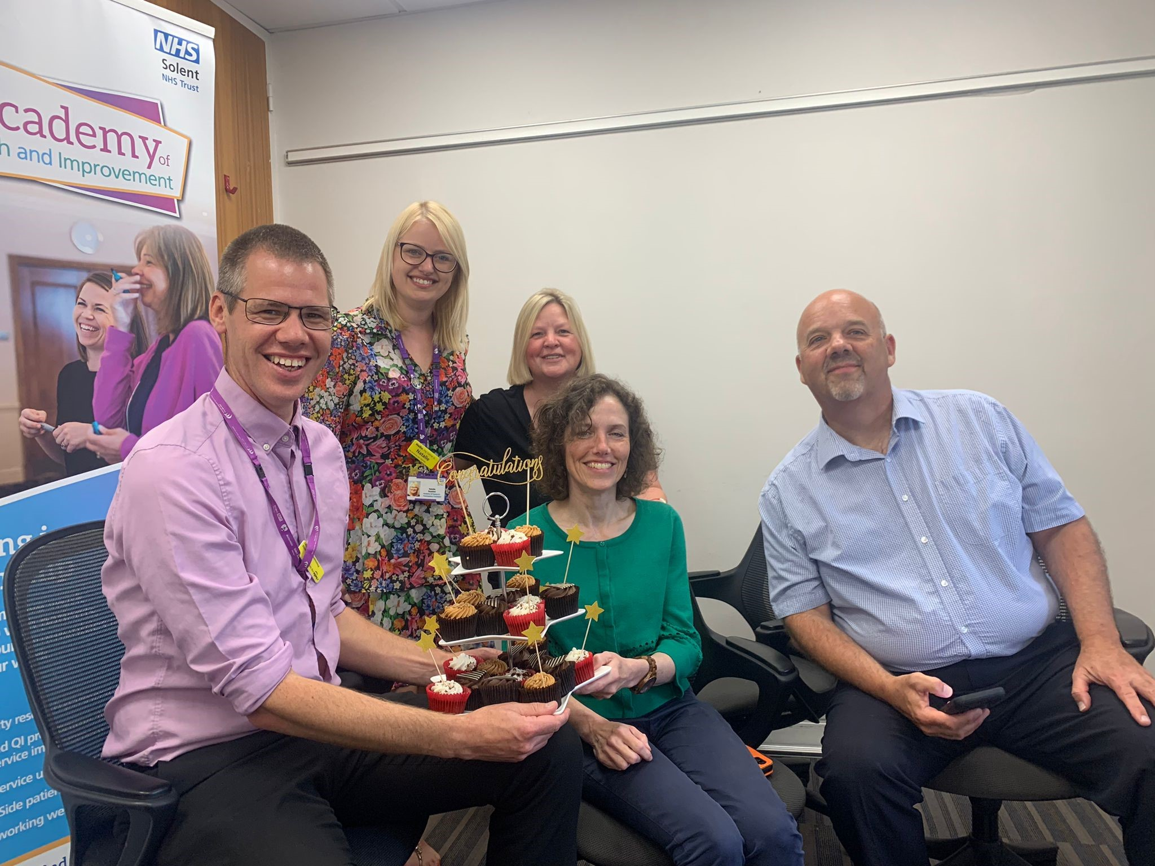
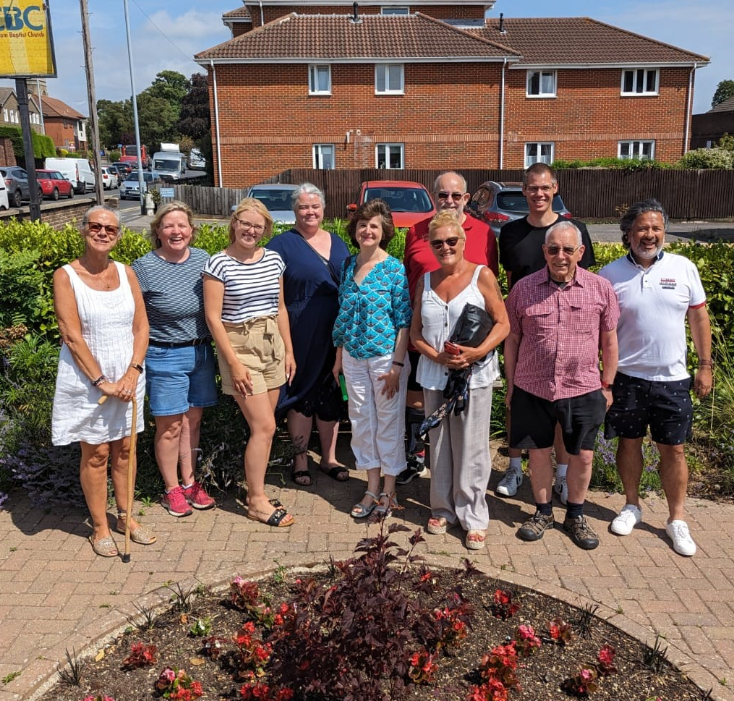
Key components of the Academy Model
Patient and public involvement and co-production
Takes time to establish
Makes sure we are improving what is important to them
Aids accessibility and feasibility
Brings in skills from other life experience
Just makes sense

