Slide 1
An Eating Disorder Doesn’t Just Disappear In Pregnancy
Hope Virgo
Author and Founder of #DumpTheScales

Slide 2
Has Eating Disorder Culture been Normalised in perinatal services?
Normalising the decision to diet after baby’s are born
Normalising talking about calories needed
Labelling of foods as good and bad
Complimenting baby bump size

Slide 3
My Story…

Slide 4
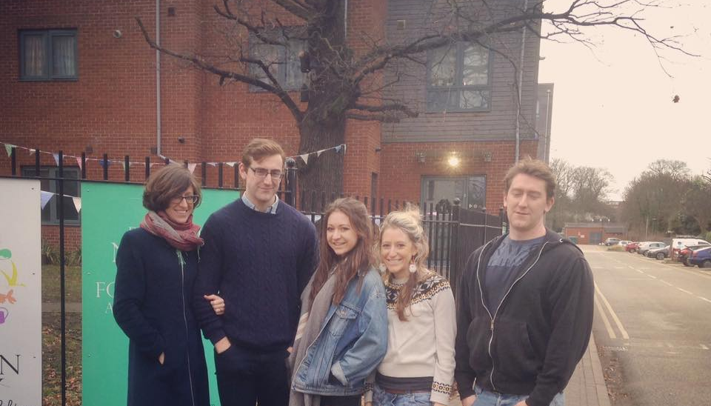
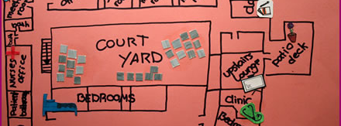
Notes:
Start of story
Born on 8 May 1990
Didn’t have a very hard upbringing – but I did always struggle with emotions
Mum looked at me and what get this cold hearted girl with no emotion staring back
I was one of 5
Messy family life
Sexual Abuse when I was 12
Quite rebellious throughout my teens
My way of coping was to stop eating and to exercise
This gave me value – made me feel something whilst at the same time helping me to switch off from everything that was going on around me.

Slide 5
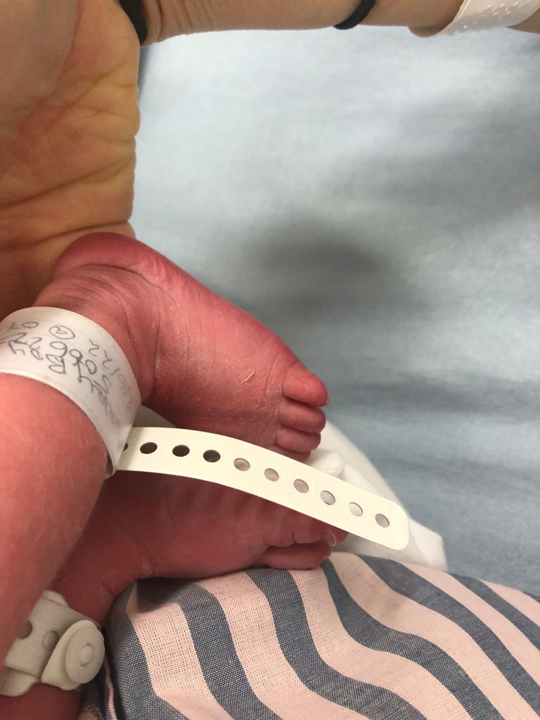
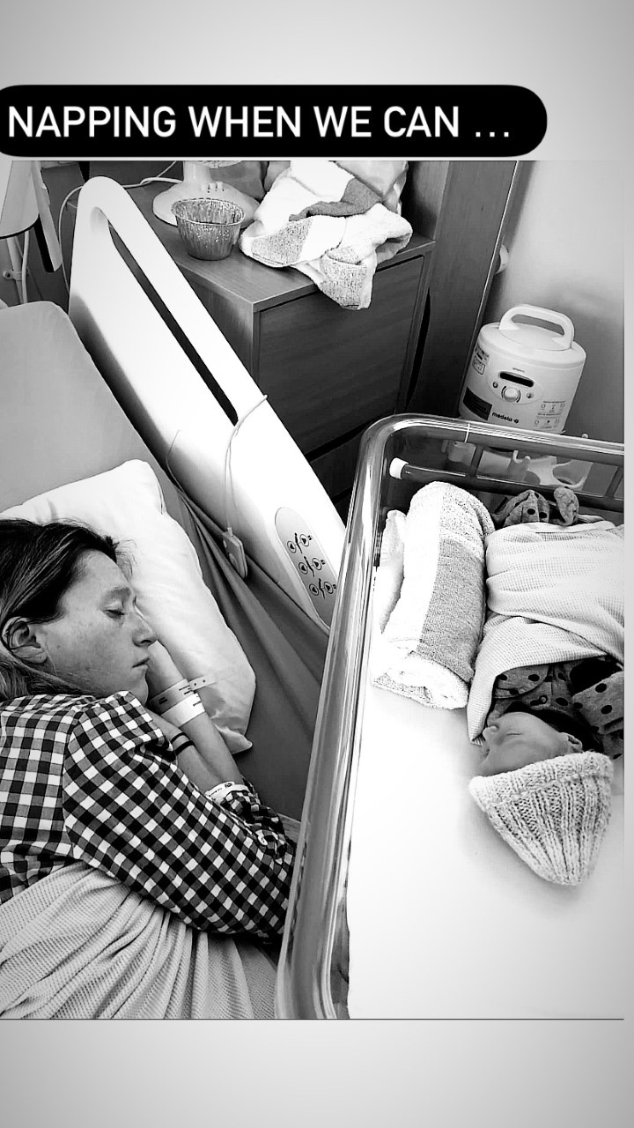
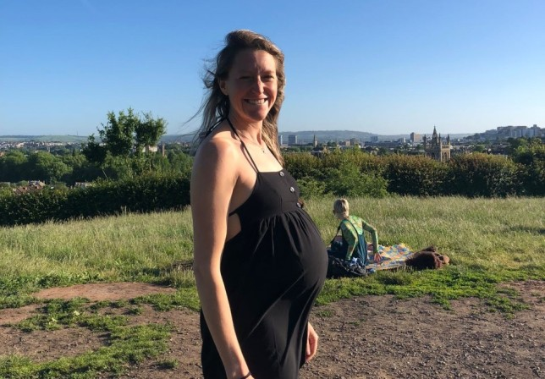
Aged 32, no period… but pregnant!

Slide 6
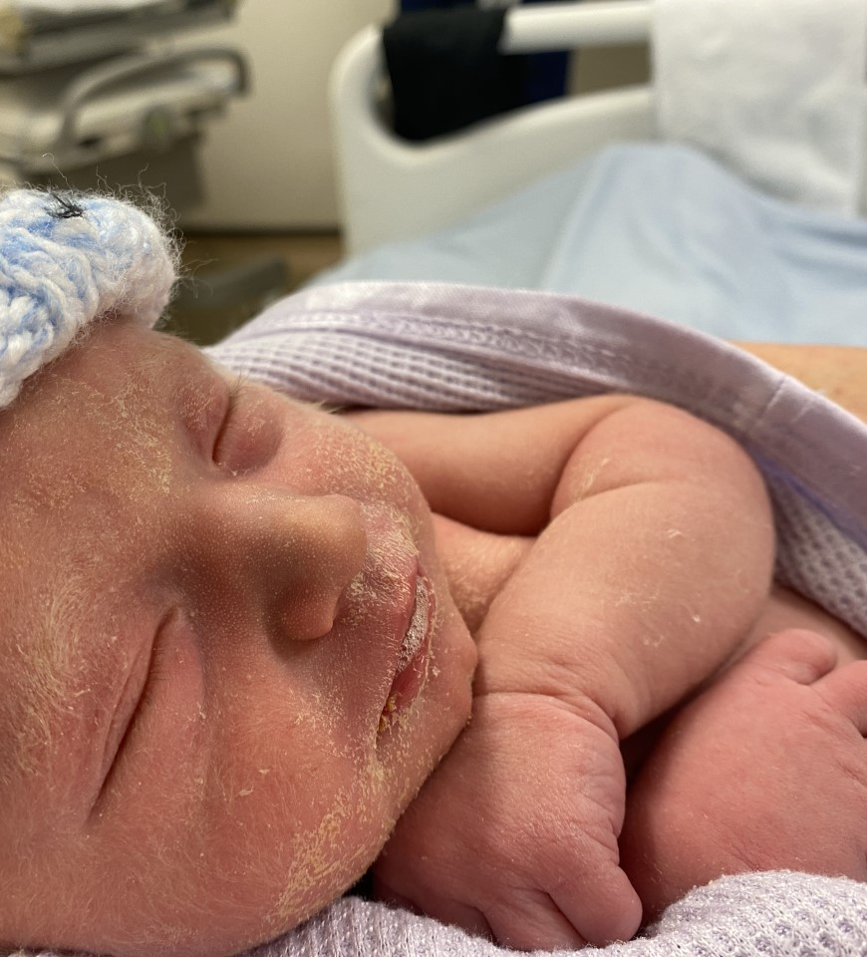
Pregnancy and post natal challenges
During:
Issues with baby’s growth
Concerns around eating and exercise
Body Image and Body Changes
After:
Managing exercise and not being able to go out
Breast feeding
Feeling uncertain and trapped
Body Image and Body Changes
Baby Weaning
Post birth perinatal team judge mood on how much going out without realising how bad walking was for me
During:
Issues with baby’s growth
Concerns around eating and exercise
Body Image and Body Changes
After:
Managing exercise and not being able to go out
Breast feeding
Feeling uncertain and trapped
Body Image and Body Changes
@HopeVirgo
Notes:
I wanted to share my story to help others know that recovery is possible
And to help people know they arent alone. I do this by:
Book
Schools
Government work
NHS
Kelly Holmes

Slide 7
What helped me stay well in pregnancy and after?
Physical Movement
Knowing my triggers
Holding on to my motivations
Breast Feeding
Challenging myself but being mindful of what I ate
Being mindful of social media usage
Asking myself what future I wanted
Talking
Therapy
@HopeVirgo
Notes:
It is important that I manage my recovery even more now I am talking about about it so I wanted to share what keeps me well and what might help your mental wellbeing
Exercise
Knowing my triggers
Making meal times fun / enjoyable
Avoiding dieting magazines
Talking about how I feel

Slide 8
What needs to happen to support those during pregnancy?
Ask about history: whilst someone may look well, they may be struggling
Make sure every single person coming into contact with pregnancy people have training on eating disorders
Don’t base the parent’s mental health on how the baby is doing
Be mindful of suggesting exercise to manage wellbeing
Offer blind weigh-ins
Who else needs to be involved? Dietician?

Slide 9
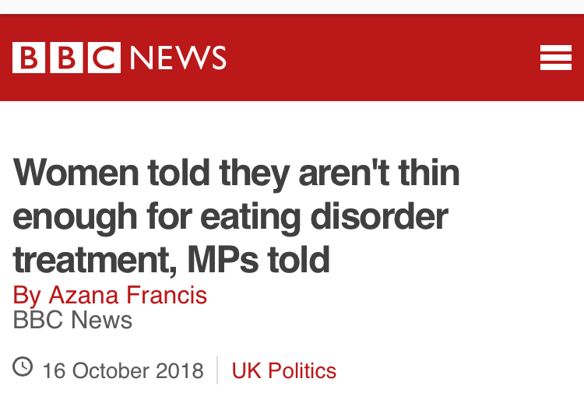
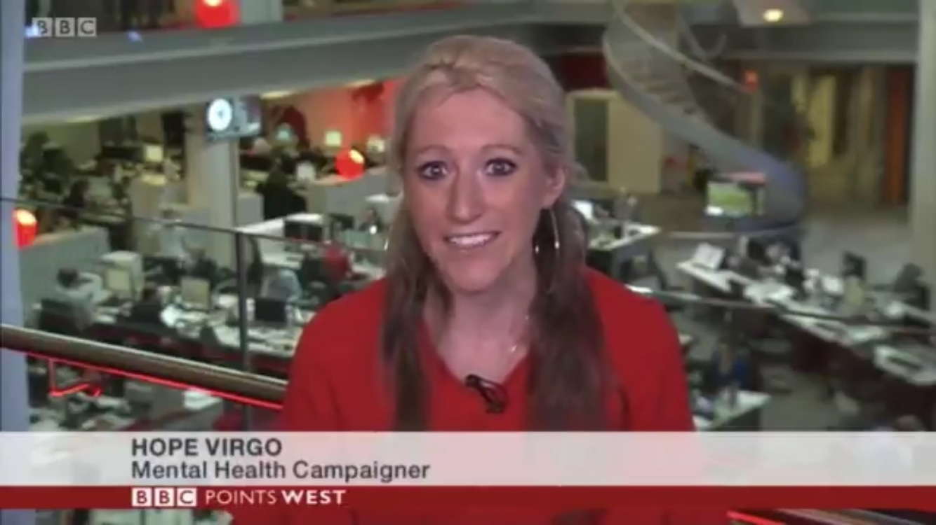
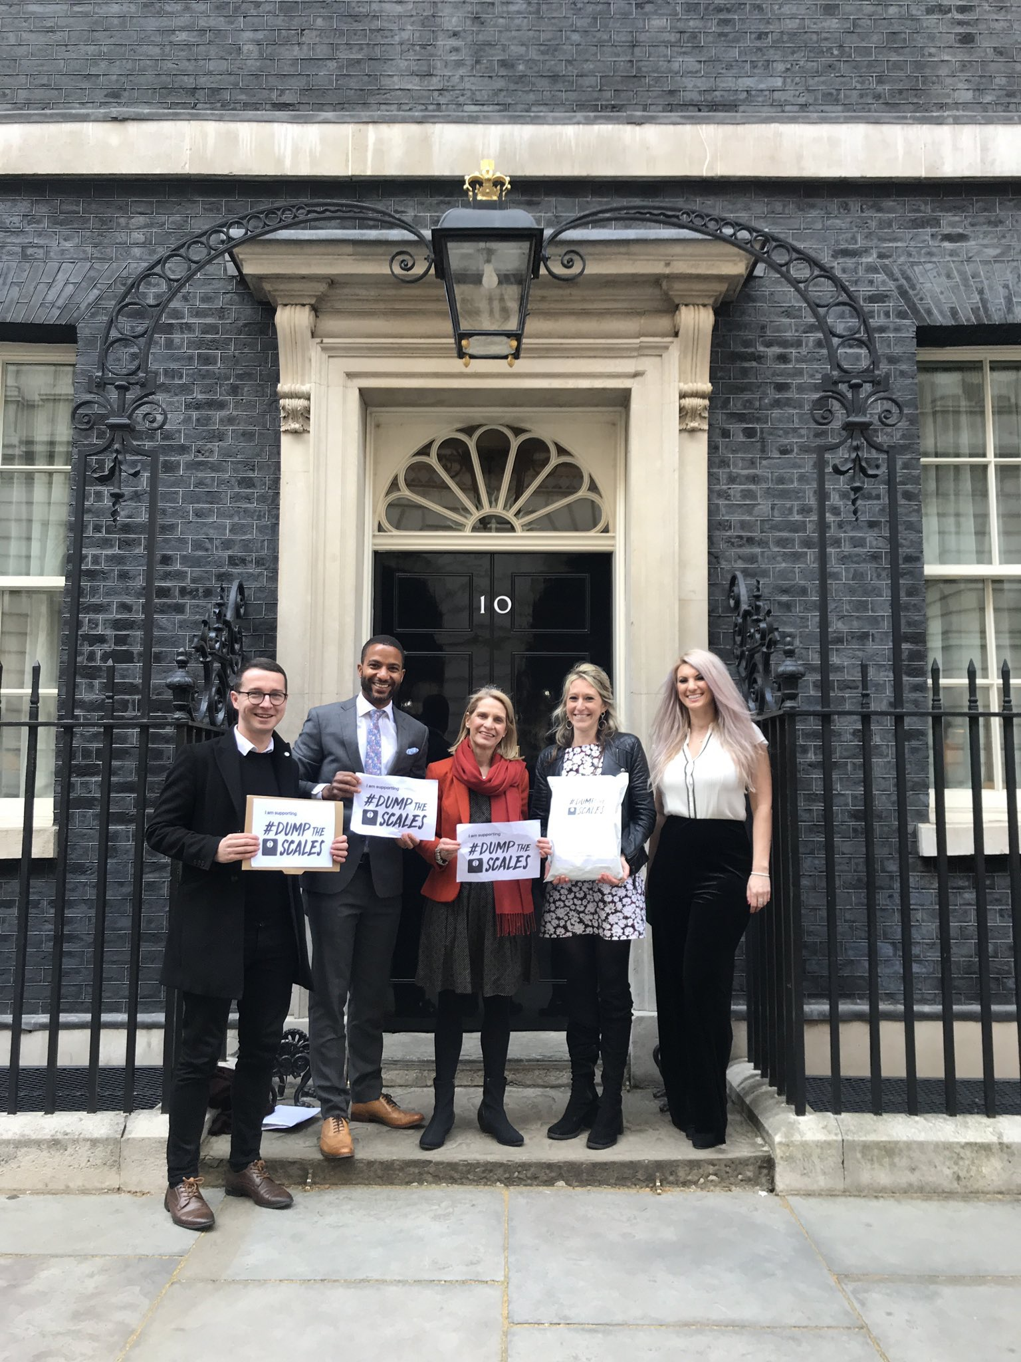
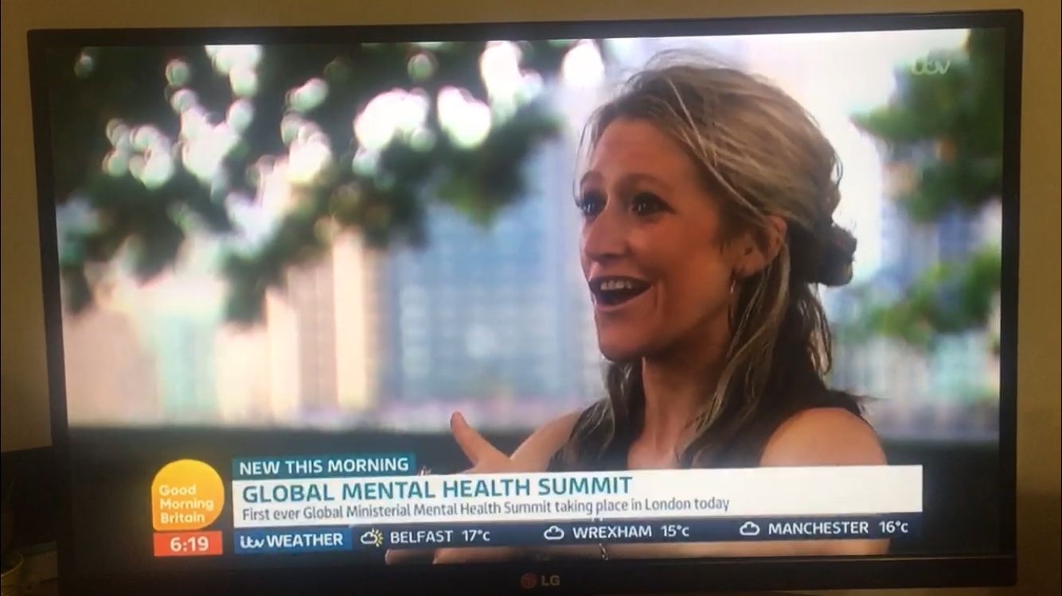
#Dumpthescales
Notes:
One final thing
Join me to make a change
My story isn’t unique but a daily occurrence for people with all eating disorders who are seeking treatment.
When asked to imagine someone suffering with an eating disorder, most will imagine a stick thin, gaunt looking girl. But this is not the reality of eating disorders.
People with eating disorders are currently not getting a fair deal in society.
Despite the guidance too often individuals are turned away from receiving essential support because they aren’t skinny enough to be considered at risk. This leaves the individual feeling like they aren’t worth getting that support, feeling like a “fake”, potentially losing more weight to hit that target and in some cases feeling suicidal. This is why I’m calling on the government to review the eating disorder guidance delivered by clinicians. .
We know that early diagnosis is a critical element in the success of treatment for eating disorders and by the time 'obvious' signs of eating disorders have manifested, it is likely that the illness will have become ingrained in the individual, and therefore much more difficult to treat. If we want to prevent people getting more unwell, save the NHS money, prevent hospital admission and save lives we need to have this review and ensure that we get full implementation of the clinical guidance around diagnosis.
The guidelines are right but these are not being uniformly implemented across the nation to the detriment of thousands of people daily. It is time we stopped waiting for people to hit crisis point before offering them support.
We need to be able to make sure that people with eating disorders are getting the right support in a timely manner.
With 1.25 million people in the UK living with an eating disorder we can’t afford to wait any longer the time to act is now.

Slide 10
hopevirgo@hotmail.com
@HopeVirgo_
Notes:
Thank you so much for listening to me today.
I know it is scary talking, and you might be worried about what people think of the impact on your career but I guarantee it 100% helps!
Has anyone got any questions?

