Slide 1
Eating Disorders & Disordered Eating in the Perinatal Period - Bridging the gap through the involvement of partners, carers, family and friends
Harriet Parsons, MSc., Reg. Prac. APPI., MICP
harriet@bodywhys.ie

Slide 2
Bodywhys
Support people affected by Eating Disorders in Ireland
People with an ED
Families / Carers
Patient Perspective
Family Perspective

Slide 3
Typical Situations…
“Everything was fine at first until staff changed shift and new staff knew nothing, made inappropriate comments.”
“They won’t let me in the room, even though my daughter gives consent. My daughter isn’t listening to them, she’s thinking, ‘have I eaten too much today’ she’s not able to take in any information, if I was there I could listen.”
Notes:
People experiencing an eating disorder share many of the following features:
Likely to have dited
Self esteem is low
Marked over-concern with body shape, weight and size
Thinness is seen as a magical solution, weight gain feared
Likely to have difficulty expressing real needs
Distorted body image
Problems around control
Hard to talk about feelings and or deal with conflict
May be depressed and isolated
Mood swings

Slide 4
Typical Situations…
“I couldn’t understand what happened, I’d sit with my daughter for the morning and she’d be fine, in good spirits sometimes, then I’d have to leave so the nurse could sit with her for her meal. I’d come back an hour later and my daughter was shouting and screaming, throwing her plate against the wall. After a week I realised it was because the nurse was praising her while she ate.”

Slide 5
Typical Situations…
“They won’t engage with me at all. I mean fine, my daughter is an adult and won’t give permission, but surely there are some things I need to know to be able to care for her when she comes out of hospital. How can I help if I don’t know what her meal plan is, what is being expected of her and what to look out for. It makes no sense to me. I don’t want to know any private details, but if she had cancer, I think I’d be told what meds she should take, and if she became unwell what to do.”

Slide 6
Common Issues (family perspective)?
Staff don’t understand EDs – We know more than them
To be able to care for our loved one we need to be included
Even though they’re an adult, I still need information
Family not being considered part of the team.

Slide 7
Pregnancy and Eating Disorders

Slide 8
Natural physical changes of pregnancy can be a source of body image concerns.
Cultural pressure / social media can set unrealistic expectations and increase body concerns or dissatisfaction in women during this time.
Pressure to look slim during and after pregnancy can contribute to weight monitoring or dieting behaviours which could potentially be damaging for the baby during the pregnancy or breastfeeding stage.

Slide 9
This pressure can also have a negative impact on the mental health of the mother.
Some research studies indicate that body image concerns are greater in women in the postpartum period than in women who are pregnant.
Some studies found an increase in body satisfaction in pregnant women in comparison to women who are not pregnant.

Slide 10
There is often greater body dissatisfaction amongst women in the postpartum period.
Many women report feeling under pressure to regain their pre-pregnancy body

Slide 11
Identifying the GAPS?
Space and time to listen and hear
Consistency of care
Nutrition during pregnancy
Weighing
Nutrition / exercise after giving birth
SUPPORT? WHO IS GIVING SUPPORT?

Slide 12
How do we bridge the gap?
Provide information, knowledge, support and skills
Work with family carers taking the perspective that everyone needs to be on the same page – the team includes the family and partner
No matter what age the person is, family and partners can be seen as essential resources to support the person. They need to be included.

Slide 13
We know from the MEED guidelines that family should be included and used as a support for the person’s care.

Slide 14
Knowledge and Learning
‘Parents and carers of people with eating disorders are often very knowledgeable about the condition’
‘Medical and nursing staff need to listen to the family and carers, and accept that they may have greater knowledge than themselves’

Slide 15
‘Staff should also recognise the important role that family and carers have in treatment and recovery, and convey this to the person receiving treatment.’
‘The overarching attitude to the family should be accepting and positive.’

Slide 16
As with all aspects of eating disorder treatment and recovery, partners, carers, family and friends, can provide ESSENTIAL SUPPORT when a gap is identified. They can BRIDGE THE GAP.

Slide 17
It is therefore crucial that a collaborative approach is taken between the person, the primary care team, the treatment team, and the family. The family should be empowered to best support both their loved one, and look after themselves.

Slide 18
Empowered? That is what we focus on. How? Family Support Package
Website
PiLaR Programme plus active waiting resources
PiLaR journal
Post-PilaR Support Group
New Maudsley Carer Skills Workshop Series
Regular monthly New Maudsley Carer Skills group
Support Services (helpline and email support)

Slide 19
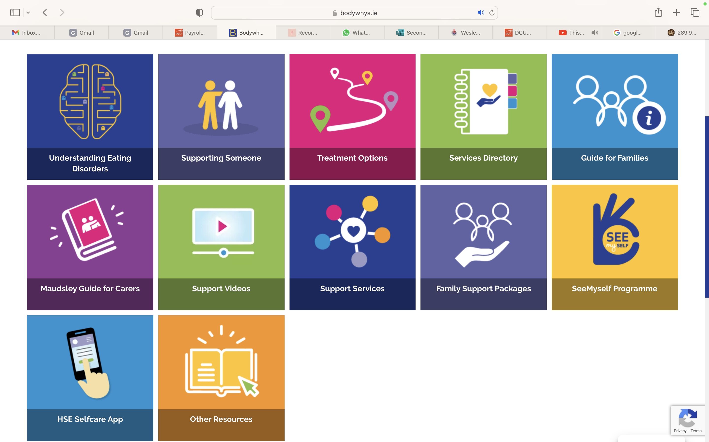
Website – Active Waiting Resources
Notes:
People experiencing an eating disorder share many of the following features:
Likely to have dited
Self esteem is low
Marked over-concern with body shape, weight and size
Thinness is seen as a magical solution, weight gain feared
Likely to have difficulty expressing real needs
Distorted body image
Problems around control
Hard to talk about feelings and or deal with conflict
May be depressed and isolated
Mood swings

Slide 20
PiLaR Programme
4 week family support programme providing knowledge and support skills
Free to attend
Online
One evening a week for 4 weeks

Slide 21
PiLaR Programme – Week 1
Understanding EDs
Coping mechanism
Functional illness
Disordered Eating – ED
Common factors – Distorted BI, Intrusive thoughts
Language
ED Cycles

Slide 22
PiLaR Programme – Week 2
Maintaining Factors – e.g. Black and White Thinking, Sensitivity,
Collaborative caring
Avoiding Power Struggles
Control - praise

Slide 23
PiLaR Programme – Week 3
Communication, having important conversations
Managing mealtimes
Eating Routine
Supporting siblings

Slide 24
PiLaR Programme – Week 4
Dealing with Triggers
Coping with an event e.g. Christmas, Easter
What does recovery feel like?
Treatment
Further supports

Slide 25
PiLaR Journal

Slide 28
Post-PiLaR Support Group
Limited places
Ethos
What comes up?

Slide 29
New Maudsley Carer Skills 8 Workshop Series
Limited places
Twice a month – 2 groups at one time Small group
Interactive – group work
Open discussion
Learn by doing
Supporting each other
Checking in
Confidentiality and honesty

Slide 30
What do we cover?
Empathising with the person
Externalising the ED
Red and blue balloon
Crap day Exercise
Remembering the person before they had an ED
Animal Metaphors
OARS

Slide 31
What do we cover?
Emotional coaching – ALVS
Advanced communication Skills – DEARS
LESS is more
Stages of Change model
Decisional balance
Reassurance trap
5 step approach to change – carer and person

Slide 32
Monthly Regular New Maudsley Carer Skills Group
Once a month
Limited numbers
Sometimes structured, sometimes not

Slide 33
Information and Clinician Training
Training Session: ‘Working therapeutically with people with eating disorders’
Psychiatrists
Psychologists
Nurses
SLTs
OTs
Dietitians
Allied health professionals
E.g. Maternity Hospitals and Law Society

Slide 34
Bridging the Gap
Early intervention with carers – Active Waiting and PiLaR Family Support Programme
Through listening and providing psychoeducation and skills we seek to both understand the challenges from a partner’s and family’s perspective and provide practical steps that can improve support.
Our focus is always on the importance of collaborative care

Slide 35
Thank you!

